Slide 1

Yealink, Your Best Choice
Presentation by Yealink

Slide 2

Agenda
About Yealink
Why Yealink
Yealink Future
Yealink Gifts

Slide 3
About Yealink

Slide 4

One of World’s Leading SIP-Phone Providers
TOP 1
TOP 3
Globally
Source: Frost and Sullivan, April 2013
TOP 3 Globally, TOP 1 in EMEA
Over 60 distributors worldwide
Customers in more than 140 countries

Slide 5






The Source of Our Success
Focus on Design
Fully-owned IPR of all products, including Hardware and Software
200+ people in R&D, Core team members with over 20 years experience in telecom industry
Providing the best products for our customers
Focus on Brand
Tailored Regional Marketing Programs
Special ITSP Initiatives
Focus on Customers
Technical & Commercial Teams
Local support

Slide 6
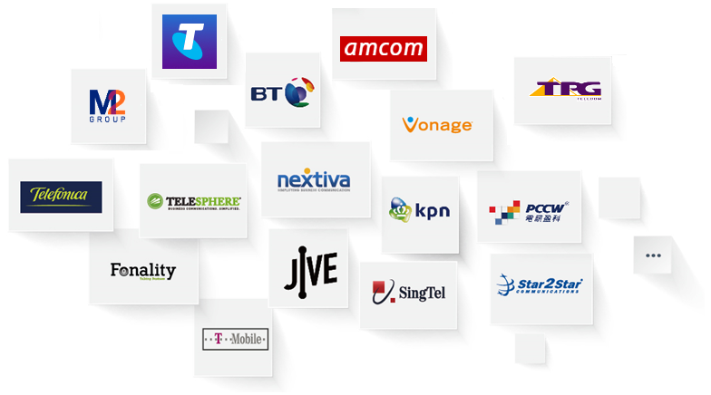





Worldwide Partners
United Nation
Qatar Airways
HSBC Bank
…
Audi HQ
T-Mobile

Slide 7
Why Yealink

Slide 8

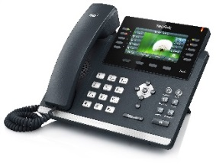
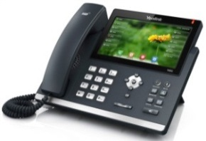
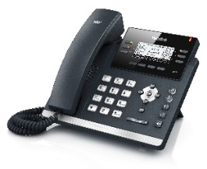

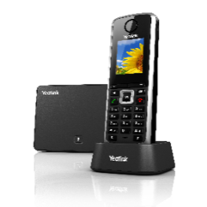
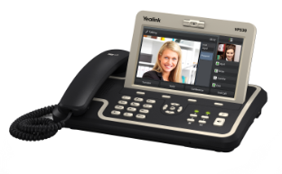
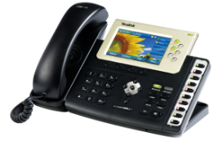
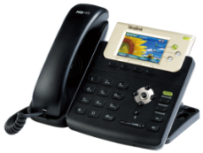
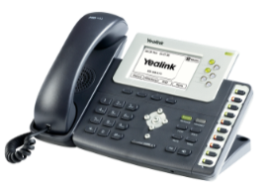
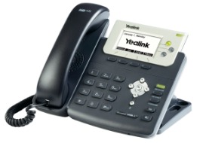
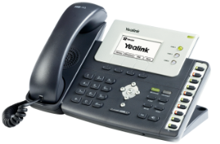
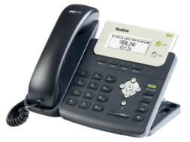
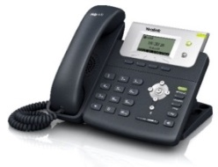
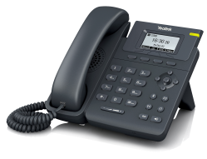
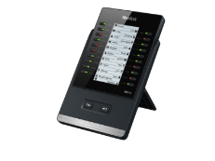

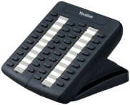
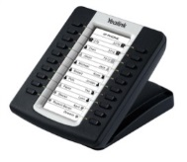
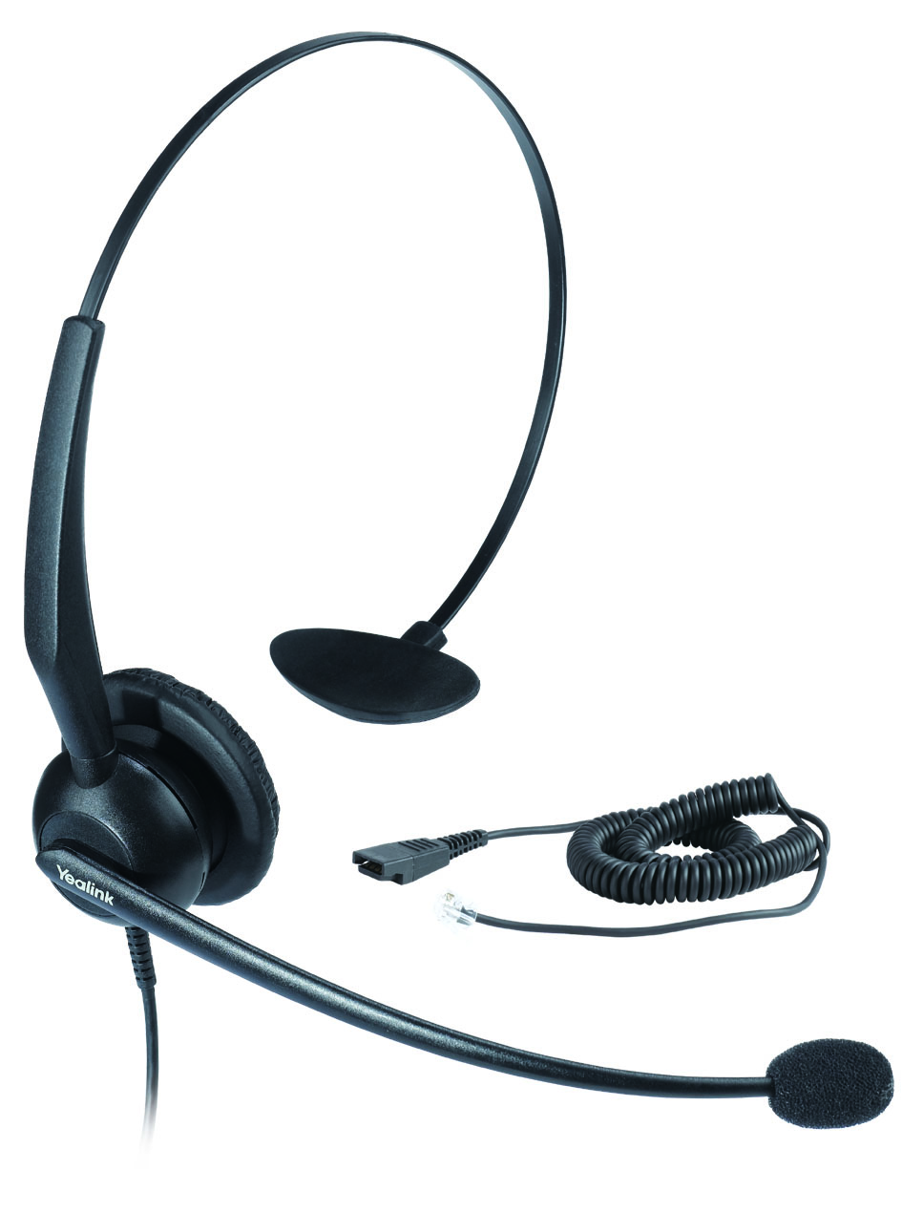
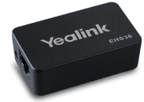
A Full-range of Products
Cloud-based Service
Redirection and Provisioning Service
Redirection Server
T4 series IP Phone
SIP-T48G
SIP-T46G
SIP-T42G
SIP-T41P
T3 series IP Phone & IP Video phone & DECT Phone
W52P
VP530
SIP-T38G
SIP-T32G
T2 series IP Phone
& T19 IP Phone
SIP-T26P
SIP-T28P
SIP-T22P
SIP-T21P
SIP-T20P
SIP-T19P
Accessories
BT40
EXP40
EXP38
EXP39
EHS36
YHS32
Notes:
From this page, you can browse full range products of yealink.
First, we have some accessories for phones, such as wireless headset adapter EHS36, call center headset YHS32, expansions EXP, Bluetooth dongle BT40.
And we have the T2 series IP phones, T2 series IP phone is with the classic business design, graphic LCD, two Ethernet ports with POE, HD voice, very rich business features, it is a perfect choice for most of the SMBs and enterprises.
Then the T3 series IP phone, its design is based on the T2 series, it has all the features in T2 series, and what’s more? It has integrated color LCD and Gigabit switch.
And The VP530 is a 4-line SIP video phone with 7-inch touch screen and 2MP camera, it is perfect choice for video calls and video conference.
The W52P is a HD DECT VoIP phone system. It covers a range of over 50m indoors and 300m outdoors and it can support up to 5 handsets, this makes it a very good choice for places where mobility is important.
Now we have the T4 series IP phones, it is with Brand-new elegant design, Gigabit switch, Paperless Dss keys, Bluetooth support. This makes T4 series perfect choice for the high end market.
Last but not least, we have the redirection service available worldwide and it is available for Yealink Full range products, it makes the deployment much easier.

Slide 9

IP Phones that Are Easy to Install & Use
  For the End-User
  Plug-and-play
  Easy-to-use
  For the Partner
  Easy to deploy-saves time
  Easy to operate-low training cost
  Fully-compatible with my system

Slide 10
High Standard
Yealink Standard
4Kv
12Kv
8Kv
1Kv
CE/FCC
Yealink
CE/FCC
Yealink
ESD, 1.5X
Surge, 4X
Higher Standard, Better Quality
Notes:
Because the spirit of yealink is Higher standard, Better Quality. The ESD(Electronic Static Discharge) protection is 12 kilovolt ['kɪləvɒlt], and the surge voltage can up to 4 kilovolt. All is higher than CE/FCC standard. Our phones have more environments friendly. The T22P’s Power Consumption is 60% of Polycom335.

Slide 11
High Quality
Defect rate
Industry Average Level
1%
Standard
Yealink
0.5%
Over millions of units shipment worldwide
Much lower than industry standard
Notes:
And Defect rate of yealink phone is the same as Polycom, 0.5%,much lower than industry standard.

Slide 12
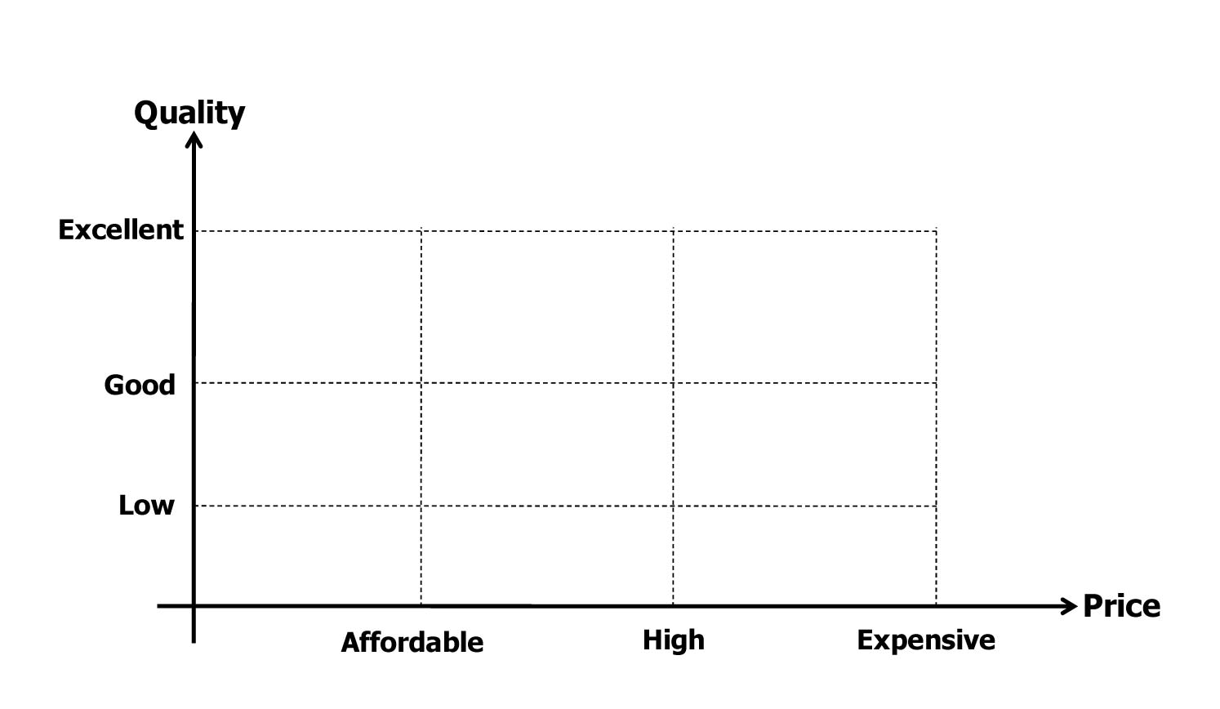




Competitive prices

Slide 13

Excellent Technical Support
200+ R&D Engineers
Core team has 20+ years of communication experience
Efficient and effective technical support
Proven strong technical ability (eg. Telstra, M2, Fonality…)

Slide 14

Yealink Solutions

Slide 15













Worldwide Partners (Partial List)
SMB
…
Enterprise
…
Carrier
…
IP Contact Center
…
Notes:
Leader in the market

Slide 16






One-Stop Service
US Office
European Office
Australia
Local Office
To provide direct Commercial and Technical service to Partners
Regional product requirement and marketing support
Talk Directly to the Yealink Technical Support Team
Trouble-shooting system
Onsite technical support
Share partner workloads

Slide 17
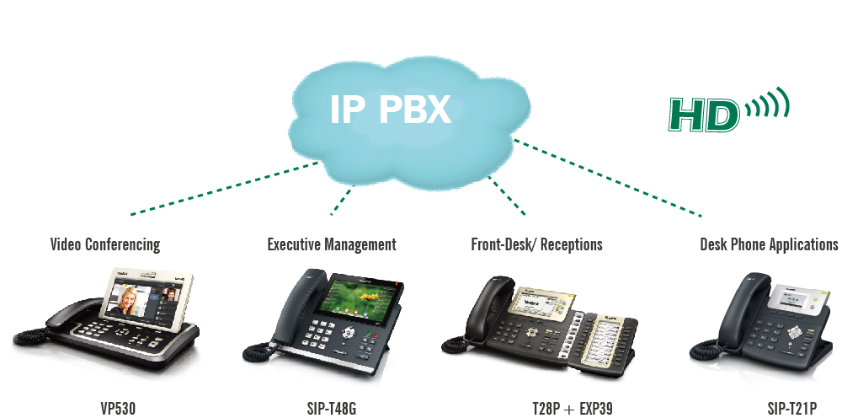





SMB Solution
Features for SMB
BLF/BLA
Voice mail
Intercom/Paging
Call pickup/park
Dial plan
Call recording
Auto provision
……
Certified by the leading IP-PBX
…

Slide 18



Enterprise Solution
Features for Enterprise
LDAP phonebook
XML browser/screen
Open VPN
Push XML
LLDP
TLS/SRTP/HTTPS
……
Certified by the leading system
…
Notes:
Yealink IP Phones are certified by Avaya, support the enterprise features like LDAP, XML and VPN ,.secure features like TLS/srtp/https

Slide 19


Carrier/ITSP Solution
Yealink is BroadSoft Premier Partner
Fully Compatible with BroadWorks R20
Notes:
In Carrier Market, Yealink IP Phone perfectly complies with Broadsoft, be Broadsoft certified, and Yealink is the premier partner of Broadsoft now, the other one is Polycom

Slide 20





Carrier/ITSP Solution
Features for BroadSoft
BW Device Management support
TR069, SNMP
BW Features Synchronization (DND, FWD, ACD)
Busy Lamp Field(BLF)
Shared Call Appearance(SCA)
DNS SRV Lookup
Network conference
Network call logs
Network phonebook ……
Customers
…

Slide 21



IP Contact Center Solution
Features for IPCC
Auto Call Distribution (Login/Logout)
Status control (Available/Unavailable)
Status synchronization
Hot-desking
Action URL
Action URI
Call pickup
Intercom
……
Compatible with the Leading System
…
Notes:
In Call center market, Yealink is also successful, and the products comply with the systems of Cosmocom, Genesys and ININ etc.

Slide 22
Yealink Future

Slide 23
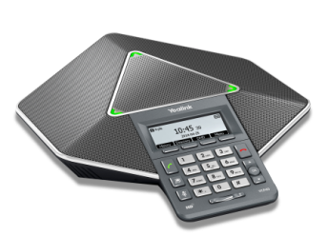
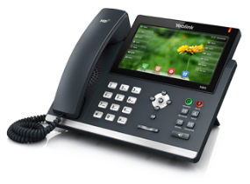
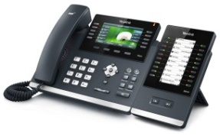
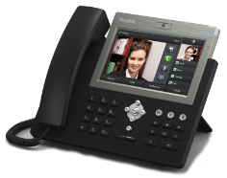
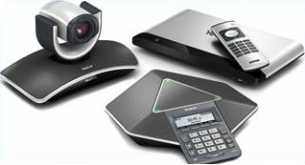
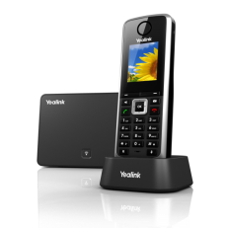
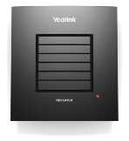
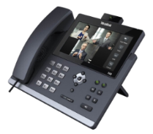
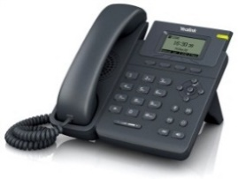
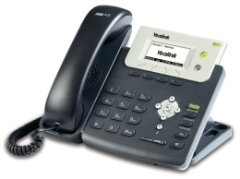
New Product Roadmap
2013
2014
2015
Audio Conference Phone
T4 Series
W52P
Video Conferencing system
Android Phone
T19/T21
New Video Phone

Slide 24

Yealink Gifts

Slide 25
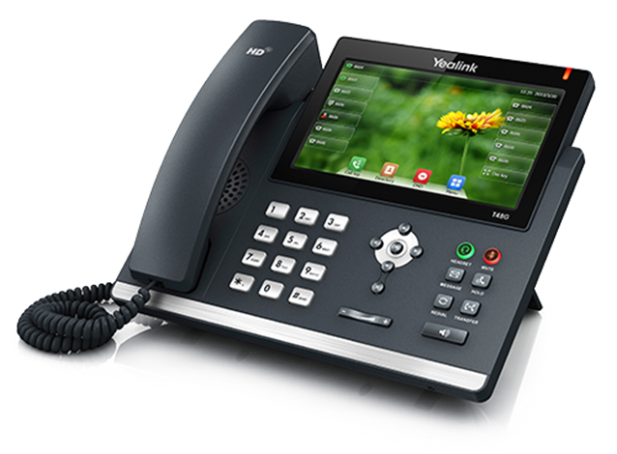

Lucky Draw—Yealink T48G
Ultimate Performance,
Future Innovation
Modern Design;
Excellent UE;
Paperless DSS Keys;
Eco-friendly.
Attendees will have the opportunity to get a FREE Yealink IP “Smart” Phone—T48G

Slide 26
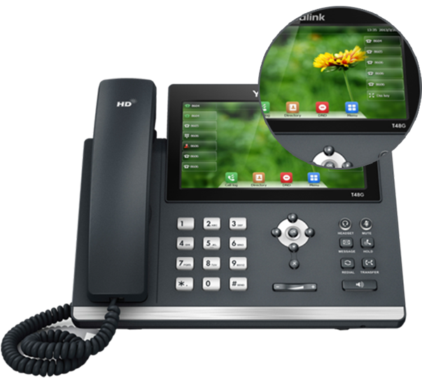
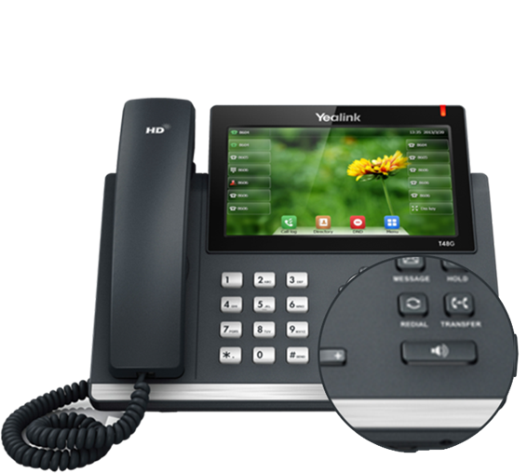
Lucky Draw—Yealink T48G
Modern Design
Mirror-style Screen
Metallic Texture
Attendees will have the opportunity to get a FREE Yealink IP “Smart” Phone—T48G

Slide 27
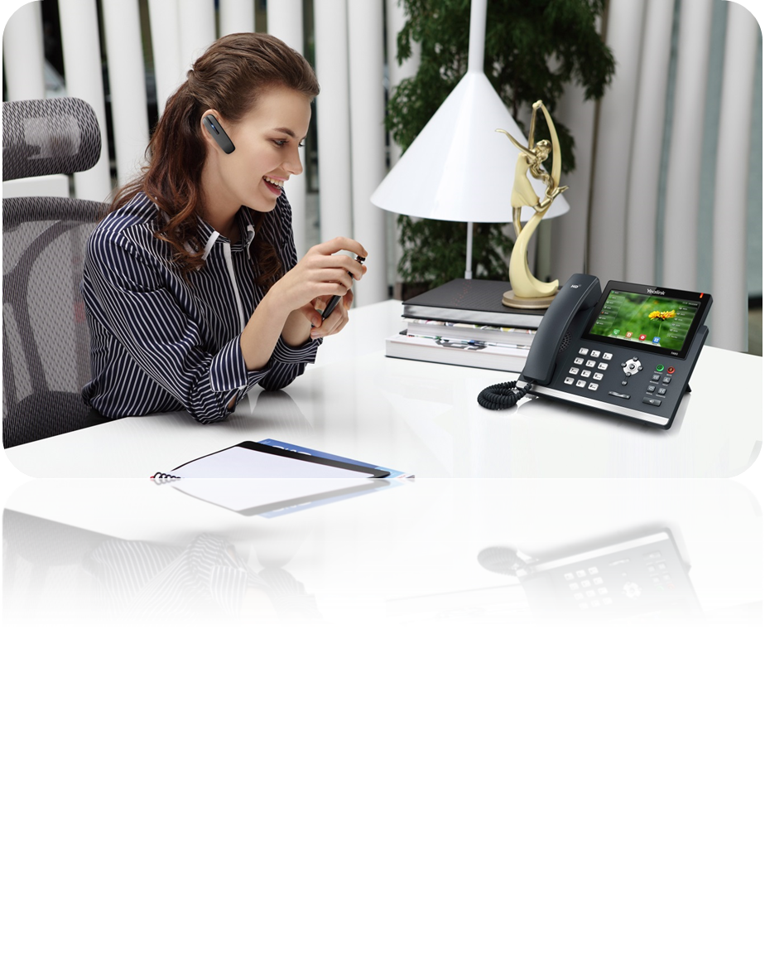
Lucky Draw—Yealink T48G
Excellent UE
High-end Office, Executive Business
No Manual Label-print Operation
More Paperless DSS Keys, Professional Services
Attendees will have the opportunity to get a FREE Yealink IP “Smart” Phone—T48G

Slide 28
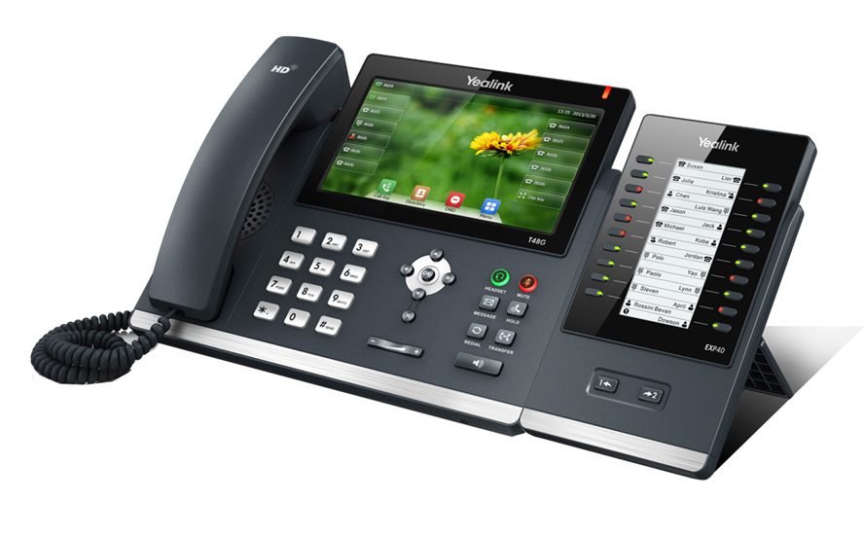
Lucky Draw—Yealink T48G
Paperless DSS Keys
Features | T48G | T46G | T42G | T41P | EXP40
Physical Keys | 0 | 10 | 6 | 6 | 20
Paperless DSS Keys | 29 Max. | 27 Max. | 15 Max. | 15 Max. | 40 Max.
Pages View | 1 | 3 | 3 | 3 | 2
Attendees will have the opportunity to get a FREE Yealink IP “Smart” Phone—T48G

Slide 29

Thank You
Q&A
Jessica: jessica@yealink.com
www.yealink.com

