Slide 1

T3X Gigabit Color Phone
——V70 Beta is Ready

Slide 2
What actually are on V70?
Yealink deployment solution
Newly added features
Works with BroadSoft R18

Slide 3
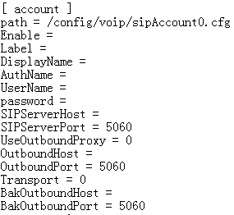
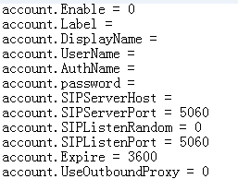
Previous Deployment
Difficulty in learning different cfg files of T2X,T3X
T2X
T3X
Taking too much time to learn different templates
2. Troublesome in manually generating mac.cfg files
one by one
……

Slide 4

Yealink Deployment Solution of V70
Unified Auto provisioning template
——“M7”
Yealink Configuration Conversion Tool
——“CCT”

Slide 5

“M7” template
What is M7?
M7 is short for unified auto-provision template format of T2x V70, T3x V70 and VP530.
Old templates of T2x and T3x can be directly converted to M7 by “CCT”.
What does it do?
Lower the learning curve for Administrator.
Improve deployment efficiency.

Slide 6
Upgrade Process
1.Upgrade to V70 firmware using old template
2.Common.cfg
Convert old template to new template-M7
via CCT tool
3.Mac.cfg
Import account information(xls or csv) and
convert to mac.cfg automatically via CCT tool

Slide 7
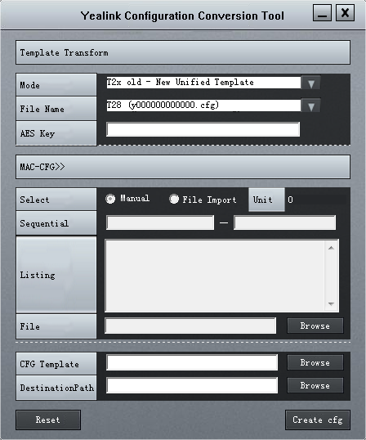
Yealink Configuration Conversion Tool
CCT

Slide 8
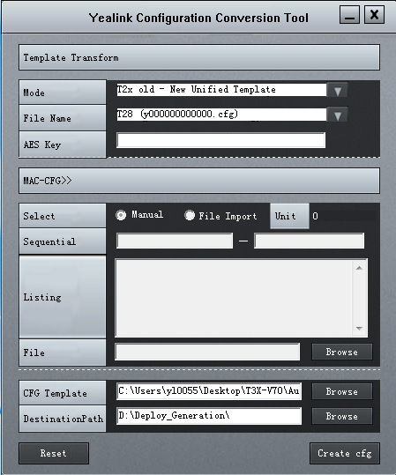
How to Convert Old Template to New M7 Template

Slide 9
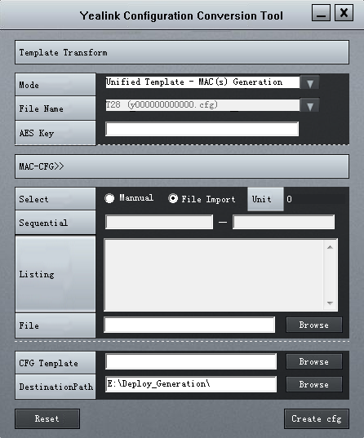
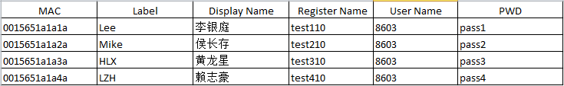
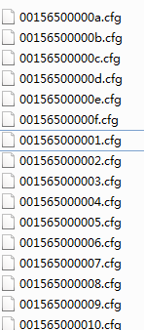
How to generate mac.cfg files automatically
Generating mac.cfg files in batch.
Output
Input

Slide 10

New Business Features
  XML Browser-Open API
  Works with IP PBX, such as getting the contact lists, menu, background, contact pictures from Starface by XML Browser;
  Specialized features, like weather info, stock info, customized call features, etc.
For more details, please refer to
<Yealink T3xG XML Browser Configuration Guide>.

Slide 11

Works with BroadSoft
BroadSoft Features
Auto-P synchronization
Busy Lamp Field (BLF) List
Shared Call Appearance(SCA)
Do Not Disturb
Call Forwarding Always (CFA)
Call Forwarding Busy (CFB)
Call Forwarding No Answer (CFNA)
ACD state
Automatic Call Distribution (ACD)
Network Conference
BroadSoft Phonebook
BroadSoft Call Log
Manuals for BroadSoft are ready!
<User Guide for Phone Features Integrated with Broadworks>
<Yealink IP Phones Deployment Guide for BroadSoft BroadWorks Environments>
<Using Integrated ACD, Call Log and Phonebook Features on BroadWorks>

Slide 12






Roadmap- Deep Compatibility
It will be ready on 2012 Q3.
IP-PBX
…
Carrier
…
Deeply Compatible with leading IP-PBX and leading VoIP carrier-BroadSoft R18.
  Not only on phone features, call park, intercom, account registration, etc.
  But also on auto provisioning compatibility.

Slide 13
Thank you !
Q&A

