Slide 1

Dial Plan
5th September, 2012

Slide 2

Agenda
What is Dial Plan
Why do we use Dial Plan
How to set Dial Plan via web page
How to set Dial Plan via AutoP
Notes:
Here is the Agenda for today’s training. First of all I will make a brief introduction about what is Dial plan. Then I will tell you the reason why we use Dial Plan via some scenarios. The last but not least, I will teach you how to set Dial Plan via web page and AutoP.

Slide 3
What is Dial Plan
Intelligent , Convenient and Fast plan to dial numbers
Dial Plan (in V60 or higher FW) includes four parts:
1. Replace Rule
2. Dial-now
3. Area Code
4. Block Out
Notes:
So what is Dial plan? Dial plan is a plan for dialing numbers aimed at making dialing intelligent, convenient and fast. Yealink provide four solution to make dial plan useful: Replace rule, dial-now, area code and block out.

Slide 4
???
Why do we use Dial Plan?
Notes:
New customers will ask this question before they decide to use Yealink Phone : why do we use Dial Plan?

Slide 5

Some scenarios of Dial Plan
Issue:
It is very difficult for old people to remember some complex numbers.
Solution:
Replace Rule can solve this issue for old people, it can help them dial complex numbers easily.
Notes:
These are the reasons, for old people, it is very difficult for them to remember some complex numbers. Replace Rule is a plan that allows you to replace complex number with simple number. so Replace Rule can solve this issue.

Slide 6

Some scenarios of Dial Plan
Issue:
Some people want to make a call without pressing “Send” button.
Solution:
Dial-now can make it possible to dial a number without pressing “Send” , if the number conforms certain rules.
Notes:
If some people want to make a call without pressing “send”, we can use Dial-now to solve it. Dial-now can help you dial number without pressing ‘send’.

Slide 7

Some scenarios of Dial Plan
Issue:
It is inconvenient for business men to add correct area code before making a call to different areas.
Solution:
Area Code can help them dial numbers adding correct area code automatically.
.
Notes:
Many people like businessman feel that it is inconvenient to add correct area code before making a call to different areas.
Area Code can help them dial numbers adding correct area code automatically.

Slide 8

Some scenarios of Dial Plan
Issue:
Some bosses don’t want their staffs to dial some forbidden numbers.
Solution:
Block Out can forbid others to dial some numbers in the Block Out list.
Notes:
This is a boss, he don’t want his staffs to dial forbidden numbers.
We can tell him to use Block Out, it can help him forbid to dial some numbers.
So this is all reasons why we use Dial Plan.

Slide 9
How to set Dial Plan via web page
Notes:
Next I will use the following page to tell you what is Replace rule, dial-now, area code and block out. And also how to set these via web page and AutoP. Let us begin first topic how to set Dial Plan via web page.

Slide 10
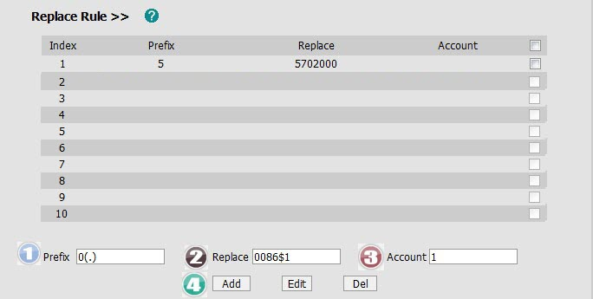
Setting via web page —— Replace Rule
There are two kinds of Replace Rule:
Exact match: If you set the Prefix as 5 and Replace as 5702000, when you dial 5 out, the phone will dial out 5702000 automatically.
Partial match: If you need to replace the unknown contents, you can use (.) or (x),
Prefix 0(.) and Replace as 0086(.), when you dial 05702000 out, the phone will dial out 00865702000 automatically.
Notes:
Replace rule is a solution to allow you to use a simple number to replace a complex number. This is setting page of replace rule in web page. The picture has shown the step to set DialPlan. There are two kinds of Replace Rule (Exact match and partial match). In order to make you clear about Replace Rule, I will use these two examples to introduce. First example is Exact match....second example is Partial match....(left bracket point right bracket).

Slide 11
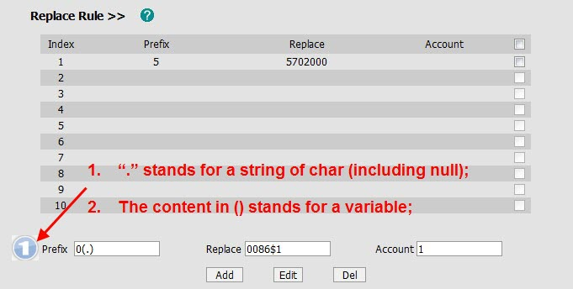
Setting via web page —— Replace Rule
If you set Prefix as 0(.) and Replace as 0086(.), when you dial 05702000 out, the phone will dial out 00865702000 automatically.
First step --- Prefix
Notes:
Now I will use the partial match as an example to explain. First step, you should fill in the prefix with 0(.), There are also some rule in the picture you can refer. “.” stands for ....

Slide 12
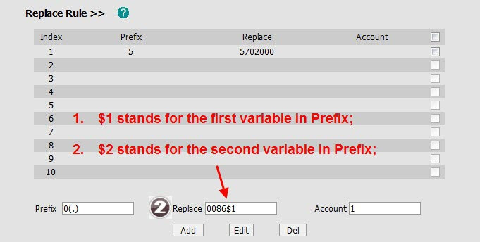
Setting via web page —— Replace Rule
If you set Prefix as 0(.) and Replace as 0086(.), when you dial 05702000 out, the phone will dial out 00865702000 automatically.
Second step --- Replace
Notes:
Secondly fill in the replace with 0086$1.$1 stands .....

Slide 13
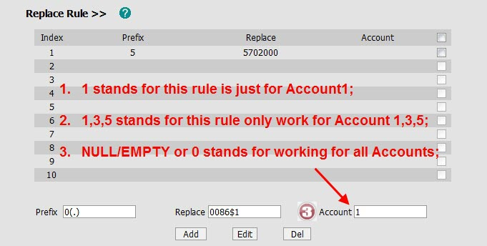
Setting via web page —— Replace Rule
If you set Prefix as 0(.) and Replace as 0086(.), when you dial 05702000 out, the phone will dial out 00865702000 automatically.
Third step --- Account
Notes:
thirdly you can fill in the account with account number as you like. 1 stands for this .....

Slide 14
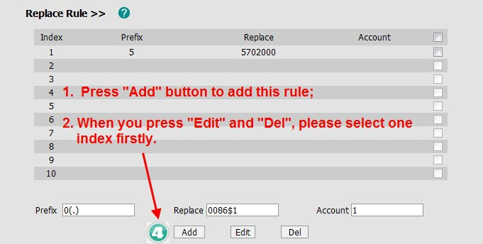
Setting via web page —— Replace Rule
If you set Prefix as 0(.) and Replace as 0086(.), when you dial 05702000 out, the phone will dial out 00865702000 automatically.
Fourth step --- Add
Notes:
After that you can press the Add button to add this rule. If you want to Edit or Delete, you should select the corresponding item firstly.

Slide 15
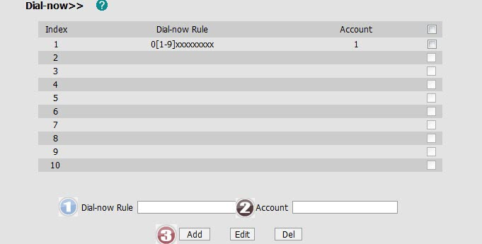
Setting via web page —— Dial-now
In the UK all number start 01 - 09 and are 11 digits long. If we set it like below, when you dial a UK number, the phone will dial out the number after 4s.
Phone->Features
Notes:
Dial-now is a solution to make you send a call conveniently. Here we would like to use a example from YUK to explain. In the UK ...

Slide 16
Setting via web page —— Dial-now
Phone->Features
NOTE:
1. By default, the delay time for Dial-now would be 1 second;
2. Valid time value would be 0~14 seconds.
Notes:
Before setting in Dial-now page, you should know this point. You can access to Phone->Feature to set the time out for Dial-now Rule. You can fill a number to decide when to dial out. There are some notes:....

Slide 17
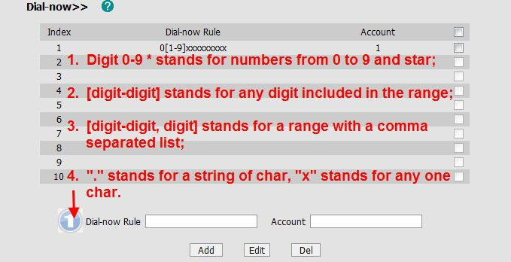
Setting via web page —— Dial-now
Some rules:
Notes:
This is the dial-now setting page, the setting steps is the same. Here is some rules you can refer.....

Slide 18
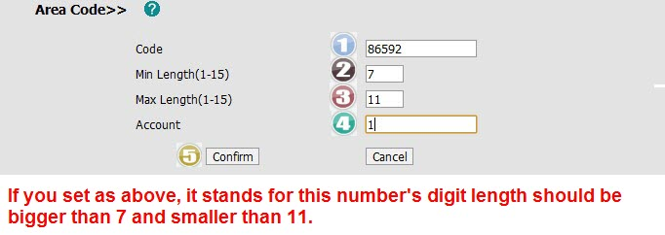
Setting via web page —— Area Code
If you set the Code as 86592, then dial the 5702000 out, the phone will dial out the 865925702000 automatically.
Notes:
Area code is a solution to automatically add area code. This is setting page of area code in web page. For example ......

Slide 19
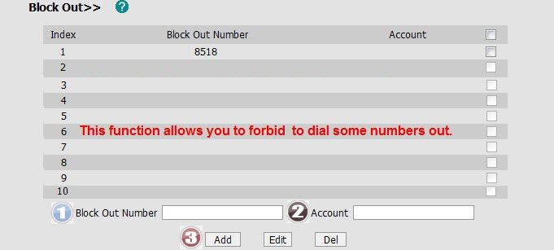
Setting via web page —— Block Out
If you set the number 8518 to the Block Out, when you dial out the 8518, the phone will indicate “Forbidden number” and forbid the outgoing call.
Notes:
Block out is a solution to allow you to forbid to dial out some numbers. For example ...... You can set this as the picture shows.

Slide 20
How to set Dial Plan via AutoP
Notes:
In the following page of how to set dial plan via AutoP, I will show you different some template files for different models.
You can refer to it if you will use autop later.

Slide 21
Setting via AutoP —— Replace Rule
CFG used for T2x
CFG used for T3x
[ ReplaceRule ]
path = /tmp/dialplan.xml
1 = 0,Prefix,Replace
2 = 0,Prefix,Replace
3 = 0,Prefix,Replace
4 = 0,Prefix,Replace
5 = 0,Prefix,Replace
6 = 0,Prefix,Replace
7 = 0,Prefix,Replace
8 = 0,Prefix,Replace
9 = 0,Prefix,Replace
10 = 0,Prefix,Replace
[ bin:/phone/config/DialPlan.xml ]
url =
XML used for T3x
<?xml version="1.0" encoding="UTF-8"?>
<DialRule>
<Data Prefix="" Replace="" LineID=""/>
<Data Prefix="" Replace="" LineID=""/>
</DialRule>
CFG used for VP530
#!version:1.0.0.1
dialplan.replace.prefix.X =
dialplan.replace.replace.X =
dialplan.replace.line_id.X =
Notes:
There are three parts in Replace Rule: CFG for T2x ,CFG for T3x, CFG for VP530.there is two points you should note, CFG used for T3x is different, we use XML file to set it. The first line of CFG for VP530 should not be deleted or modified.

Slide 22
Setting via AutoP —— Dial-now
CFG used for T3x
CFG used for T2x
[ bin:/phone/config/DialNow.xml ]
url =
XML used for T3x
[ DialNow ]
path = /tmp/dialnow.xml
1 =
<?xml version="1.0" encoding="UTF-8"?>
<DialNow>
<Data DialNowRule="" LineID=""/>
<Data DialNowRule="" LineID=""/>
</DialNow>
CFG used for VP530
#!version:1.0.0.1
dialplan.dialnow.rule.X =
dialplan.dialnow.line_id.X =
Notes:
This is the CFG used for T2x/T3x/VP530 to set Dial-now, you should also note cfg for T3x and VP530

Slide 23
Setting via web page —— Area Code
CFG used for T2x
CFG used for T3x
[ AreaCode ]
path =
/config/DialRule/areacode.cfg
code =
minlen =
maxlen =
LineID =
[ cfg:/phone/config/user.ini,reboot=0 ]
AreaCode.code =
AreaCode.minlen =
AreaCode.maxlen =
AreaCode.LineID =
CFG used for VP530
#!version:1.0.0.1
dialplan.area_code.code =
dialplan.area_code.min_len =
dialplan.area_code.max_len =
dialplan.area_code.line_id =
Notes:
This is CFG for three models to set Area code, CFG used for T3x doesn’t need XML file.

Slide 24
Setting via AutoP —— Block Out
CFG used for T2x
CFG used for T3x
[ BlockOut ]
path = /config/DialRule/BlockOut.cfg
#Set Block Out number.
1 =
2 =
3 =
4 =
5 =
6 =
7 =
8 =
9 =
10 =
[ cfg:/phone/config/user.ini,reboot=0 ]
BlockOut.1 =
BlockOut.2 =
BlockOut.3 =
BlockOut.4 =
BlockOut.5 =
BlockOut.6 =
BlockOut.7 =
BlockOut.8 =
BlockOut.9 =
BlockOut.10 =
CFG used for VP530
#!version:1.0.0.1
dialplan.block_out.line_id.X =
dialplan.block_out.number.X =
Notes:
This is for Blout Out.you can refer to it.

Slide 25
Q&A
Notes:
Do you have any question ,you can type on the screen or speak by mic directly .

