Slide 1

Yealink XML feature

Slide 2

Agenda
What is Yealink XML feature
XML Browser
What is XML Browser
Application Scenario
Instruction
Push XML
What is Push XML
Application Scenario
Instruction
Notes:
This is the agenda ,first one part I will have a simple introduction for XML feature ,what kind of feature it is for yealink phone .
In second and third part ,I will have a detailed introduction to two main XML features :XML Browser and Push XML .

Slide 3
What is Yealink XML Feature
Notes:
What is Yealink XML feature ?

Slide 4
What is Yealink XML Feature
XML stands for eXtensible Markup Language.
Yealink XML feature is one kind of XML-based API ,it can used for defining different custom applications.
Yealink XML feature :
XML Browser
Push XML
Notes:
XML is stands for eXtensible Markup Language , It is a markup language much like HTML. HTML was designed to display data and to focus on how data looks. XML was designed to describe data and to focus on what data is.
Yealink XML feature is one kind of XML-based API ,API means application programming interfaces. it can used for defining different custom applications. There are two Yealink XML feature :XML browser ,push XML ,this two feature are similar ,I will have a detailed description for them in following contend .

Slide 5
XML Browser
Notes:
First will introduce XML Browser feature .

Slide 6
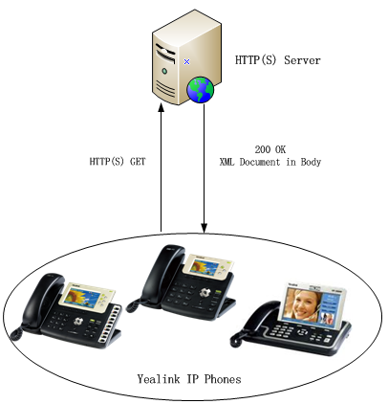
What is XML Browser
XML browser on the phone use the HTTP(s) transport protocol .It is the Phone-initiated application.
Yealink IP phone acting as a client
Notes:
This attached picture shows that the work flow for XML browser .it is the phone-initiated application ,and use the HTTP or HTTPS transport protocol .Phone can request the data from server on it own .
You can press the predefined key on phone to trigger the phone initiated application of XML browser. After pressing the key, the IP phone issues an HTTP or HTTPs GET command to the server,and waits for the 200 OK answer with XML document in message body ,phone can decodes and displays the xml document on the LCD screen such as Microsoft Internet Explorer or Firefox would do as a web client.

Slide 7
Application Scenario
The XML Browser in the Yealink IP phones allows users to create custom services which meet user functional requirements on the server.
Users can customize practical applications, such as weather report, stock information, Google search and news service ,etc..
Users can execute some actions ,such as ,rebooting the phone , resetting the phone ,changing the LED status ,etc..
User can configure the phone .
Notes:
And why we want to use XML Browser feature on phone ? What XML browser can bring to you ?
Use XML Browser ,you can be allowed to create custome services on the server according to your functional requirements .Like the practical applications ,such as weather report ,stock information ,google search . Also you can execute some actions ,such as reboot the phone rest the phone ,change the LED status and so on .Also it can be used for configuring the phone .

Slide 8
XML Browser Instruction
Supported 2 types of XML objects:
UI objects: XML objects used to control the display of the IP phone.
Non UI objects: XML objects use for doing some execute on phone and doing some configurations which have no direct impact on the display of the IP phone.
T3XG/VP530:
• TextMenu (UI)
• TextScreen (UI)
• InputScreen (UI)
• Directory (UI)
• PhoneExecute (non UI)
• PhoneConfiguration (non UI)
• PhoneStatus (non UI)
• FormattedTextScreen (UI)
• ImageScreen (UI)
T2X:
• TextMenu (UI)
• TextScreen (UI)
• InputScreen (UI)
• Directory (UI)
• PhoneExecute (non UI)
• PhoneConfiguration (non UI)
• PhoneStatus (non UI)
Notes:
As we just said ,we can create custom services ,configutation and execute on the server ,all of this application are create in XML format file ,and put on server side .
Yealink phone Supported 2 types of XML objects: first one is UI objects ,it is used to control the display of the IP phone.
Second one is non UI objects, objects use for doing some execute on phone and doing some configurations which have no direct impact on the display of the IP phone.
These are some difference between T3serises/VP530 and T2series .I list all of the supported XML objects on this page .T2 series only can support 7 kind of XML objects ,and T3 series VP530 can support 9 XML objects .This two additional FormattedTextScreen and ImageScreen objects request phone to support the color screen ,so T2 series don’t support .
I will have a separated instroduction for every XML object.

Slide 9
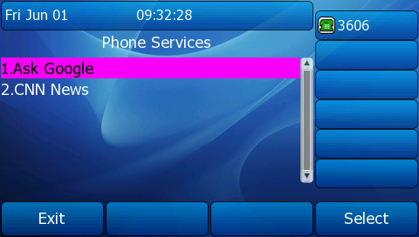
TextMenu
TextMenu object allows users to display a list of menu items on IP phones. You can browse the menu item by linking HTTP requests.
Scenario :
You can use the TextMenu object to customize some functions such as weather report, stock information, new services, etc.
T38G
Notes:
First one is TextMenu ,it allows users to display a list of menu items on IP phones. You can browse the menu item by linking HTTP requests.It can use for customize some functions such as weather report, stock information, new services, etc. This picture is an sample on T38G . I will introduce how this sample is defined in XML document in following content .

Slide 10
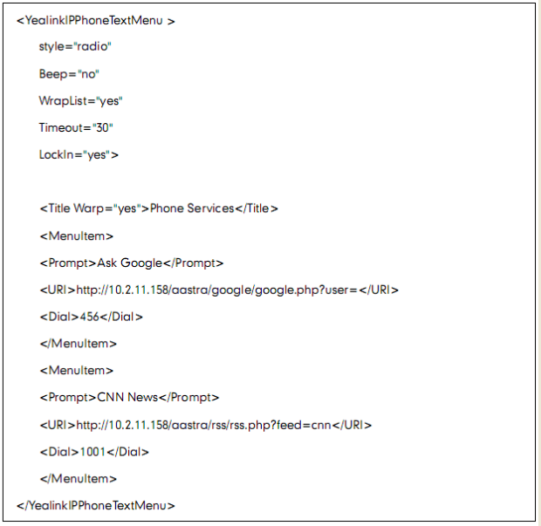

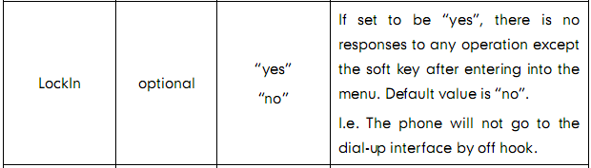
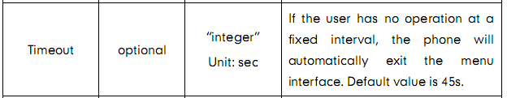
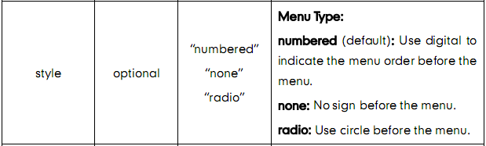
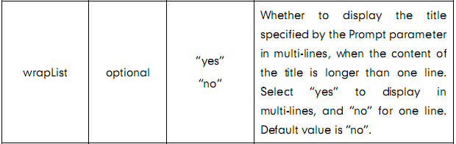
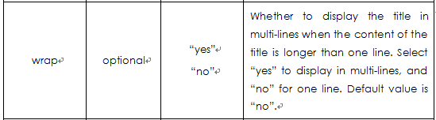






TextMenu XML document
Sample of Text Menu XML document:
Child elements of the root
Notes:
This is the XML document for Textmenu .For using textmenu ,we need to create one XML doucment like this picture shows in server side .One XML file consisted of Root element and child elements of the root ,we define the XML parameters on Child elements of the root .now I will introduce every parameter in order .The style parameter …the first table is the parameter name ,second table indicated this parameter is optional or mandatory .optional means that you can choose whether to configure this parameter according to your requirement . Mandatory means that you need to configure this parameter in textmenu document .For style parameter ……..
Also you can define the softkey .for more information ,youc an refer to he XML browser manual which I will send to you .
Other XML object’s XML document are similar with TextMenu ,they also have different parameters for defining every display details ,I will not have a detailed introduction for them ,but only introduce the application scenario and LCD display sample for your reference in following content .You can check the XML parameters for every XML object in XML browser manual.

Slide 11
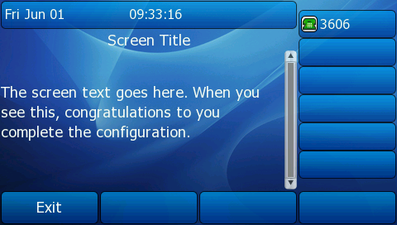
TextScreen
TextScreen allows users to display the text on IP phones.
Scenario:
You can use the TextScreen to display the news of TextMenu or send the notify.
T38G
Notes:
This is Text Screen ,it allows users to display the text on IP phones. You can use the TextScreen to display the news of TextMenu or send the notify from server .
In the picture you can see the test content and title .

Slide 12
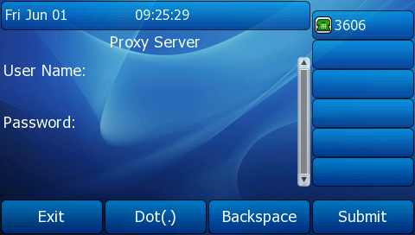
InputScreen
InputScreen allows users to create a screen capable of gathering user input. It prompts user to input content, and sends the input content to the server.
Scenario :
You can use InputSceen for user login or saving something on server. You can define the content and format of input.
T38G
Notes:
This is Inputscreen ,it allows users to create a screen capable of gathering user input. It prompts user to input content, and sends the input content to the server. It can be used for user login or saving something on server. You can define the content and format of input by yourselves .

Slide 13
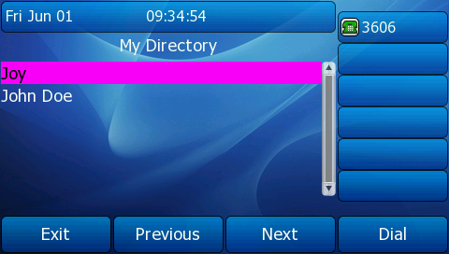
Directory Object
Directory allows user to browse an online directory in real time.
Scenario :
Directory can displays an automatically numbered list of contacts. By selecting a contact with the cursor, the contact can be dialed directly by pressing the “Dial” softkey, picking up the handset, or pressing line key.
T38G
Notes:
Directory likes the remote phonebook. It allows user to browse an online directory in real time. Phone can get automatically numbered list of contacts. You can see the picture .
By selecting a contact with the cursor, the contact can be dialed directly by pressing the “Dial” softkey, picking up the handset, or pressing line key.

Slide 14
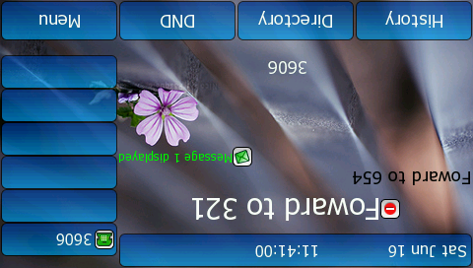
PhoneStatus Object
PhoneStatus allows users to display a status message on a single designated line on the phone’s idle screen when XML information is pushed from the servers.
Scenario :
The PhoneStatus can prompt user about received messages, missed calls, news, notify, etc.
T38G
Notes:
PhoneStatus allows users to display a status message on a single designated line on the phone’s idle screen when XML information is pushed from the servers. It can be used to prompt user some status ,such as received messages, missed calls, news, notify, etc.

Slide 15
PhoneExecute
PhoneExecute allows an external application to ask the phone to execute a sequence of local commands using URIs. The phone will execute each specified command in order.
Scenario :
PhoneExecute can be use for rebooting the phone ,changing the LED status ,Clearing some directory records ,etc..
Notes:
PhoneExecute is non UI object ,it will not affect the LCD display of phone ,but allows to let phone execute a sequence of local commands using URIs,such as rebooting the phone ,changing the LED status ,clearing some directory records and so on .

Slide 16
PhoneConfiguration
PhoneConfiguration allows an external application to modify configuration of the phone.
Scenario :
PhoneConfiguration can be used for configuring the Line Key ,DSS key in Phone ,Extension DSS key.
Notes:
Phoneconfiguration also is none UI object , It can be used for configuring the Line Key ,DSS key in Phone ,Extension DSS key. Can implement Similar feature like Auto provision

Slide 17
FormattedTextScreen Object-T3XG/VP530
FormattedTextScreen allows users to display formatted (alignment, size, color and scrolling) text.
This text is divided into 3 distinct blocks, any of which can be empty.
displayed at the top of the display and contains static text
Header Zone
Scroll Zone
Footer Zone
displayed below the first block, displays scrolling text
contains static text and will take up whatever lines are left on the screen.
Notes:
FormattedTextScreen only can be supported by T3 series and VP530 ,formatted text which you can custom alignment ,size ,color and scrolling .
Whole test can be divided into 3 zones ,that are , header zone ,scroll zone and footerzone ,any of which can be empty .
The first zone is displayed at the top of the display and contains static text. This block takes up as many lines as the XML object specifies and can range from 0 up to the size of the physical screen.
The next zone, displayed below the first block, displays scrolling text and also takes up as many lines as the designer specifies up to the size of the screen.
The final zone contains static text and will take up whatever lines are left on the screen.

Slide 18
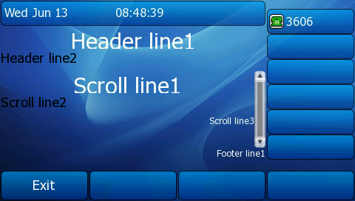
FormattedTextScreen -T3XG/vp530
Scenario :
You can design it like an web Browser interface :
T38G
Notes:
This is a sample of formattedtextscreen ,it can be designed like an web Browser interface ,and you can custom the display position ,font and color for the text .

Slide 19
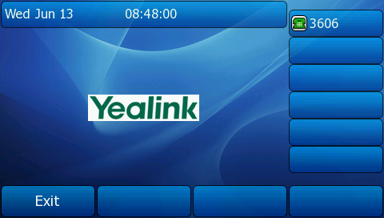
ImageScreen -T3XG/VP530
ImageScreen allows users to display simple image on the IP phone. The user can specify where the image should be placed.
Scenario :
You can use ImageScreen to get the news or stock information in picture from server and show in LCD .
T38G
The user can specify where the image should be placed by setting horizontal and vertical alignment of the upper left hand corner, along with the height and width of the image
Notes:
This ImageScreen also only is supported by T3 series and VP530 .It allows user to display simple image on the IP phone. The user can custom the place where image display .It can be used to get the news or stock information in picture from server and show in LCD .
Now all the XML object introduction are finished .

Slide 20
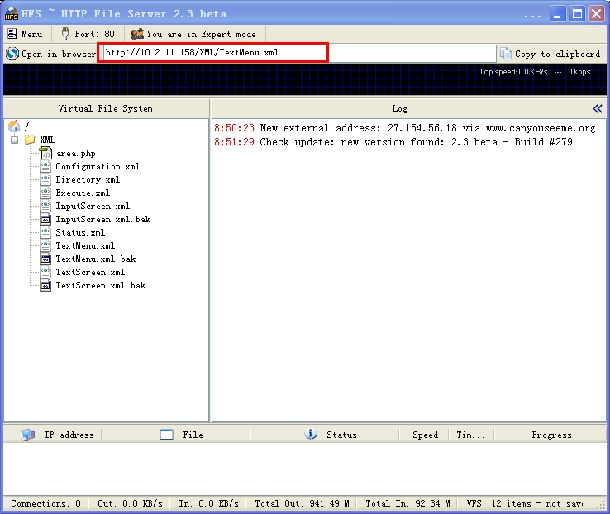
Setting up a XML Server
Support HTTP(s) protocol .
Example :
HTTP server : Get the IP address of XML document.
Notes:
Before using XML Browser feature on phone ,you need to set up a XML server and put the XML documents on server .XML Browser support HTTP and HTTPs protocol .
This picture shows an example for HTTP server ,you need to get the IP address of specific XML document.This address will be configured on phone side .

Slide 21
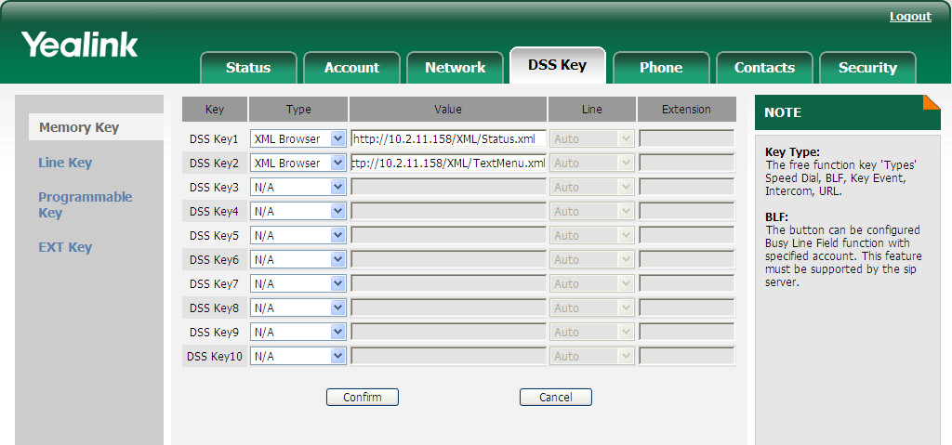
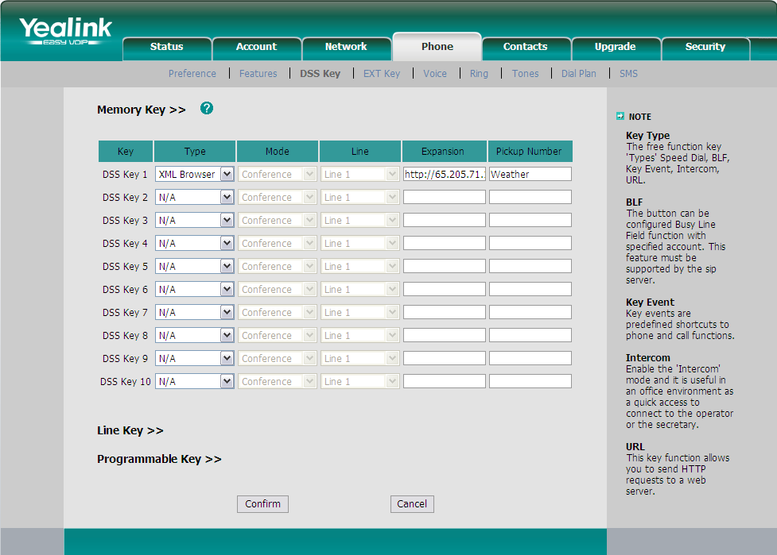
Configuring XML Browser on phone
Web setting interface (T3XG/VP530):
DSS Key →Memory Key /Line Key(EXT Key for T38G)
Web setting interface (T2X):
Phone→DSS Key/line Key (EXT Key for T28/T26)
Also ,you can configure on Phone side .
Notes:
To configure the XML Browser ,you need to enter into web setting interface of phone and browse to DSS Key →Memory Key or Line key to configure the DSS key and line key .
Then select XML Browser from the pull-down list of Type.And fill the available access XML document URL in the Value field.Click the Confirm to accept the change.
The screenshot of the web interface for reference is shown in PPT .
For T38G ,T28 and T26 phone with extension module connected ,you can also configure XML Browser on the EXT key .After configuring ,you can press this key to request XML document from server .
Now the instrocution about XML Browser are finished .

Slide 22
Push XML
Notes:
Now is turn to Push XML ,Push XML feature is similar with XML Browser .

Slide 23
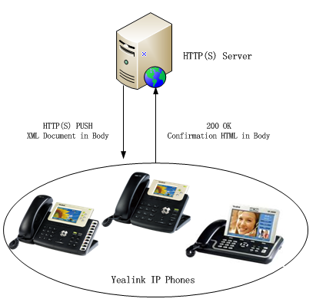
What is Push XML
Push XML on the phone use the HTTP(s) transport protocol .It is the Server-initiated application.
Yealink IP phone acting as a server (HTTP(S) post)
Notes:
Push XML also use the HTTP and HTTPs transport protocol ,but is the server-initiated application .
The end users do not need to do any additional operate. The server alters the XML application by posting an HTTP or HTTPs message to the phone. when phone receives request, it will determine whether to display corresponding content on the phone which sent by the specified server or not.

Slide 24
Application Scenario
The Push XML in the Yealink IP phones allows users to create custom services which meet user functional requirements on the server .
Users can customize practical applications, such as weather report, stock information, Google search and news service ,etc..
User can remote control the phone ,such as rebooting the phone ,resetting the phone ,changing the LED status on phone ,etc..
User can remote configure the phone ,like Auto provision .
Notes:
Push XML can do the similar things with XML Browser ,it allows users to create custom services which meet user functional requirements on the server, such as weather report, stock information, Google search and so on ,Server can push these info to user for chekcing .It also can be used to remote control the phone for some operation and remotely configure the phone ,like auto provision .

Slide 25
Push XML instruction
XML Object which Push XML supported:
T3XG/VP530:
• TextMenu (UI)
• TextScreen (UI)
• InputScreen (UI)
• PhoneExecute (non UI)
• PhoneConfiguration (non UI)
• PhoneStatus (non UI)
• FormattedTextScreen (UI)
• ImageScreen (UI)
T2X:
• TextMenu (UI)
• TextScreen (UI)
• InputScreen (UI)
• PhoneExecute (non UI)
• PhoneConfiguration (non UI)
• PhoneStatus (non UI)
Notes:
The XML application put on server side are created in .php format file .The phone supported push XML object also are same with XML Browser .Beside only T3 series/PV530 support FormattedTextScreen and ImageScreen ,there are some addinitonal difference between T2 series and T3 series /VP530 .That is Phoneconfiguration .

Slide 26


PhoneConfiguratio
PhoneConfiguration (non UI) :
T3XG/VP530:
Line Key
DSS Key
EXT Key
T2X(almost all of configuration):
Line Key
DSS Key
EXT Key
Account
LDAP
ActionURL
Forward
.
.
.
Notes:
Phoneconfiguration for T3 series and VP530 only can configure the Line key ,dss key and extension key on phone .But for T2 series ,phonecongiguraiton can configure almost all of the configration on phone ,such as account info ,LDAP,ActionURL ,Forward and transfer feature and so on .I had arranged the supported model documents for different series and will send to you after training ,you can have a reference .

Slide 27

Setting up Push XML server
How to Install a Demo Push XML:
Notes:
Before using Push XML feature ,you also need to setting up one Push XML server firstly and put the XML application documents on server ,then push to sepecific end points .
You can refer to this manual about how to install a demo push XML after training .

Slide 28
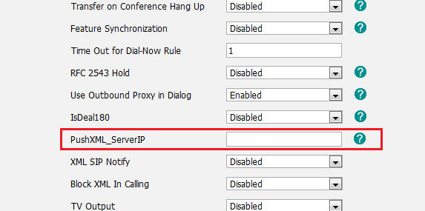
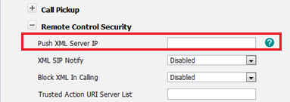
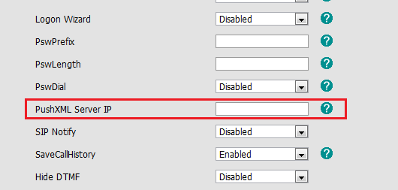
Configuring Push XML on phone
Web setting interface(VP530) :
Phone→Features
Web setting interface(T3XG) :
Phone→Features→Remote Control Security
Web setting interface(T2X) :
Phone→Features
Push XML server configuration :
1)Empty means that this phone can’t receive any server ‘s request .
2)You can enter the server address like below :
one server :10.2.1.12
more than one server(s) :
10.2.1.12,10.3.2.14,10.4.2.12
Notes:
In phone side , Users configure the available server's IP address on Web page, when phone receives request, it will determine whether to display corresponding content on the phone which sent by the specified server or not according to this setting .
I list all models configure page in PPT ,you can have reference .For this options ,if you let it empty ,it means that this phone can’t receive any server’s request . if you want to cinfigure more than one server address ,you can seperated the different address by comma symbol .

Slide 29


Documents
T2X :XML Browser
T3XG/VP530 :XML Browser
T2X/T3XG/VP530 :Push XMl
Notes:
These are some document about XML Browser and Push XML ,we will send you after this tranning .

Slide 30
Q&A

