Slide 1

Yealink Solution on
BroadWorks
8th July, 2012
Notes:
Hello everybody ,this is **** from Yealink technical support team .It’s my pleasure to host today’s training .Here is our topic for reference. let’s start the training now.

Slide 2

Agenda
Who is Broadsoft
Successful Cases
Yealink Feature List for BroadWorks
Provisioning in BroadWorks
How to configure Yealink and BroadWorks
Notes:
This is the Agenda for today’s training .First of all, we will introduce who is Broadsoft and his main product,Broadworks .Then we share some successful cases about carrier project with Broadsoft. At last, we will make a feature instroduce about the configure between Yealink and Broadsoft.

Slide 3

Who is Broadsoft
American Based Company,Established at 1998
Focus on Carrier Market Biggest carrier IMS
solution provider
Occupy 70% Carrier Market share
Notes:
BroadSoft is an American Based Company and it’s established at 1998 .They focus on VOIP Carrier Market which is the biggest Carrier IMS solution provider now.The Carrier Market share is about 70%.
Yealink is constructing a good relationship with Broadsoft now.

Slide 4
What is Broadworks
Broadsoft has 3 product as :
BroadWorks/BroadCloud/BroadTouch
BroadWorks is an integrated system of voice applications and servers for service providers.
The system delivers a broad set of differentiated, value-added communication services . – ranging from media-oriented services to personal calling functions .
Notes:
Broadsoft has 3 products as follows :BroadWorks/BroadCloud/BroadTouch. Today we only focus on Broadworks .
BroadWorks is an integrated system of voice applications and servers for service providers . The system delivers a broad set of differentiated, value-added communication services -ranging from media services such as voice mail, conference to personal calling functions ,such as selective call forwarding, and dial-by-name.

Slide 5
Successful Cases
Successful Cases
Notes:
First of all, We want to share some of our successful cases about carrier project with Broadsoft.

Slide 6

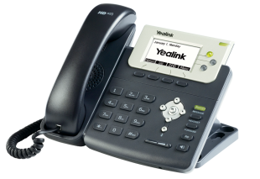
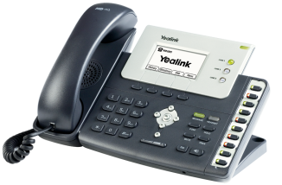
Telefonica
One of the largest telecommunication carriers in the World and the second largest telecommunication carriers in Europe.
Cooperated with BroadSoft to provide stable solutions for abundant European customers since 2009, satisfying the needs of communication and collaboration on a large scale.
Target to Enterprise and Firms
Monthly fee with free phone use
Choose Yealink T26P, T22P
Notes:
Telefonica is one of the largest telecommunication carriers in the World and the second largest telecommunication carriers in Europe.
They Cooperated with BroadSoft by providing stable solutions for abundant European customers since 2009, satisfying the needs of communication and collaboration on a large scale.
Target to Enterprise and Firms with operation mode of Monthly fee with free phone use
They Choose Yealink T26P, T22P

Slide 7


PCCW
The largest telecommunication carrier in HK.
Yealink has established a friendly relationship and co-operation to provider customers with various solutions for the development needs of the corporates.
Target to SMB
Monthly fee with free phone use
Choose Yealink T28P, T26P
Notes:
And this case is PCCW ,PCCW is the largest telecommunication carrier in HK.
Yealink has established a friendly relationship and co-operation with provider customers by various solutions for the development needs of the corporates.
They Target to SMB with operation mode of Monthly fee with free phone use
Their model is Yealink T28P, T26P

Slide 8



And More…
We have more and more successful cases with BroadSoft Carrier all over the world .
Notes:
Now We have more successful cases with BroadSoft Carrier all over the world .
Such as KPN :The largest telecommunication carrier in the Netherlands, rewarded as one of the top 10 telecommunication companies for investment.
SingTel :the largest telecommunication carrier in Singapore ,Telkom SA ,the largest telecommunication carrier in South Africa .

Slide 9
Yealink Feature List for BroadWorks
Notes:
In order to have a general view of the following features which will be introduced in today’s training .
We will share the Yealink Feature support list for Broadsoft in this topic .

Slide 10
Yealink Feature List for Broadsoft
Model | Busy Lamp Field List (BLF List) | Automatic Call Distribution (ACD) | Feature Key Synchronization | Shared Call Appearance (SCA) | Phonebook and Call Log
T2X(V61) | Supported | Supported | Supported | Supported | Supported
T3XG(V70) | Supported | Supported | Supported | Supported | Supported
VP530(V70) | Supported | Will support on V71 | Supported | Supported | Supported
Notes:
We could almost support most of Features on Broadsoft, contain Busy Lamp Field List, Automatic Call Distribution, Feature Key Synchronization, Shared Call Appearance ,Phonebook and Call Log . ACD didn’t be supported on VP530 .
According to the preliminary plan ,Version 71 of VP530 will support it ,and it will be released at the end of this year .

Slide 11
Provisioning in Broadworks
Notes:
The Next Topic we will talk about Auto Provisioning Process in Broadworks .

Slide 12
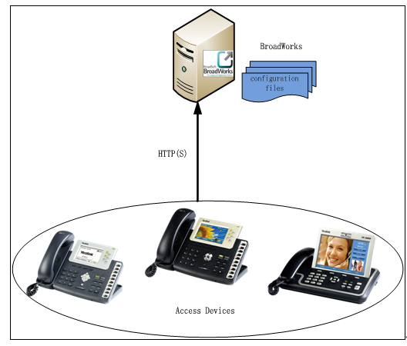
What is BroadWorks Device Management
The BroadWorks Device Management is a comprehensive solution for simplifying the
integration, deployment, and maintenance of access devices in your network .
The administrator can manage and control all aspects of device configuration centrally
in the network.
Notes:
The BroadWorks Device Management is a comprehensive solution for simplifying the integration, deployment, and maintenance of access devices in your network .Administrator on Broadworks can manage and control all Device configuration centrally
in the network. Just like you could manage or control all Yealink T2 seris/T3/VP series phone on Broadworks .By connecting devices to BroadWorks,it can download the configuration files, firmware, and other file resources required to deliver services.

Slide 13
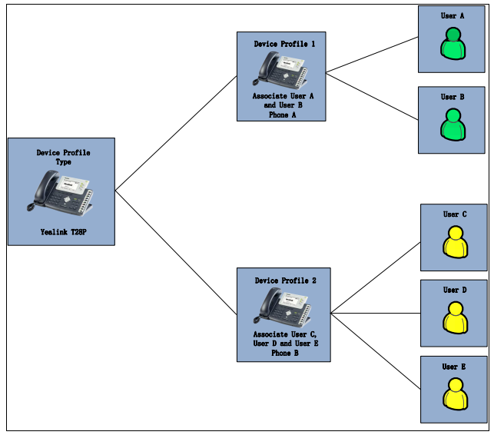
Key concepts
BroadWorks uses the following three key concepts for delivering services
and managing devices:
The Device Profile Type
The Device Profile
The User
Notes:
Before using Device Management, it is very important to check some key words:
The Device Profile Type/The Device Profile/The user
Device Profile Type is like a template for a model, like model Yealink T28.
When a new type of device is added to the network, a new device profile type should be created on BroadWorks to manage that type of device.
Device Profile is like a specific device , like Yealink T28P with specific MAC address .
When a new device is added to the network, a new device profile should be created on BroadWorks to manage that device. The device profile should be created from a given device profile type. This gives the device profile a predefined settings that are consistent with other devices of the same type in the network.
And Device Profile is like a specific T28P phone, like T28P with MAC
The User is like an account which we had in other PBX platform. The administrator can assign a device profile to one user or multiple users.
In the picture ,T28P is a device profile type ,this two phones are specific device profiles with multi-users .

Slide 14
What is Group Administrator
Web portals : Group Administrator
Limited feature configuration authority which already prefined by System
Administrator .This access allows addition, modification and deletion of
individuals within a calling group.
In following content ,We will instroduce all of the configuration steps on
BroadWorks which login as Group Administrator .
Notes:
In order to simplify the feature configuration steps on BroadWorks . We will introduce all configuration steps on BroadWorks which login as Group Administrator as follows.
Group Administrator portal is one of the portals which is used to login BroadWorks platform .It has limited feature configuration authority which already be prefined by System Administrator .
This access allows addition, modification and deletion of individuals within a calling group.

Slide 15
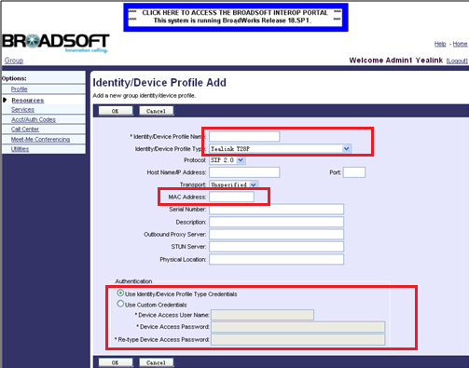
Adding BroadWorks Device Profile
Browse to Resources →Identity/Device Profiles .
Fill in a Profile name
Select Profile Type
Assign Profile to a Device MAC
Select Use Custom Credentials
,Provide http login user name & password
Notes:
If you want to add a specific T28 phone on Broadworks
You have to create one Device Profile first.
Login the web portal as the group administration . Browser to Resources->Identity/Device Profiles. Click on Add. You can see this webpage . Select the desired device profile type (e.g. Yealink T28P) from the pull-down list of Identity/Device Profile Type .And Assign Profile to a Device MAC. You can use the default identity device profile type credentials .If you want to set the Authentication of Autop by yourselves , Select Use Custom Credentials ,Provide http login user name & password

Slide 16
What is Device Template Configuration Files
There are two types of the template configuration files：
system template configuration files → y0000000000xx.cfg
Device-specific template configuration files→MAC.cfg
You can add upload device template configuration files at the profile level and at the group level.
We will instance the Group level in following feature introduction .
Notes:
As we know, phone need two different template configuration files for Autop .It is the same with BroadWorks .There are two types of files which is MAC.cfg.
You can upload device template configuration files at the profile level and at the group level . If you upload at profile level , the template configuration files can only be effectual for the specific device profile (e.g. yealinkT28).If you upload at group level , the template configuration files will be effectual for the device profile type (e.g. Yealink T28P). It means all the device profile associated with this device profile type can download the configuration files.

Slide 17
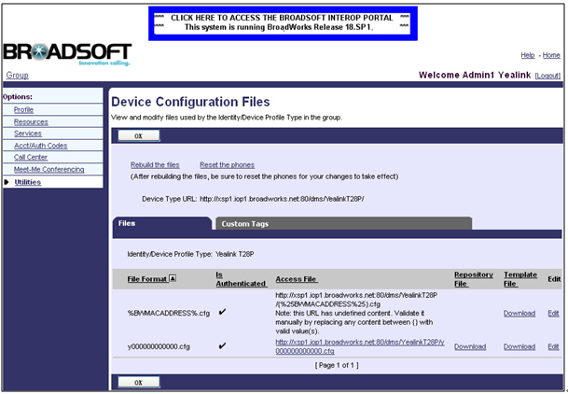
Uploading Device Template Configuration Files
Browser to Utilities->Device Configuration. The page appears all existing device profile types.Select the desired device profile type to edit (e.g. Yealink T28P).
Notes:
After login as group administration .you can Click on Utilities->Device Configuration. All existing device profile types will appear on he page.
Select the desired device profile type to edit (e.g. Yealink T28P). Click on Files tab. The page lists all existing template configuration files like the picture shows. Select the desired template configuration file to edit (e.g. y000000000000.cfg).

Slide 18
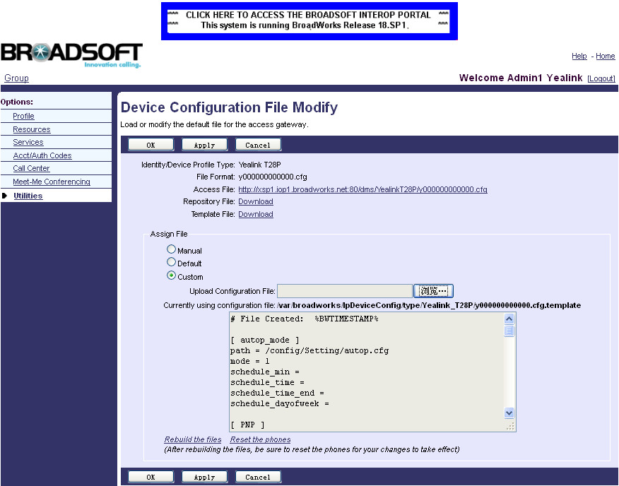
Uploading Device Template Configuration Files
Select the Custom in the Assign File block.
the template configuration files will be effectual for the device profile type (e.g. Yealink T28P). It means all the device profile associated with this device profile type can download the configuration files.
Notes:
You will enter the Device File Modify page .Here you could choose to change the configuration file Manually.
Or Use the default one .Also can upload your own one by choosing “Custom” options .
After the above settings, the template configuration files will be effectual for the device profile type (e.g. Yealink T28P). It means that all the device profile associated with this device profile type can download the configuration files.

Slide 19
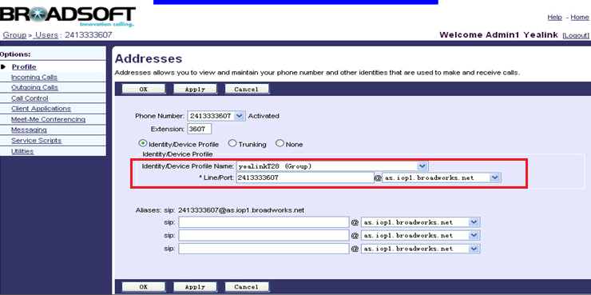
Assigning the Device Profile to the user
Browser to Profile->Users->Search to display all the existing users.Select one of the users to be assigned to device profile.Click on Addresses.Select the Identity/Device profile.
Notes:
Browser to Profile->Users->Search to display all existing users .Select one of the users to be assigned to device profile.
Click on Addresses. You can see the page as picture shows .you can Select the Identity/Device profile. In the Identity/Device profile block, select the desired device profile(e.g. yealinkT28) from the pull-down, enter the register’s user name in the Line/Port field, and select the domain name (e.g. as.iop1.broadworks.net) from the pull-down list of @.

Slide 20
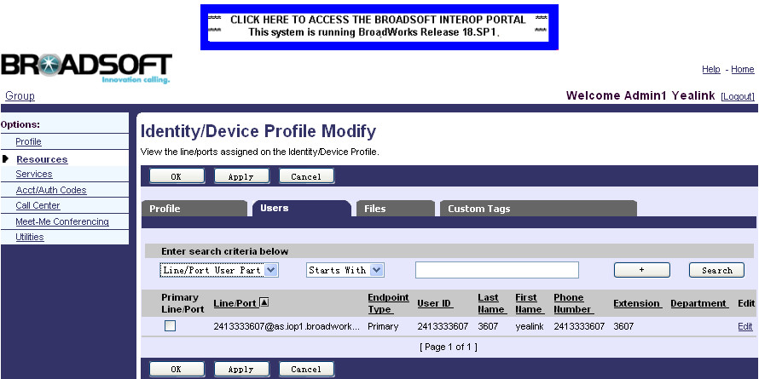
Checking the users assigned to the device profile
Browser to Resources->Identity/Device Profiles, and select the desired device
profile (e.g. yealinkT28) to edit . Click Users ,you can check the assigned use like below .
Notes:
You can check the users assigned to the device profile by entering into this path . e.g. yealinkT28 ,you can see the user we just assigned .

Slide 21
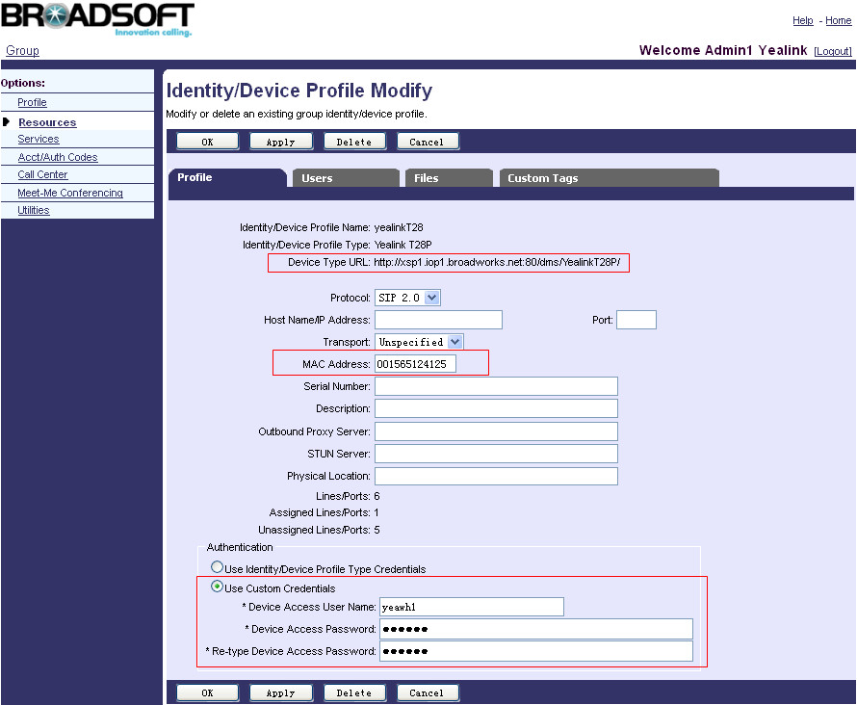
Downloading and Verifying Configurations
Browse to Resources->Identity/Device Profiles. Select the desired device
profile (e.g. yealinkT28) to edit . Click on Profile tab to check : URL, mac address,
username and password in the corresponding fields.
Notes:
After all the settings you have made on Broadworks. It need to apply it on your Device ,but you should know the Autop URL firstly .you could Broswer to this path , Select the desired Device (Yealink T28)
And then you will log into indentity/Device Profile Modify page again .Here you will find the configuration file downloading URL
Before Copying this URL to your own T28,.Make sure that the MAC address/user name/Password is all correct .

Slide 22
Downloading and Verifying Configurations
Web setting page of phone :Browser to Upgrade→Advanced
Notes:
Write the URL which you copy from Broadworks just now to your T28 phone now, Under Upgrade→Advance page .
Remember to Copy the user name/Password and Set Check New Config to be “Power On” As figure shows.
Then you could press “Auto Provisioning” or reboot the phone to make your T28 download the Configuration file from Broadworks.
(Also you could use ZERO-SP-TOUCH to do the Provisioning Process, for details ,you can refer to autop manual)

Slide 23
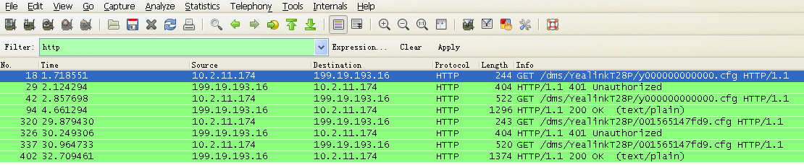
Downloading and Verifying Configurations
You can verify it via phone user interface or web user interface of the phone. During the auto provisioning process, you can monitor the downloading request and response message by a WinPcap tool.
Example: Yealink IP phone downloads configuration files by HTTP.
Notes:
You could take a Wireshark trace to monitor the whole Provisioning process as figure below.
You could see Yealink phones which use HTTP to download the Configuration file from Broadworks.
After a Successfully Provisioning , the Phone will apply all the settings you have made from Broadworks.
Also you could check those settings on your T28, like Account being registered and so on.

Slide 24
How to configure Yealink and BroadWorks
Notes:
Now we will introduce the specific configuration step on BroadWorks and yealink phone for every features. BLF list ,SCA,ACD, Feature Key Synchronization, Phonebook and Call log .

Slide 25
Busy Lamp Field (BLF) List
Notes:
First one is BLF LIST —BLF LIST stands for Busy Lamp Field List.
It’s the BLF feature on Broadworks.

Slide 26
The Busy Lamp Field
The Busy Lamp Field (BLF) List feature on the IP phone allows a list of specific extensions to be monitored for status changes.
For example, you can create a BLF List URI to monitor a list of users on the BroadWorks server. The monitored users include a list of user1, user2 and user3. The BLF List keys on the IP phone can present the status of user1, user2 and user3. The key LEDs illuminate either flashing or solid depending on the status of those users.
Notes:
The Busy Lamp Field (BLF) List feature on the IP phone allows a list of specific extensions to be monitored for status changes.
You can use BLF List feature to monitor a list of users defined on BroadWorks. For example, you can create a BLF List URI to monitor a list of users on the BroadWorks server. The monitored users include a list of user1, user2 and user3. The BLF List keys on the IP phone can present the status of user1, user2 and user3. The LEDs key illuminate either flashing or solid depending on the status of those users.
This feature enables the monitoring phone to subscribe to a list of users, and receive notifications of the state of the monitored users. Different indicators on the monitoring phone show different status of the monitored users. When the monitored user places a call, a busy indicator on the monitoring phone shows that the user’s phone is in use and busy.

Slide 27
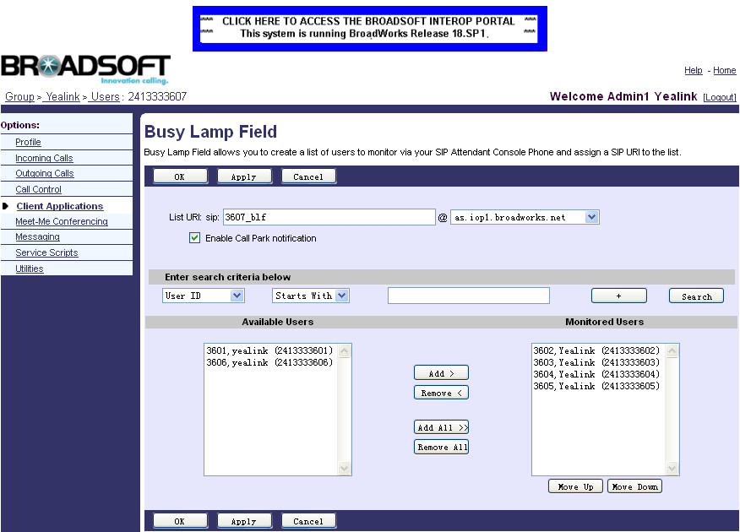
Configuring BLF list on the BroadWorks Server
Browser to Profile->Users->Search to display all the existing users. Select one of the users (e.g. 2413333607) to configure the BLF List feature.Click on Client Applications->Busy Lamp Field.
Notes:
For using BLF list feature ,you need to predefine the BLF list group firstly on BroadWorks . After login as group administrator, you can click Profile->Users->Search to display all the existing users . Select one of the users (e.g. 2413333607) to configure the BLF List feature. Then click on Client Applications->Busy Lamp Field, which as picture show . Enter the BLF List URI (e.g. 3607_blf) in the List URI field. Select the domain name (e.g. as.iop1.broadworks.net) from the pull-down list followed by @ sign. If you want to use the Call notification function ,you can Click the Enable Call Park notification checkbox. Click Search to display all available users. Select the desired users from the Available Users list, and click the Add> button to add them to the Monitored Users list. you can repeat the above steps to add more users to the Monitored Users list.

Slide 28
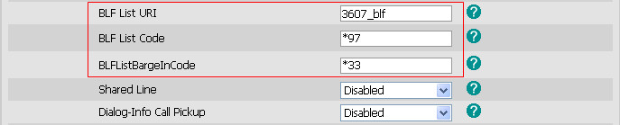
Configuring BLF List onthe Yealink IP Phone
Browser to Account→Advanced.Enter the BLF List URI in the BLF List URI field.
(Optional.)Enter the pickup code in the BLF List Code field.
(Optional.)Enter the barge-in code in the BLFListBargeInCode field.
Notes:
After defining the BLF list group, you need to configure the necessary configuration in phone. For the following steps:
1.Enter into web setting page of phone ,and click on Account page.
2. Select the account from the pull-down list of Account, which has been configured the BLF List feature on the BroadWorks server.
3.Click on Advanced page. Enter the BLF List URI in the BLF List URI field, Enter the pickup code in the BLF List Code field. (This option is Optional. It is used for pick up the incoming call on monitor phone), Enter the barge-in code in the BLF List Barge In Code field. (This option is Optional too. it used for join in the active call on monitor phone to set up an conference)

Slide 29
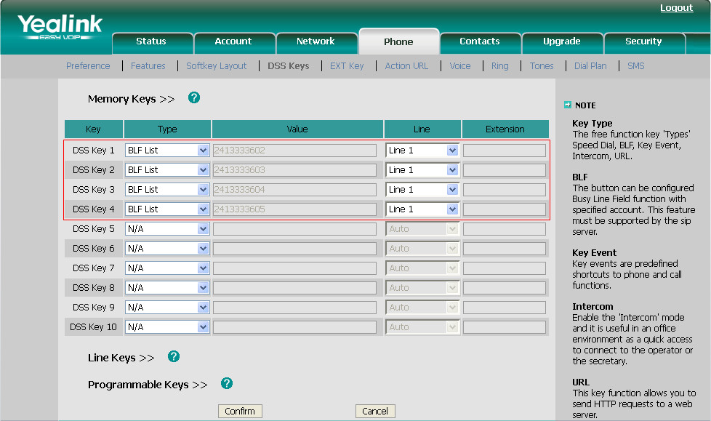
Click on Phone→DSS Keys→Memory Keys(Line Keys).Select the desired DSS key.
Select BLF List from the pull-down list of Type.
After the above configurations, according to the response message from the BroadWorks server, the IP phone will automatically assign the phone number of the BLF List users to the BLF List keys in order.
Notes:
Also you need to configure BLF list option on DSS key or line key . For the following steps:
1. Click on Phone->DSS Keys->Memory Keys>> (Line Keys>>).
2. Select the desired DSS key
3. Choose BLF List from the pull-down list of Type .
4. Select the desired line from the pull-down list of Line.
5. Click Confirm to save the change.
You can repeat steps 2 to 5 to configure more BLF List keys. After setting the above configurations, according to the response message from the BroadWorks server, the IP phone will automatically assign the phone number of the BLF List users to the BLF List keys. Then the BLF setting is finished .

Slide 30
Automatic Call Distribution(ACD)
Notes:
Now we would like to introduce ACD feature ,which stands for Automatic Call Distribution feature .

Slide 31
What is Automatic Call Distribution
Automatic Call Distribution (ACD) feature is often used in offices for customer service, such as call center.
The ACD system handles incoming calls by automatically queuing and directing calls to available agents. The ACD feature on the IP phone allows the ACD system to distribute calls from large volumes of incoming calls to the registered users.
Notes:
Automatic Call Distribution (ACD) feature is often used in offices for customer service, such as call center.
The ACD system handles incoming calls by automatically queuing and directs calls to available agents. The ACD feature on the IP phone allows the ACD system to distributing calls from large volumes of incoming calls to the registered users.

Slide 32
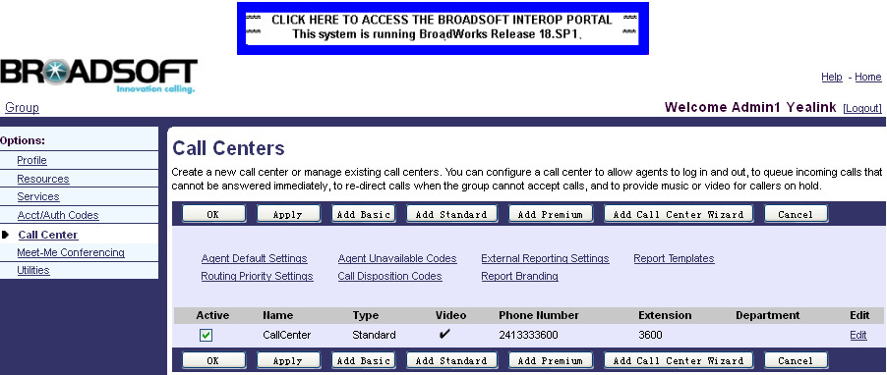
Creating a call center on the BroadWorks server:
To create a call center on the BroadWorks server:
Browser to Call Center→Call Centers→Add Standard to add a Standard call center.
Go back to Call Center→Call Centers and check the Active checkbox for the call center.
Notes:
For using ACD feature ,you need to create a call center on the BroadWorks server and Assign agents to the specific call center .
.For creating a call center ,you need to Log in as the group admin firstly ,then Click Call Center->Call Centers to enter call centers adding page ,click Add Standard to add a Standard call center.
After creating the call center, go back to Call Center->Call Centers and click the Active checkbox to active this call center, as show in picture.

Slide 33
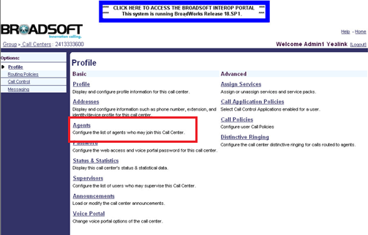
Assigning agents to the call center on the BroadWorks server
To assign agents to the call center on the BroadWorks server:
Click on Call Center→Call Centers, browse to the call center created and click Edit.
Click on Agents.
Notes:
After creating one new call center ,you need to assign agents to this call center .The incoming call to this call center can be assigned to the agents in this call center.
Click on Call Center→Call Centers , browse the call center created and click Edit. Click on Agents to enter into the agents assign page .

Slide 34
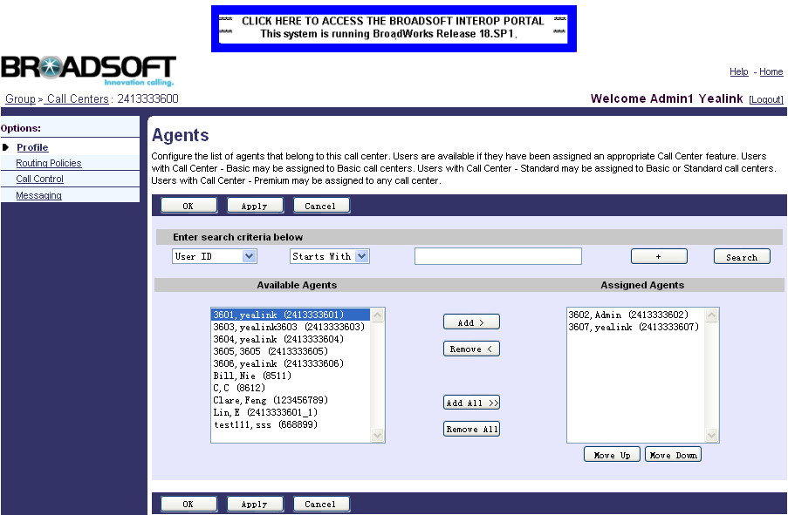
Assigning agents to the call center on the BroadWorks server
Click Search to display all available agents.
In the Available Agents box, select the desired agent and click Add> to assign it to the call center.
Notes:
To display all available agents. You need to click search .All available agents will display in the below Available Agents box .You can add multi-agents to this call center . Click Apply to save the change.

Slide 35
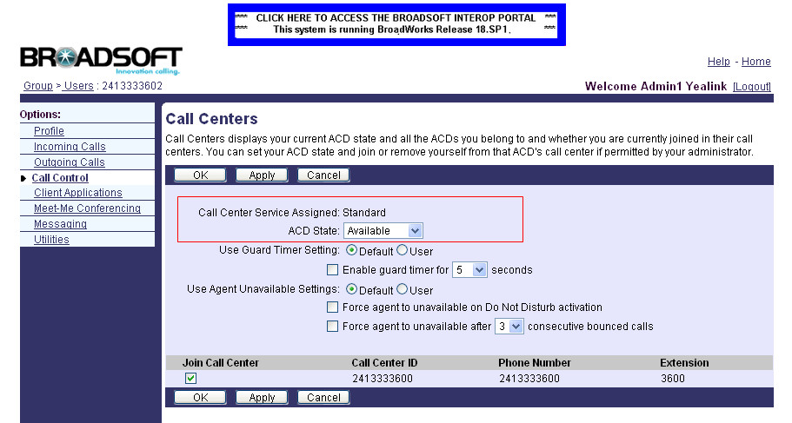
Changing the ACD State on the BroadWorks Server
Browser to Users→Search.Select one of the call center agents.
Click on Call Control →Call Centers.
Select the desired state from the pull-down list of ACD State.
Make sure the Join Call Center is checked.
Notes:
After assigning the agents ,you can check the specific agent status by entering the user’s call center configuration page.
Entering into Users→Call control →call centers, you can see the corresponding options related to an agent .
Two kinds of important ACD states are Available and Unavailable .
The ACD system can handles incoming calls by automatically queuing and directing calls to available agents.
Now the Broadworks ACD configuration is finished .

Slide 36
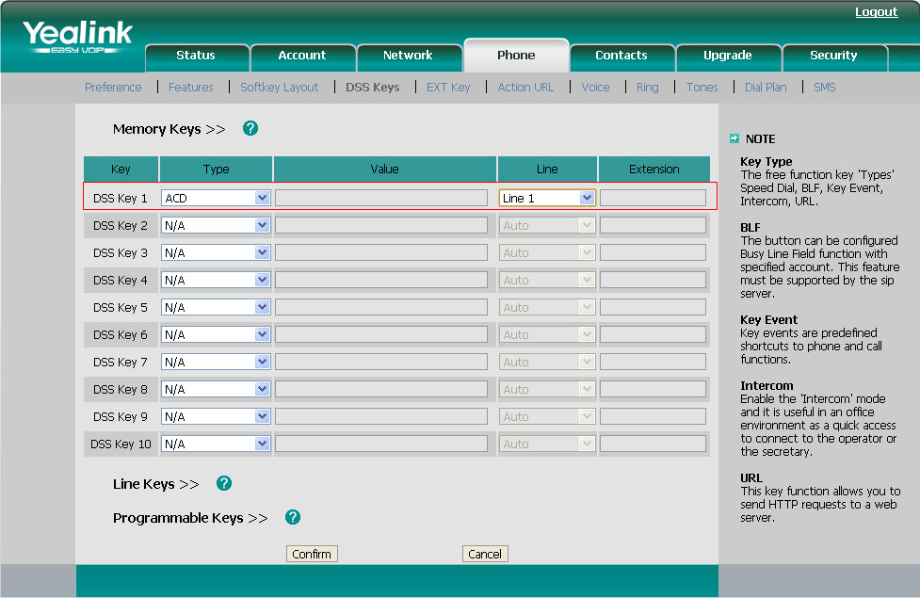
Configuring ACD on Yealink phone
To configure an ACD key via web user interface:
Browser to Phone→DSS Keys
Make sure the selected line has registered one of the call center agents.
It is recommended you configure no more than a single ACD key per IP phone.
Notes:
Now go to phone side .To use the ACD feature, you should configure an ACD key on phone in advance. Browser to Phone→DSS Keys
And Select ACD from the pull-down list of Type.
Select the desired line from the pull-down list of Line. Then click on confirm .
Please Make sure the selected line has registered one of the call center agents.
We recommended configure no more than a single ACD key per IP phone.

Slide 37
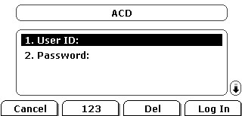
Using ACD on Yealink phone
Press the ACD Key.
The phone LCD screen prompts you the following information:
User ID: the user identity used to log in the ACD system.
Password: the password used to log in the ACD system.
After log in ,press the Avail / Unavail soft key to change the ACD status.
Notes:
You can press this ACD key to login the ACS system .After pressing ACD key ,phone screen will prompts you to enter the USER ID and Password . User ID means the user identity used to log in the ACD system.
Password means the password used to log in the ACD system .
And after login ,you can switch ACD status by pressing the Avail / Unavail soft key .

Slide 38
Feature Key Synchronization
Feature Key Synchronization
Notes:
Now is turn to Feature key synchronization(ˌsiŋkrənaiˈzeiʃən]) .We will only have a simple introduce for this feature in today’s training .For the specific configuration on BroadWorks for this features ,please refer to the manuals which we will send you after training .

Slide 39
Feature Key Synchronization
Feature Key Synchronization provides the capability to synchronize the following BroadWorks feature status with the IP phone.
Do Not Disturb
Call Forwarding Always (CFA)
Call Forwarding Busy (CFB)
Call Forwarding No Answer (CFNA)
ACD state
This function is convenient for user to remote control phone function in server side .
Notes:
This feature provides the capability to synchronize the following five BroadWorks feature status with the IP phone.
Do Not Disturb/Call Forwarding Always/Call Forwarding Busy/Call Forwarding No Answer /ACD state .
If a user changes the status of one of these features via the BroadWorks web portal or feature access code ,the BroadWorks server will notify the IP phone of the status change. Conversely, if the user changes the feature status on the IP phone, the IP phone will notify the BroadWorks server of the status change.
This function is convenient for user to remote control phone function in server side .

Slide 40
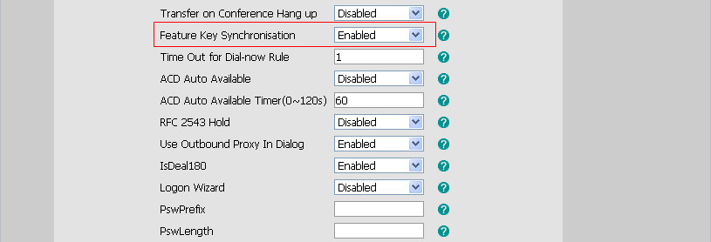
Configuring the Feature Key Synchronization on the IP Phone
Browser to Phone→Features ,enabled Feature Key Synchronisation .
Notes:
For active this feature ,you need to enter into phone setting page and Browser to Phone→Fetures ,and enabled the Feature Key Synchronisation .
For example, when you enable the Feature Key Synchronisation, and active the DND feature by pressing the DND soft key on the IP phone, the IP phone will synchronize the DND state to the BroadSoft user registered on the IP phone. And if DND state is change in BroadWorks , server will notify phone to change the state ,too .

Slide 41
Shared Call Apperance(SCA)
Notes:
Now let me instroduce the feature of the shared call apperance .

Slide 42
Share Call Apperance
The Shared Call Appearance (SCA) feature allows the administrator to assign an extension to multiple phones. Any of the phones can be used to make or receive calls.
A call that is active on one phone will be presented visually to phones that share the call appearance, and some special operations can be done according the state .
A SCA group contains one primary account and multi-alternative accounts(same features but different in configuration on phone ) .
Notes:
The Shared Call Appearance (SCA) feature allows the administrator to assign an extension to multiple phones. Any of the phones can be used to make or receive calls.
A call that is active on one phone will be presented visually to phones that share the call appearance, It means if one member in SCA group change the call state ,other members in the same group can see the instant state change .
A SCA group contains one primary account and multi-alternative accounts(they have same features but some difference in configuration on phone ) .

Slide 43
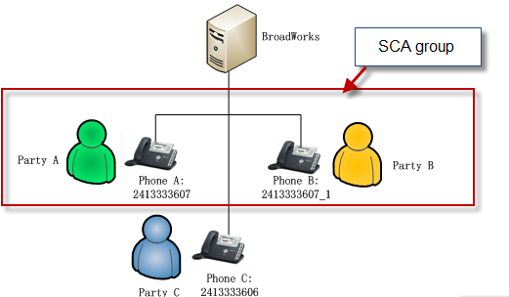
Share Call Apperance
This feature is very useful in the similar scenario like boss and secretary :
The secretary can share the boss's extension on her phone. When there is an incoming call to the extension of the boss, both the phones of the boss and the secretary will ring simultaneously. Either the boss or the secretary can answer the call. This call state can be shared and also some special operation can be done according the state indication .
A primary account(Party A:Boss) on the IP phone and the alternate accounts(Party B: secretary) on the other IP phones.
Notes:
This feature is very useful in the similar scenario like boss and secretary ,If the secretary and boss are in the same SCA group . When there is an incoming call from Party C to the extension of the boss, party A, both the phones of the boss and the secretary will ring simultaneously. Either the boss or the secretary can answer the call. For example ,secretary answer the call .This call state can be shared on boss .and boss can make some special operations according the state ,such as public hold ,private hold, barge in .You can refer to the document which we will send you later for details .Now we are aim at introducing the configuration on BroadWorks and phone .

Slide 44
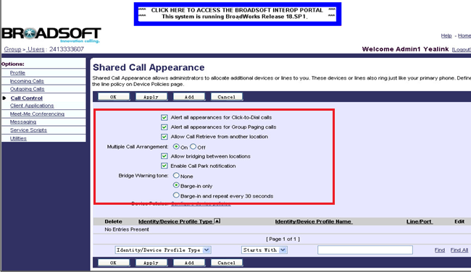
Configuring the BroadWorks Server
Browser to Profile->Users->Search to display all the existing users. Click on Call Control-> Shared Call Appearance. Set the SCA parameters as follow ,then Click on Add to add alternate accounts to this user.
Notes:
You can follow the steps to configure the BroadWorks Server. Firstly, log in as the group admin. Go to Profile->Users, and press Search to display all the existing users . You can Select the user 2413333607.Then Click on Call Control->Shared Call Appearance. Set the SCA parameters as follow , these parameters are for configuring the specific authorities of this SCA account .then you can Click on Add to add alternative accounts to this user.

Slide 45
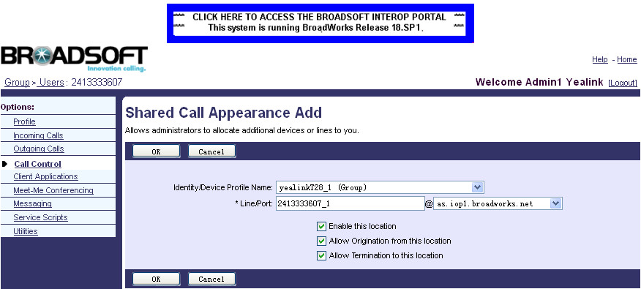
Configuring the BroadWorks Server
Select the desired device profile name (e.g. yealinkT28_1) from the pull-down list of Identity/Device Profile Name. Enter the alternative extension (e.g. 2413333607_1) in the *Line/Port field.
Notes:
After you click on Add button ,you can enter into the setting page of alternative account, you can Select the desired device profile name (e.g. yealinkT28_1) from the pull-down list of Identity/Device Profile Name. Then Enter the alternative extension (e.g. 2413333607_1) in the *Line/Port field. And press OK to finish one alternative account adding .You can follow the adding steps to add multi-alternative accounts to this user .
Now the server configuration has been finished .

Slide 46
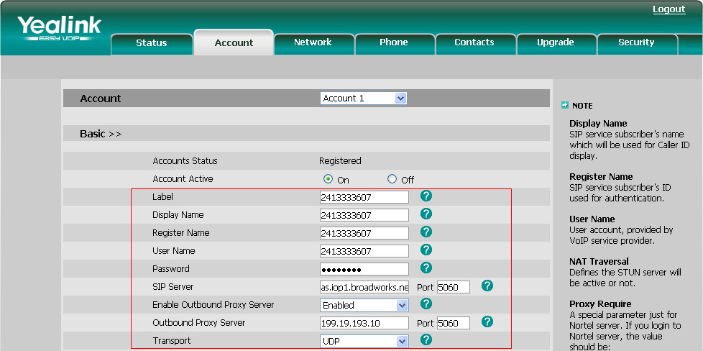
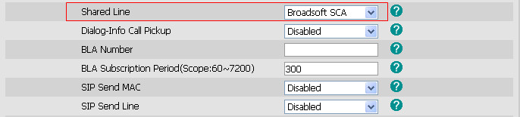
Configuring SCA on Yealink phone
To configure the primary account settings on the phone A via web user interface:
Browser to Account→Basic ,Register the primary account 2413333607.
Click Advanced .
Notes:
And in phone side ,in order to configure Phone A with primary account ,you can enter the corresponding account information in account Basic page .And set the value of Shared line as Broadsoft SCA in Advanced page .

Slide 47
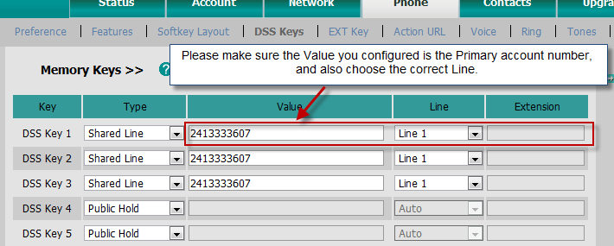
Configuring SCA on Yealink phone
Browser to Phone→DSS Keys .Configure Share Line/Public Hold/Private Hold either in Memory Key or Line Key.
Notes:
Then go to Phone DSS key page , and configure Share Line/Public Hold/Private Hold either in Memory Key or Line Key. Please note that the value of the key is the Primary account number and also choose the correct line .Then primary account setting in phone side has been finished .

Slide 48
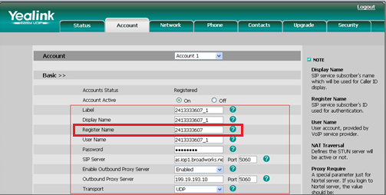
Configuring SCA on Yealink phone
To configure the alternate account settings on the phone B via web user interface:
Register the alternative account 2413333607_1.
You should fill the primary account 2413333607 in the Register Name field on the
alternate phones.
Click Advanced .
Notes:
As to configure Phone V with alternative account ,it is familiar with primary account configuration . One thing to note here is that you should fill the same primary account 2413333607 in the Register Name field .

Slide 49
Configuring SCA on Yealink phone
Phone→DSS Keys .Configure Share Line/Public Hold/Private Hold either in Memory Key or Line Key.
Notes:
And the number in shared line DSS key should be Primary account number .
So the SCA phone configuration is finished .

Slide 50
Phonebook and Call Log
BroadSoft Phonebook and Call Log
Notes:
Now is the Phonebook and Call log feature in BrodWorks . I will only make a brief introduction about the configuration of his two feature in phone side for server configuration ,you can refer to the documents which we will sent you after training .

Slide 51
BroadSoft Phonebook
You can access the BroadSoft directory through your IP phone. And add contacts from the BroadSoft directory to your local directory. You can also dial a contact from the BroadSoft directory.
You can configure your IP phone to access up to 6 BroadSoft directories.
Yealink phone supports Enterprise Directory, Group Directory, Personal Directory .
Notes:
You can access the BroadSoft directory through the IP phone. You can add contacts from the BroadSoft directory to your local directory. You can also dial a contact from the BroadSoft directory. The BoradWorks server provides four types of directory: Enterprise Directory, Group Directory, Personal Directory and Common Directory. The Common Directory is not supported by Yealink IP phones.
Yealink phong can support maximum 6 Broadsoft directories .
About the introduction for every kind of directory ,you can refer to the documents which we will sent you after training ,the manual also contains the phonebook configuration on BroadWorks .

Slide 52
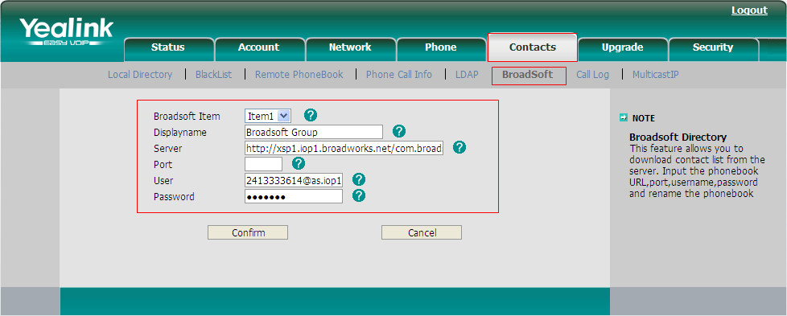
Configuring Broadsoft Phonebook on Yealink IP Phone
Browser to Contacts->BroadSoft
Notes:
For configurating the Broadsoft phonebook ,you need to browser to Contacts->BroadSoft.
And Select the desired BroadSoft item from the pull-down list of BroadSoft Item.
Enter the parameters: display name, server address, port, username and password in the corresponding fields .

Slide 53
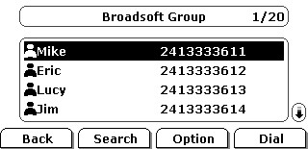
Accessing the BroadSoft phonebook via phone user interface
Press Directory->Broadsoft . Select the desired BroadSoft group, and then press the Enter soft key.
Notes:
When using the phone ,you can Press Directory->Broadsoft , Select the desired BroadSoft group, and then press the Enter soft key., The phone will connect to load the BroadSoft phonebook, and then displays the desired BroadSoft contact list on the LCD screen . And you can search contacts in this group or press Optional softkey to add a contact to local contact .

Slide 54
Call Log
You can access the call log of the desired BroadSoft user through your IP phone. The call log contains call information such as remote party identification, time and date.
You can check the call log, dial a call, add a contact or delete an entry from the call log list. The BroadSoft call log allows users to view and dial the stored numbers in the following lists: Missed, Received, and Placed.
Yealink phone can support maximum 3 call log items.
Notes:
For Call log , You can access the call log of the desired BroadSoft user through your IP phone. The call log contains call information such as remote party identification, time and date.
In phone side ,You can check the call log, dial a call, add a contact or delete an entry from the call log list. The BroadSoft call log allows users to view and dial the stored numbers in the following lists: Missed, Received, and Placed.
You can configure your IP phone to access up to 3 call log items.

Slide 55
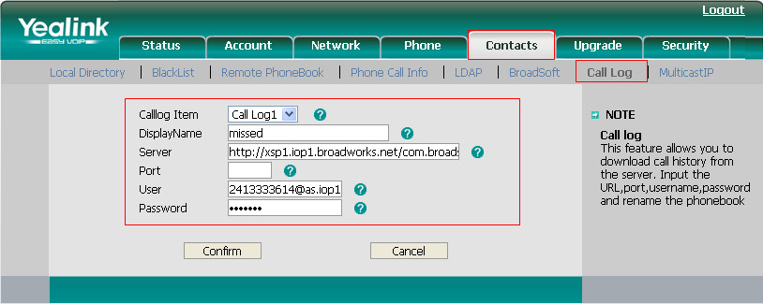
Configure Call Log on Yealink IP Phone
Browser to Contacts->Call Log
Notes:
Enter into web setting page, Browser to Contacts->Call Log, then Select the desired call log item from the pull-down list of Calllog Item.
Then Enter the parameters: display name, server address, port, username and password in the corresponding fields.

Slide 56
Configure Call Log on Yealink IP Phone
The following table lists the corresponding URL used to access the desired BroadSoft call log list of the specific user.
Call Log List | URL
Missed Lists | http://xsp1.iop1.broadworks.net/com.broadsoft.xsi-actions/v1.0/user/username@as.iop1.broadworks.net/directories/calllogs/missed
Received Lists | http://xsp1.iop1.broadworks.net/com.broadsoft.xsi-actions/v1.0/user/username@as.iop1.broadworks.net/directories/calllogs/received
Placed Lists | http://xsp1.iop1.broadworks.net/com.broadsoft.xsi-actions/v1.0/user/username@as.iop1.broadworks.net/directories/calllogs/placed
All Lists | http://xsp1.iop1.broadworks.net/com.broadsoft.xsi-actions/v1.0/user/username@as.iop1.broadworks.net/directories/calllogs/
Notes :The All Lists contains Missed, Received and Placed Lists. It’s not supported by Yealink IP phones.
Notes:
You can use the corresponding URL used to access the desired BroadSoft call log list of the specific user in the following table . Username means the account username you are using.

Slide 57
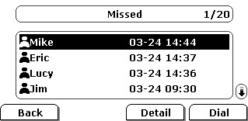
Accessing the Call Log via phone user interface
Press Menu->History Type->Network CallLog. Select the desired call log menu, and then press the Enter soft key.
Notes:
Press Menu->History Type->Network Call Log in phone side to load the BroadSoft call log, and then phone will display the desired call log list on the LCD screen.

Slide 58
Documents
Documents which we will send you after training :
User Guide for Phone Features Integrated with Broadworks
Using Integrated Features on BroadWorks
Yealink IP Phones Deployment Guide for BroadWorks Environments
Notes:
Now Today’s training is all finished .After training ,we will send you three documents as below .These three documents will detail the Broadsoft features or the phone deployment on Broadworks .

Slide 59
Q&A
Notes:
Do you have any questions ,you can type on the screen or speak by mic directly .

