Slide 1

Yealink IP Phone
The Global TOP5 Sip Phone Supplier

Slide 2

Agenda
Yealink Products
Yealink Advantages
Target Market
Compare To Competitors

Slide 3
Yealink Products

Slide 4

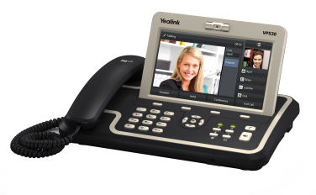
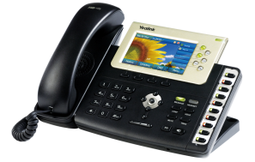
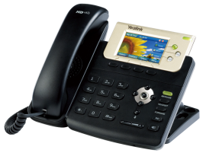
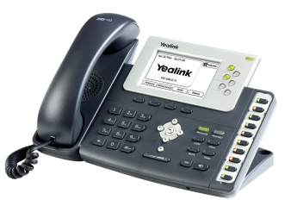
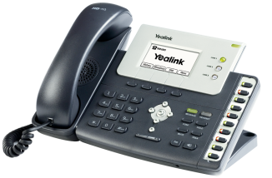
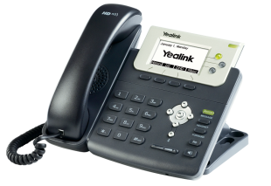
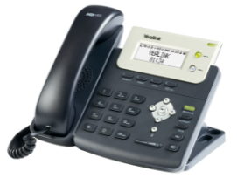
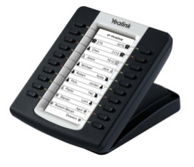


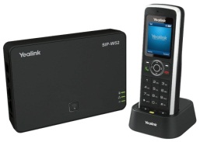
Yealink IP Phone Family
Cloud-Based Service
Redirection Server
Color Phone
VP530
T38G
T32G
IP Phone
T28P
T26P
T20P
T22P
DECT Phone &
Accessory
EXP39
YHS32
EXP38
W52

Slide 5
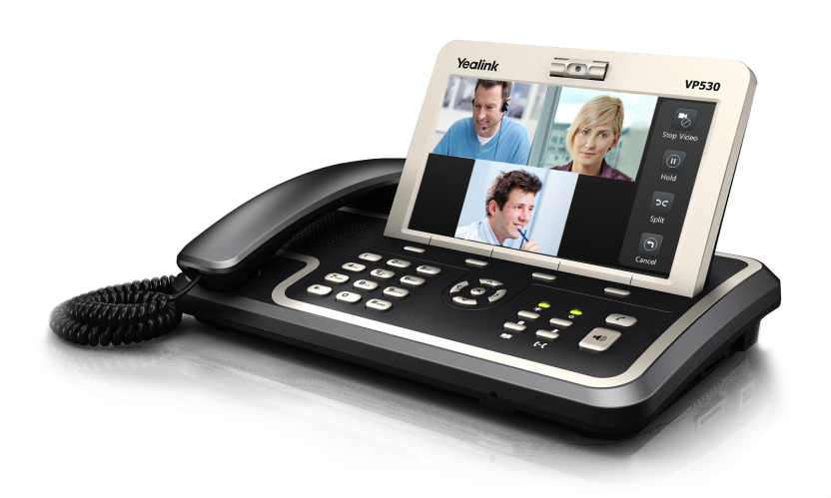
VP530
  2M CMOS camera
  7” 800x480 digital LCD, Touch screen
  18 one-touch soft DSS keys
  Local 3-way video conferencing
  TI DaVinci dual-core chipset
  HD Voice
  H.264/H.263 video codec supported
  4 VoIP accounts
  PoE, 2xRJ45, 1xUSB, 1xSD,Headset

Slide 6
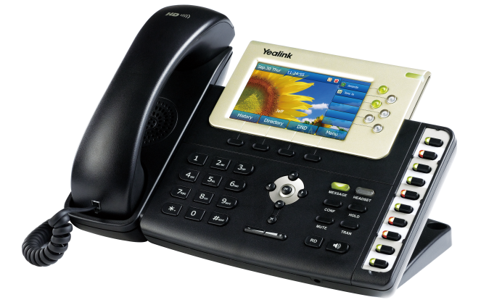
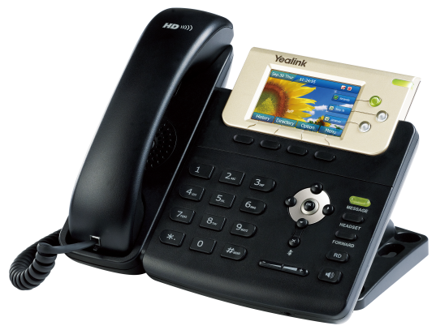
SIP-T3XG
  Dual-port Gigabit Ethernet
  4.3” TFT-LCD, 480*272 pixel, 16.7M colors
  10 DSS keys
  Expansion module, EHS
  TI Aries chipset and TI voice engine
  HD Voice
  6 VoIP accounts
  PoE, Headset
  T38G
  Differences VS T38G:
  3” TFT-LCD, 400*240 pixel, 262K colors
  3 VoIP accounts
  T32G

Slide 7

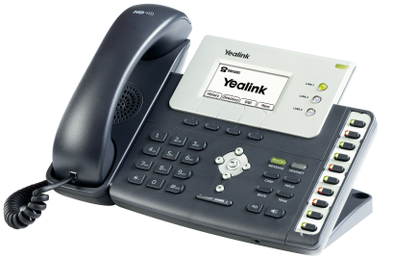
SIP-T2XP | High-end
  Dual-port Ethernet
  320*160 graphic LCD
  10 DSS keys
  Expansion module, EHS
  TI TITAN chipset and TI voice engine
  HD Voice
  6 VoIP accounts
  PoE, Headset
  T28P
  Differences VS T28P:
  132*64 graphic LCD with backlight
  3 VoIP accounts
  T26P

Slide 8

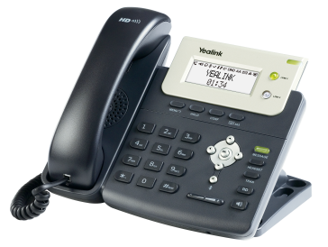
SIP-T2XP | Entry-end
  Dual-port Ethernet
  132*64 graphic LCD with backlight
  3 VoIP accounts
  TI TITAN chipset and TI voice engine
  HD Voice
  PoE, Headset, Wall-mountable
  T22P
  Differences VS T22P:
  3-line LCD (2*15 chars and an icon line)
  2 VoIP accounts
  T20P

Slide 9
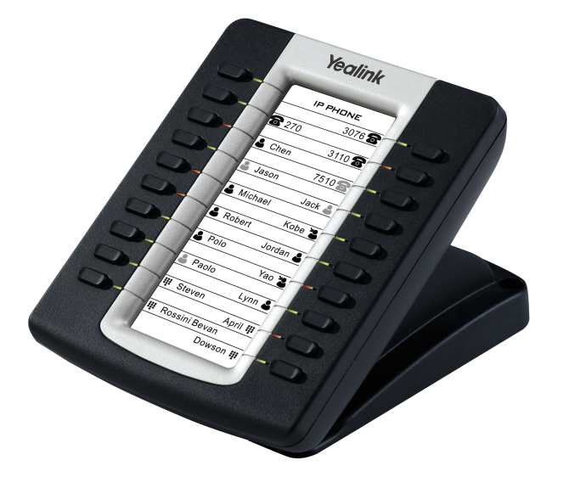
EXP39 | Expansion module
  20 programmable keys x 2 page views
  160*320 graphic LCD
  20 physical keys with dual-color LED
  Daisy-chain 6 modules

Slide 10
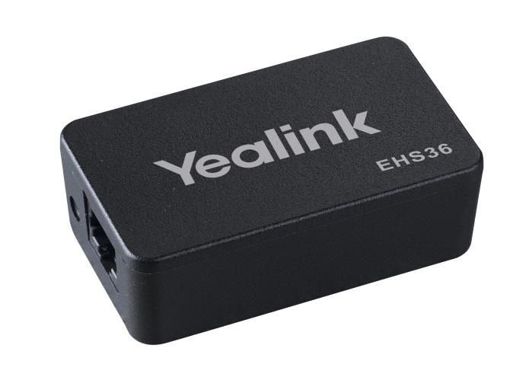
EHS36
  Plantronics, Jabra, Sennheiser wireless headset supported
  Phone control through wireless headset
  Plug and Play
  T38G/T28P/T26P supported

Slide 11
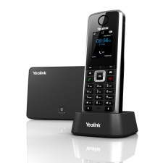
W52
Cat-ip2.0, G.722 codec
1.8” 128x160 TFT color LCD
Full duplex speaker/handset
PoE Supported
50m indoor, 300m outdoors
Notes:
4 lines simultaneous calls, up to 5 handsets
Cost saving
Perfect high efficiency for busy offices

Slide 12
Yealink Advantages

Slide 13
Yealink Phone Advantages
Yealink Phone
TI Solution
HD Voice
Broad IOT
Easy to Deploy
Easy to Use
Technical support
Notes:
Here is the main advantages of Yealink phone

Slide 14
Easy to use

Slide 15
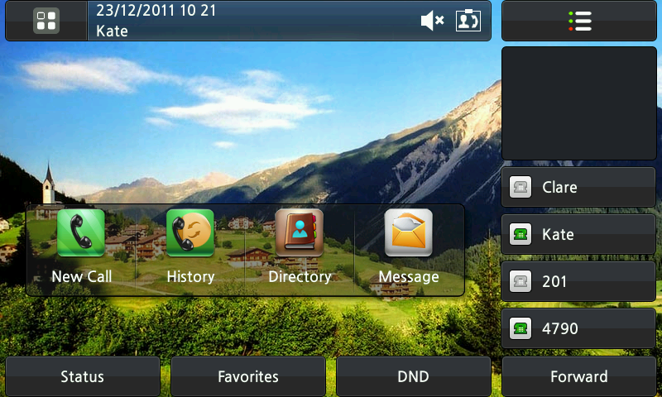
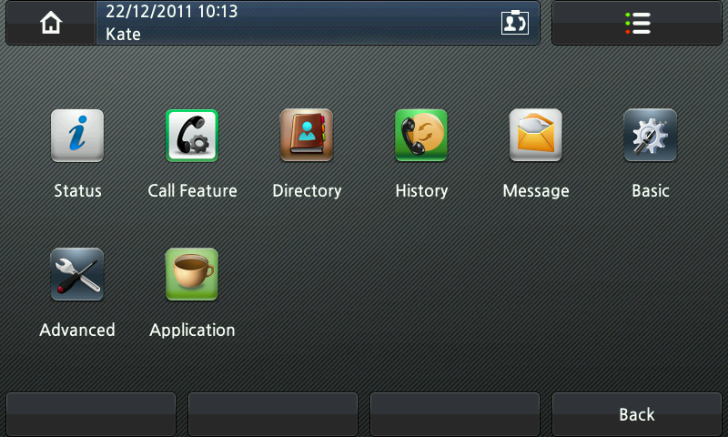
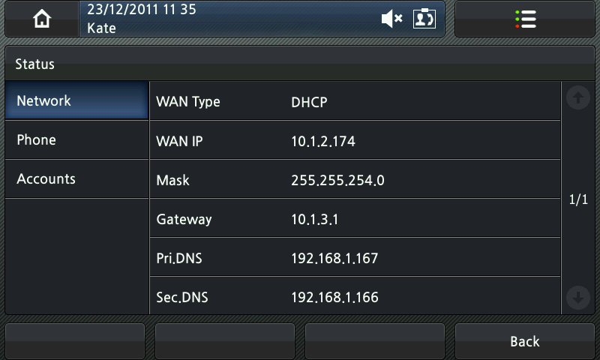
Intuitive User Experience

Slide 16
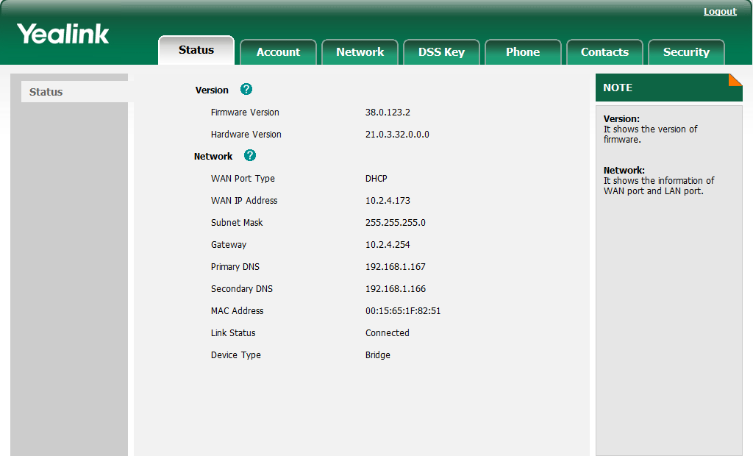

Friendly User Interface

Slide 17
Efficient for Working
BLF(Busy Lamp Field)
Hot Desking
Dial plan
XML/LDAP Phonebook
…

Slide 18
Easy to Deploy and Maintain

Slide 19

Plug & Play Provisioning
Zero-touch provisioning:
Auto Provisioning/TR069

Slide 20

Various ways for Provisioning
Various ways for configuration:
Configure via LCD/Web/Auto provisioning.
Various ways for auto provisioning:
PnP/DHCP/FTP/TFTP/HTTP/HTTPS/RPS
RPS(Redirection and Provisioning Service)

Slide 21
Configure VOIP Account-V70
#!version:1.0.0.1
#Enable or disable the account1, 0-Disabled (default), 1-Enabled;
account.1.enable = 1
#Configure the label displayed on the LCD screen for account1.
account.1.label = Cathy
#Configure the display name of account1.
account.1.display_name =Cathy
#Configure the username and password for register authentication.
account.1.auth_name = 100
account.1.password = 123456
#Configure the register user name.
account.1.user_name = 100
#Configure the SIP server address.
account.1.sip_server_host = 10.2.1.178
#Specify the port for the SIP server. The default value is 5060.
account.1.sip_server_port = 5060
Notes:
http://www.yealink.com
Support-Documents and Downloads
http://www.yealink.com/SupportDownloadfiles_detail.aspx?ProductsID=61&CateID=184&flag=142

Slide 22
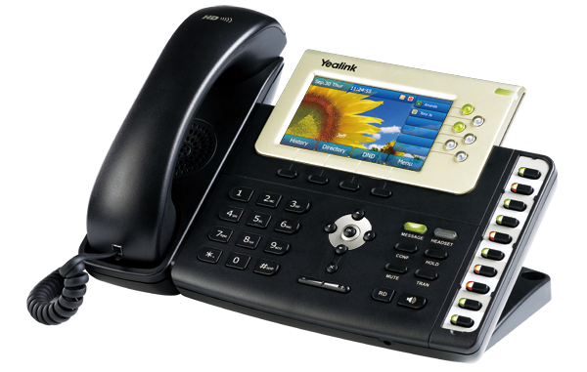



RPS
Service Provider
Simple PO information
Distributor
  Directly ship phones
Unpack+Configure+Pack
Registration of
the phone
Zero-touch config
Customer
Notify config server URL
RPS servers
Contacting RPS upon boot-up
Phone A

Slide 23
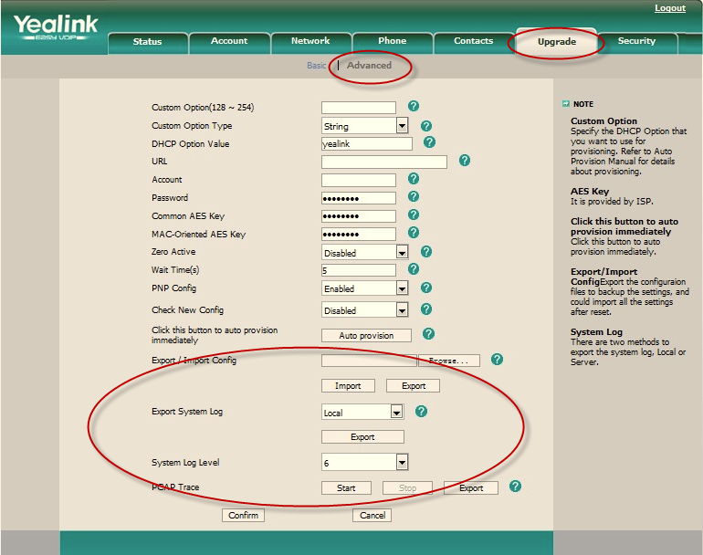
Multiple Management & Maintenance
LCD/Web management.
SNMP/TR069 for remote management and maintenance.
Syslog and debug server records

Slide 24
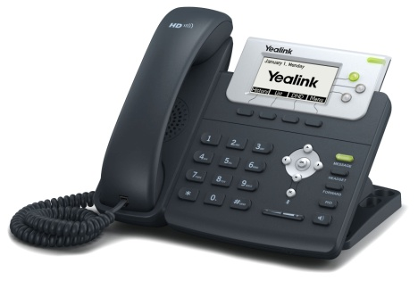
Redundant server support
in UK
Connection
1
SIP Server
A
SIP
Connection
2
SIP Server
B
SIP
in India

Slide 25
Broad Interoperability

Slide 26
Broad Interoperability
Carrier Solution |  | IP-PBX for SMB |  | Hard Phone and Soft phone
BroadSoft |  | 2N |  | Aastra
Cisco |  | 3CX |  | AudioCodec
Ericsson |  | Asterisk |  | Avaya
Huawei |  | Brekeke |  | Cisco
Alcatel-Lucent |  | Critical Edge Box |  | Counterpath
Nokia-Siemens |  | Datus |  | Dlink
Nortel |  | Digium SwitchVox |  | Doro
ZTE |  | Elastix |  | Firefly
Metaswitch |  | Epygi |  | Grandstream
VoipSwitch |  | Freeconet |  | LG
 |  | IP Brick |  | Linksys
Enterprise Solution |  | IPCortex |  | Nortel
Altigen |  | PBXnSIP |  | Planet
Avaya |  | PolySpeak |  | Polycom
Dasan |  | Sangoma |  | Radvision
eOn |  | Siptel |  | Samsung
Fujitsu |  | Starface |  | Siemens
ITS |  | TalkSwitch |  | SJ phone
NEC-Phillips |  | Teleware |  | Snom
Nortel SCS |  | Trixbox |  | Thomson
Panasonic Communications |  | Xorcom |  | Vocal
Tadiran |  | Yeastar |  | VoIPBuster
Teltronics |  | Zultys MX250 |  | Voip Switch
Notes:
Yealink phone also have a broad interoperability. In this list, you can see Yealink phone can works in almost all the popular IP-PBXs

Slide 27
HD Voice

Slide 28
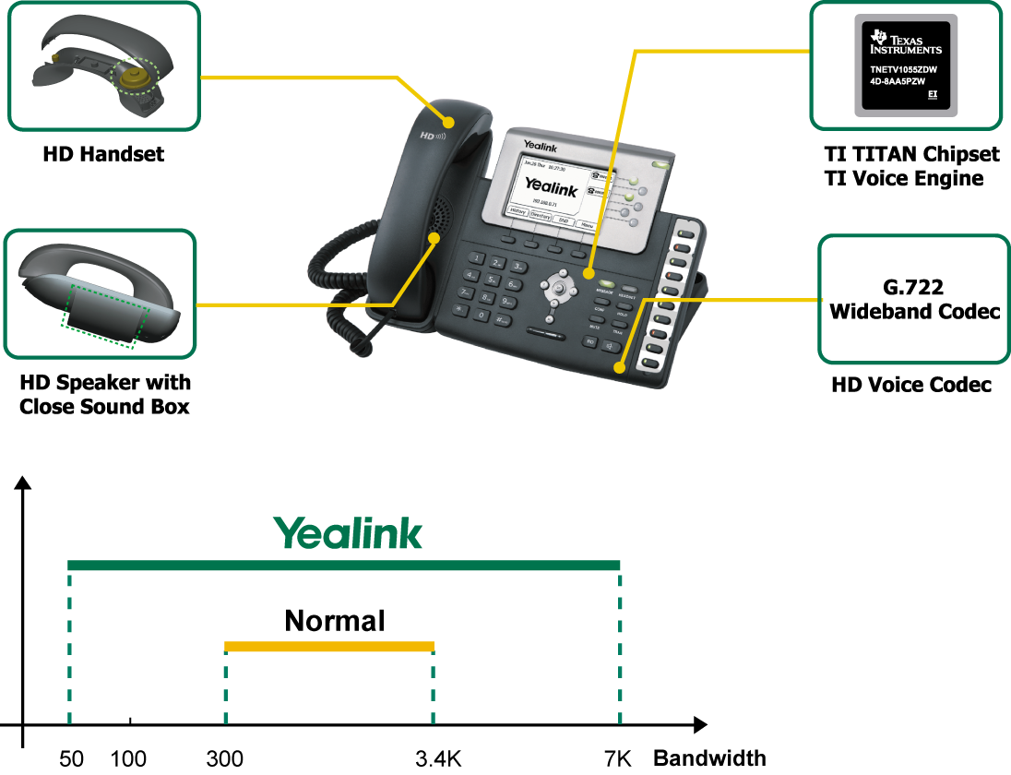
HD Voice
Bandwidth(Hz)
Notes:
This page will show you how Yealink IP phone provide a high definition voice, Yealink phone support HD handset, HD speaker and have wideband codec G722 supported

Slide 29
TI Solution

Slide 30

TI Solution
TI TITAN chipset and TI voice engine
The No.1 VoIP chipset provider
Advanced technology: robust stability, interoperability and superb clarity in voice & video transmission
Consistent new product: Advanced Roadmap and continuous investment on R&D
Proven good quality: Polycom and Cisco choose same TI chipset
Yealink is unique IP phone partner of TI in mainland China

Slide 31
Technical Support

Slide 32

Rapid technical support
34 technical engineers to provide rapid technical support.
More than 100 R&D engineers to ensure good and rapid technical support.

Slide 33
Target Market
Notes:
In this topic, we will discuss which is Yealink target market

Slide 34
Target Market
SMB
IPCC
Carrier
Enterprise
UC
Notes:
Yealink target market is: SMB, IPCC, carrier and enterprise,UC

Slide 35
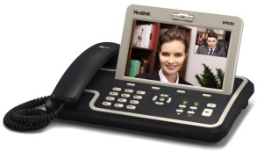



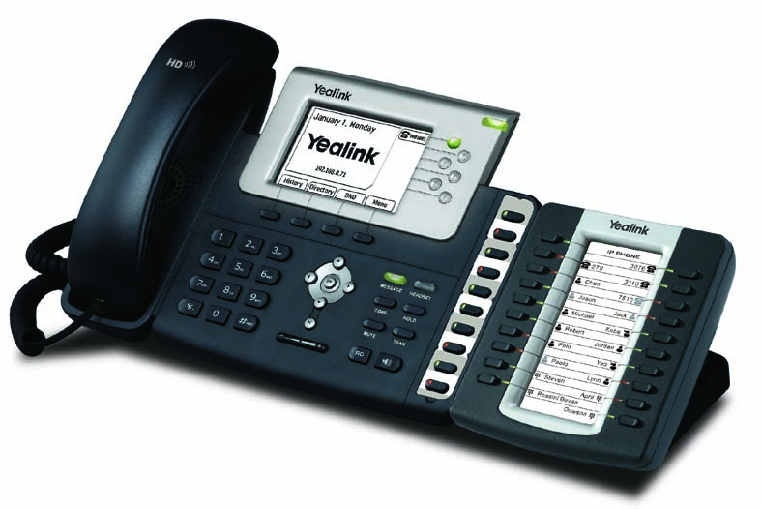


Yealink Solutions
Video Conferencing
VP530
SMB
Executive Management
T38G
Enterprise
Front-Desk / Receptions
T28P + EXP39
Carrier
Network
Desk Phone Applications
T22P
IPCC
Soft-phone/ Skype Calling
USB Handset
One-stop Solution
Notes:
Yealink IP Phone focus on Business market, we can provide an one-stop solution for business market. We have video phone for video call, color IP phone for management, T28 plus expansion module for receptions, T22 or T20 for desk phone applications, and the usb phone which can work together with soft phone

Slide 36
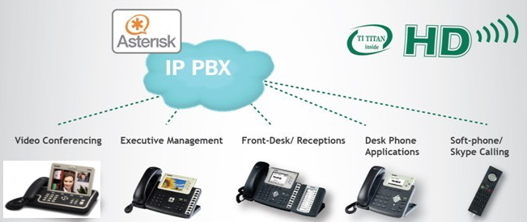





SMB Solution
Features for SMB
BLF/BLA
Voice mail
Intercom/Paging
Call pickup/park
Dial plan
Call recording
Auto provision
……
Certified by the leading IP-PBX
…
Notes:
Yealink already have a great success in SMB market, we have all the leading IP-PBX certificated in SMB market such as asterisk, 3CX

Slide 37





Enterprise Solution
Features for Enterprise
LDAP phonebook
XML browser/screen
Open VPN
Push XML
LLDP
TLS/SRTP/HTTPS
……
Certified by the leading system
…
Notes:
Yealink IP Phone support many enterprise features like LDAP，XML，VPN. And many security features like TLS, SRTP, HTTPS,802.1x to ensure Yealink phone can fulfill with enterprise requirement

Slide 38





Carrier Solution
Yealink is Broadsoft Technology Partner
Fully compatible with Broadworks
Features for Broadsoft
BW Device Management support
TR069, SNMP
BW Features Synchronization (DND, FWD, ACD)
Busy Lamp Field(BLF)
Shared Call Appearance(SCA)
DNS SRV Lookup
Network conference
Network call logs
Network phonebook
……
More than 20 Carrier Customers
…
Notes:
In Carrier Market，Yealink IP Phone is full compatible with Broadsoft features, we have broadsoft validated. Yealink is the technology partner of BSFT.
We have many famous carrier customers like Telefonica, PCCW, KPN, they all use Yealink phone and BroadSoft server.

Slide 39





IP Contact Center Solution
Passed the IOT with Genesys and Cosmocom.
Features for IPCC
Auto Call Distribution (Login/Logout)
Status control (Available/Unavailable)
Status synchronization
Hot-desking
Action URL
Action URI
Call pickup
Intercom
……
Compatible with the Leading System
…
Notes:
Yealink have passed the IOT with the Genesys and cosmocom which is the leading IP-PBX in IPCC market

Slide 40
Business Cases

Slide 41











Business Cases
UN Governments
HSBC Bank
UOB Bank
Ping An Group
T-Mobile
China Mobile
State Grid
Pizza Hut
……
Qatar Airline
South Africa Subway
Dubai 5-star Hotel
Notes:
Yealink phones are deployed in these government organizations, for example…
So our phones involves in all walks of life.

Slide 42
Compare To Competitors

Slide 43
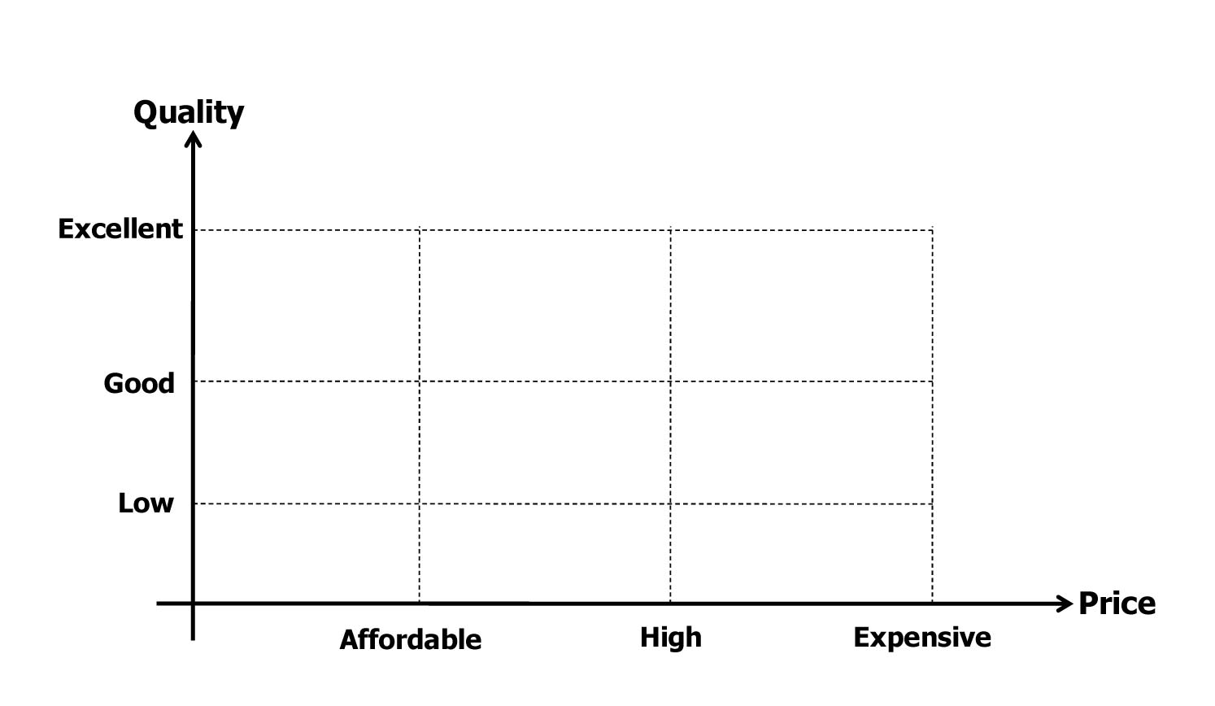







Yealink Position
Notes:
You can see Yealink position in this picture, Yealink provide a high quality production and with an affordable price

Slide 44

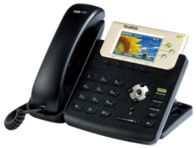
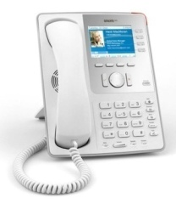
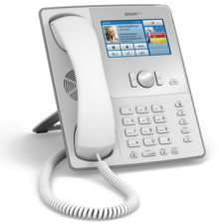

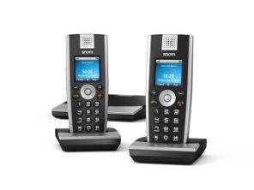
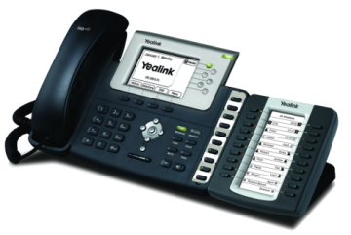
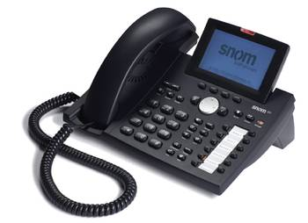
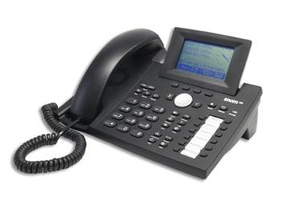
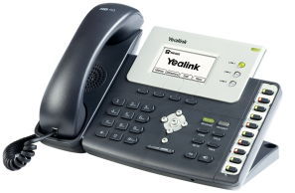

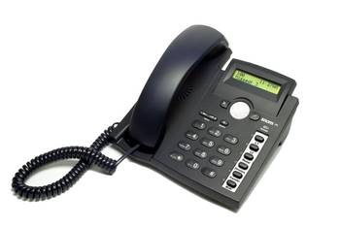
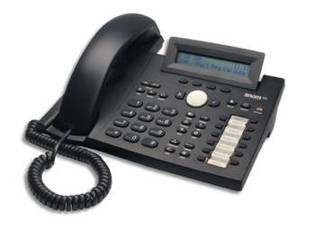

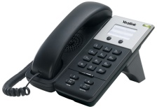
SNOM
Yealink Phone
SNOM Phone
Notes:
The family of Yealink phone and SNOM phone 德国

Slide 45
Compare to SNOM
Save xx% cost
Rapid technical support
Easy to use
Broad interoperability
Notes:
Yealink phone have the same quality and same features as SNOM phone. the main advantage of Yealink phone is the price, technical support, easy to use and deploy .

Slide 46
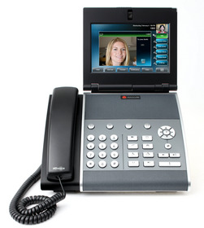

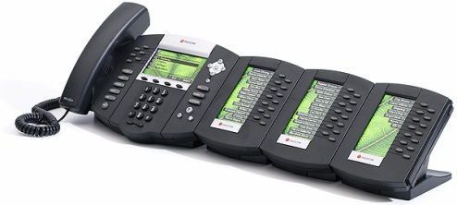
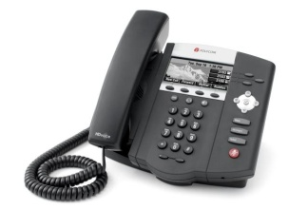
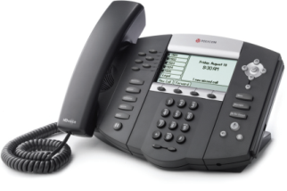
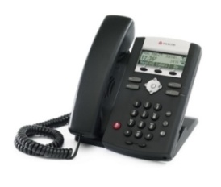
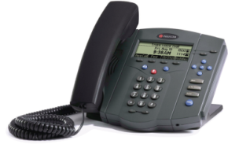
Polycom
Yealink Phone
Polycom Phone
Notes:
美国

Slide 47
Compare to Polycom
Save xx% cost
Rapid technical support
Easy to use and deploy
Notes:
The price of Yealink phone is around 50% of Polycom phone’s price. And as we all know, the polycom phone is not that easy to use, the UI of polycom phone is not friendly, in polycom phone, every single configuration change need to reboot the phone, and the reboot time is very long.

Slide 48






Aastra
Yealink Phone
Aastra Phone
Notes:
Canada

Slide 49
Compare to Aastra
Save xx% cost
Rapid technical support
Broad interoperability
Notes:
And compare to Aastra ,our main advantage is more cheaper ,and more rapid technical support .

Slide 50
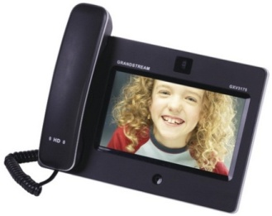
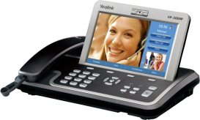
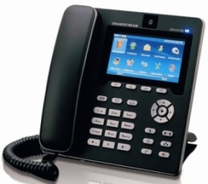
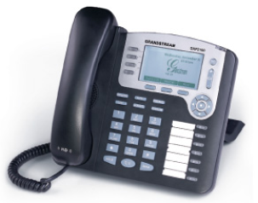





Grandstream
Yealink Phone
Grandstream Phone
Notes:
One chinese company ， they go public on American and this is their phone family conparison

Slide 51
Compare to Grandstream
High quality
More powerful features
Rapid technical support
Notes:
The main advantage compare to Grandstream is the high quality ,yealink have better voice quality and more powerful features like xml feature ,ACD .

Slide 52








Cisco/Linksys
Yealink Phone
Cisco/Linksys Phone

Slide 53
Compare to Cisco
Save xx% cost
Rapid technical support
Broad interoperability
Notes:
Compare to Cisco, the price is more cheaper than Cisco. And Cisco IP phone always sales combined with their own server, Cisco phone not compatible well with other IP-PBX, so yealink have the broad IOT

Slide 54




Panasonic
Yealink Phone
Panasonic Phone

Slide 55
Compare to Panasonic
Save xx% cost
Rapid technical support
Easy to use
Broad interoperability
Notes:
Siemens phones only can works with their own PBX hi-path, as we tested, Siemens phones even can’t use in 3cx, phxnSIP server.

Slide 56

Thank you!
Notes:
Q & A

