Slide 1

How to Do Technical Support
Notes:
If you have any questions during the meeting, you can write down the page and your questions in our chat window, and we will answer all of your questions at the end of the meeting.

Slide 2

Agenda
Find an Answer
Feedback to Yealink
Highlight of Yealink Phone
Business Cases
Auto Provisioning
RPS

Slide 3

Find an Answer

Slide 4

Find an Answer
Website
Specification
Homologation
Forum
FAQ

Slide 5
Download From Yealink Website
● Firmware
● DataSheet
● Features manual
…
Download:
http://www.yealink.com/SupportDownloadfiles_detail.aspx?ProductsID=61&CateID=184&parentcateid=

Slide 6
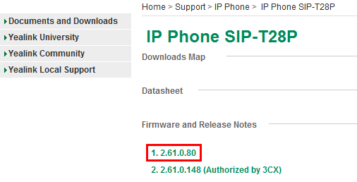
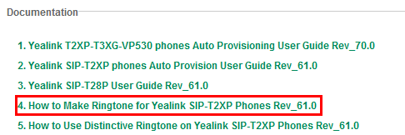
Download From Yealink Website
Q1: Could you send me the latest T28P firmware?
Q2: How can I upload my custom ringtone?

Slide 7
Specification
● Features supported
● Phonebook entries
● Headset port standard
…
Download:
ftp://yealinkftp:yealinkftp@ftp.yealink.com/Training/Specification/

Slide 8
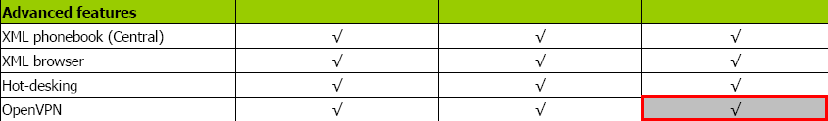
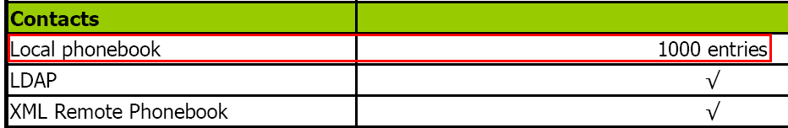
Specification
Q1: Does Yealink T22P support VPN in V70 firmware?
Q2: How many local phonebook entries can VP530 support?

Slide 9
Homologation
● All tested platform-Yealink Interop List
● Configuration guide
● Certification
Download:
ftp://yealinkftp:yealinkftp@ftp.yealink.com/Training/Homologation

Slide 10
Homologation
Carrier Solution |  | IP-PBX for SMB |  | Hard Phone and Soft phone
Broadsoft |  | 2N |  | Aastra
Cisco |  | 3CX |  | AudioCodec
Ericsson |  | Asterisk |  | Avaya
Huawei |  | Brekeke |  | Cisco
Alcatel-Lucent |  | Critical Edge Box |  | Counterpath
Nokia-Siemens |  | Datus |  | Dlink
Nortel |  | Digium SwitchVox |  | Doro
ZTE |  | Elastix |  | Firefly
Metaswitch |  | Epygi |  | Grandstream
VoipSwitch |  | Freeconet |  | LG
 |  | IP Brick |  | Linksys
Enterprise Solution |  | IPCortex |  | Nortel
Altigen |  | PBXnSIP |  | Planet
Avaya |  | PolySpeak |  | Polycom
Dasan |  | Sangoma |  | Radvision
eOn |  | Siptel |  | Samsung
Fujitsu |  | Starface |  | Siemens
ITS |  | TalkSwitch |  | SJ phone
NEC-Phillips |  | Teleware |  | Snom
Nortel SCS |  | Trixbox |  | Thomson
Panasonic Communications |  | Xorcom |  | Vocal
Tadiran |  | Yeastar |  | VoIPBuster
Teltronics |  | Zultys MX250 |  | Voip Switch

Slide 11
Homologation
Q1: How to configure BLF feature of BroadWorks?
A1: Please refer to the guide
“Using Integrated Features on BroadWorks-V1.0.pdf”
Q2: Do you have configuration guide for Cisco Call Manager?
A2: Sorry we don’t have such guide, but you can test first, any question please let us know, we will try our best to solve the problem ASAP.

Slide 12
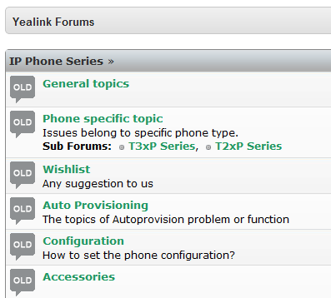
Yealink Forum
Q: I have some technical issues, how can I report these issues?
A:
1. Report your issue to Yealink Forum
http://forum.yealink.com/forum/?Cate_Id=
271&CateId=271&NewsCateId=271&Produ
ctsCateID=271
Support@yealink.com
2. Contact us directly

Slide 13
FAQ
● Common questions and answers
Download:
http://www.yealink.com/Upload/document/FAQT2X/FAQ- 00064769246.pdf

Slide 14
FAQ
Q: How many expansion modules can be connected to T28\T26?
A: You can connect at most six extension modules to T28\T26. Please note that, when you connect the third expansion module to the phone, you need to connect one more adapter.

Slide 15


Feedback to Yealink

Slide 16

Feedback to Yealink
Bug
New Feature Request

Slide 17
Bug
Model
Latest firmware
Reset to factory default and try
Try other models(Yealink/Other model)
PCAP trace, syslog(level 6), config.bin
Test accounts

Slide 18

Export the files
● PCAP Trace
● Syslog
● Config.bin

Slide 19

PCAP Trace
Export from webpage →Upgrade →Advanced
Captured by Wireshark
Hub/switch mirror
Wireshark.exe
How to use wireshark :
ftp://yealinkftp:yealinkftp@ftp.yealink.com/Training/Feedback%20to%20Yealink/Wireshark/How to use Wireshark.pdf

Slide 20

Syslog-Local
Set Log Level to 6
Reboot
Reproduce

Slide 21
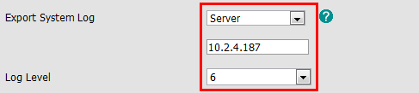
Syslog-Server
Set Log Level to 6
Fill in server IP address
Reboot
Reproduce
How to export the syslog to the server
ftp://yealinkftp:yealinkftp@ftp.yealink.com/Training/Feedback%20to%20Yealink/Syslog/

Slide 22

Config.bin

Slide 23
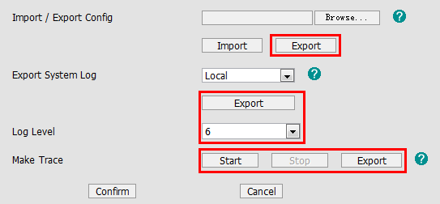
Template
Please access to webpage →Upgrade →Advanced
1.Set Log Level to 6
2.Reboot the phone
3.Click Start
4.Reproduce the issue
5.Click Stop, and export the PCAP trace, syslog, config.bin file

Slide 24
New Feature Request
Application scenarios
Other solutions
Project progress
Time demand
Other brand phone support

Slide 25
How to Judge Priority
What’s the status of the project?
Pre-sale:
Bidding
First round testing
Last round testing
Deploying
After-sale:
Can’t use the phone
Many customers complain
…

Slide 26

Highlight of Yealink phone

Slide 27
Highlight of Yealink phone
Yealink Phone
TI Solution
HD Voice
Broad IOT
Easy to Deploy
Easy to Use
Technical support

Slide 28
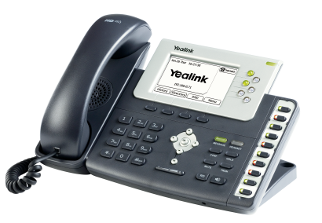
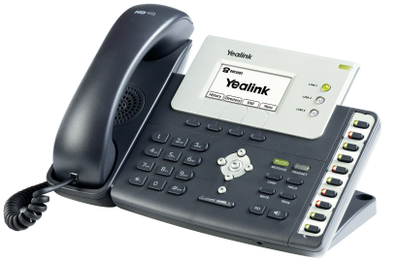
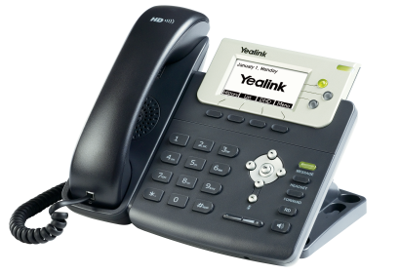
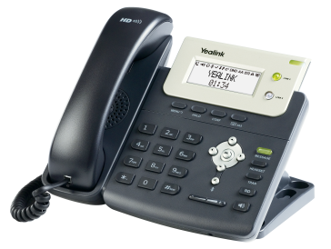
T2xP Series
TI TITAN Chipset
HD Voice Quality
Easy to Use & Deploy
Full Business Features
XML App

Slide 29
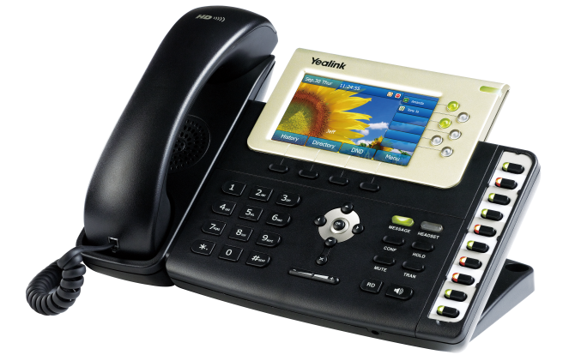
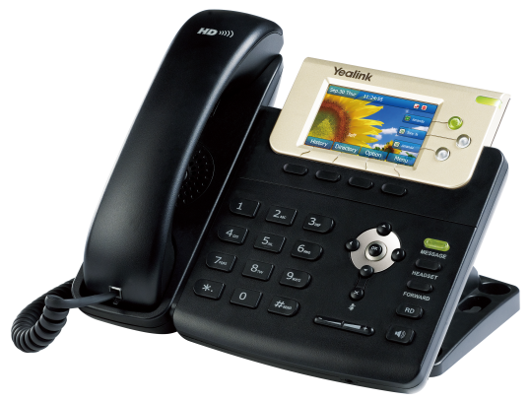
T3xG Series
TI Aries Chipset
Dual-port Gigabit Ethernet
High-Resolution TFT Color Display
Supported Most of Features as T2 Series Supported
The Same SIP Stack/Compatibility as T2 Series Phone

Slide 30
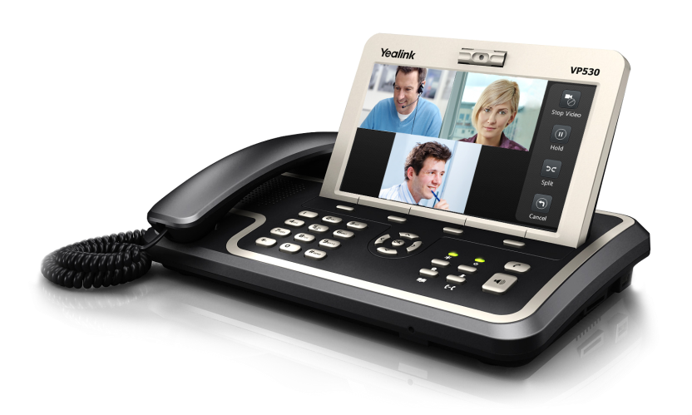
VP530
TI Davinci Chipset
7" TFT-LCD Touch Screen
2M CMOS Camera
3 - Way Video Conferencing
18 Soft DSS-Keys
Intelligent Search Method
XML App

Slide 31
Comparison Table
Polycom
Cisco
Linksys
Aastra
…
Download
ftp://yealinkftp:yealinkftp@ftp.yealink.com/Training/Comparison%20Table/
Only for Distributors

Slide 32

Business Cases

Slide 33

Worldwide Distribution
60+ distributors all over the world

Slide 34












Worldwide Partner
SMB
…
Enterprise
…
Carrier
…
IP Contact Center
…
Notes:
3CX is a PBX based on Windows, it’s popular in SMB field.
Elastix is based on Asterisk-open source.
Broadsoft-BLF list, SCA, ACD…
Now we can compatible with Genesys platform well, we support many features of this platform, for example, Genesys ACD, Business Continuity(redundancy server), and now we are making IOT certification with Genesys.

Slide 35












Worldwide Customers-1
Carrier
Others
…

Slide 36











Worldwide Customers-2
UN Governments
HSBC Bank
UOB Bank
Ping An Group
T-Mobile
China Mobile
State Grid
Pizza Hut
……
Qatar Airline
South Africa Subway
Dubai 5-star Hotel
Notes:
Yealink phones are deployed in these government organizations, for example…
So our phones involves in all walks of life.

Slide 37

Auto Provisioning

Slide 38
Auto Provisioning
What
How
Example
M7(V70)

Slide 39
What
Mass deployment
Plug and Play
Common.cfg
Mac.cfg-Account
Notes:
When you put common.cfg and mac.cfg file to the auto provision server at the same time, the phone will first download common.cfg, and then mac.cfg.
So if there’s same parameter in common and mac cfg file, the phone will get the value from mac cfg file.

Slide 40
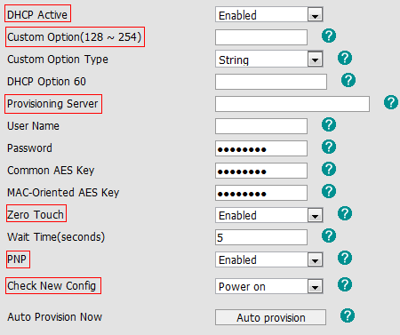
How
Zero-Sp-Touch
PnP Server
DHCP Custom Option
DHCP Option 66
DHCP Option 43
Phone Flash
(HTTP/HTTPS/TFTP/FTP)
Notes:
This is the flow when the phone power on.
First it will detect Zero-Sp-Touch, if you enabled Zero Touch option, after the phone boot up, the phone will ask you to set your network environment, and fill the auto provision server URL, so you don’t need to access to your webpage to configure these.
If ZST is disabled, the phone will detect PnP server, if you enabled PNP option. the phone will send SIP SUBSCRIBE messages to a multicast address when it boots up. Any SIP server understanding that message will reply with a SIP NOTIFY message containing the Auto Provisioning Server URL where the phones can request their configuration.
DHCP Custom Option, A valid Custom Option is from 128 to 254. The Custom Option Type must be in accordance with the one defined in the DHCP server

Slide 41
The Name of CFG File
Phone Model | Common Configuration File
SIP-T28(P) | y000000000000.cfg
SIP-T26(P) | y000000000004.cfg
SIP-T22(P) | y000000000005.cfg
SIP-T20(P) | y000000000007.cfg
SIP-T12(P) | y000000000008cfg
SIP-T18(P) | y000000000009.cfg
SIP-T38G | y000000000038.cfg
SIP-T32G | y000000000032.cfg
VP530 | y000000000023.cfg
Auto Provisioning User Guide
-V61 or lower version:
http://www.yealink.com/Upload/document/YealinkT2XPT3XGVP530phonesAutoProvisioningUserGuide/YealinkSIPT2XPphonesAutoProvisionUserGuideRev_610-21130127888.zip

Slide 42
Example
1. How to upgrade firmware(V61)
ftp://yealinkftp:yealinkftp@ftp.yealink.com/Training/Autop/Upgrade Firmware via Auto Provision.pdf
2. Set DSS Key 1 to BLF
Search “BLF” in Common.cfg
#Configure Memory Key1
memorykey.1.line = 0
memorykey.1.value = 102
memorykey.1.type = 16

Slide 43
M7
V70 Upgrading Manual
Template
CCT tool
Download:
http://www.yealink.com/Upload/document/YealinkT2XPT3XGVP530phonesAutoProvisioningUserGuide/YealinkT2XPT3XGVP530phonesAutoProvisioningUserGuideRev_700-02264277235.zip

Slide 44
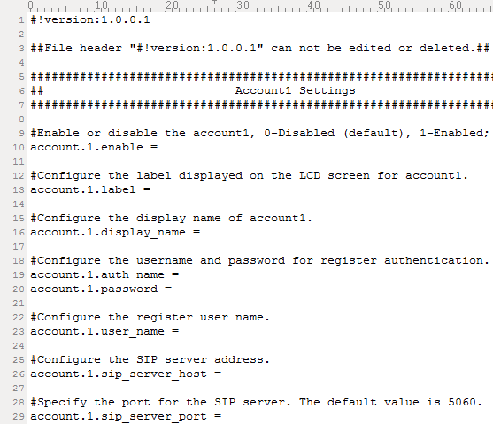
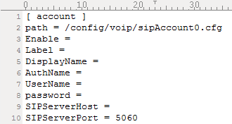
M7 Template
M7 -Unified V70 template of T2x/T3x/VP530
M1/ M2--- T2x/ T3x old template
M7
M1

Slide 45
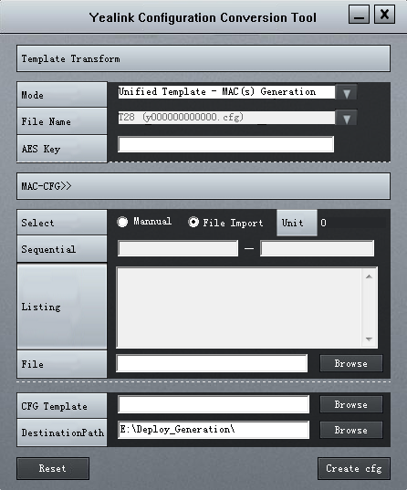
CCT Tool
Yealink Configuration Conversion Tool——”CCT”
①Convert M1/M2 to M7
②Generate Mac.cfg files
in batch automatically

Slide 46

RPS
(Redirection and Provisioning Service)

Slide 47
RPS
Challenges in SP Market
How RPS Works
Benefits of Using RPS

Slide 48
Challenges in SP Market
PO/AutoP URL /Address…
Service Provider
Distributor
Unpack + Configure + Pack
Purchase Order
Ship Phones
Customer
Service Provider
Complex PO information sending
Security hazard
Distributor
Troublesome unpacking process
Complicated manual phone configuration

Slide 49




Yealink Perfect Solution
Redirection & Provisioning Service
Hosted cloud servers

Slide 50
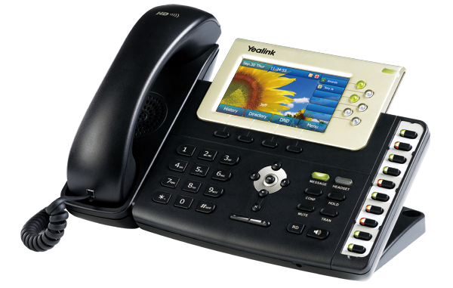
How RPS works
Service Provider
Simple PO information
Distributor
  Directly ship phones
Unpack+Configure+Pack
Registration of
the phone
Zero-touch config
Customer
Notify config server URL
RPS servers
Contacting RPS upon boot-up
Phone A

Slide 51
Benefits of using Yealink RPS
Simplified deployment — Customer Plug and Play installation
Savings of time and money — Direct shipping to customers
Reduced configuration errors — No manual configuration

Slide 52

Q&A
Thank you!

