Slide 1

Yealink Phone Features
The Global TOP5 Sip Phone Supplier

Slide 2

Agenda
Basic Features
Advanced Features

Slide 3

Basic Features

Slide 4
Basic Features
Call Transfer
Speed Dial
BLF
Pick Up
Call Park/Retrieve
Intercom
Voice Mail
Call Completion
SMS
Multicast Paging
Music on Hold
…

Slide 5

Call Transfer
Scenarios: A→B→C
Blind Transfer
B press Transfer+ C + Transfer/Hang up
Semi-attended Transfer
B press Transfer+ C + OK/SEND, when C is ringing, B hang up
Attended Transfer
B press Transfer+ C + OK/SEND, after C answered, B talk with C, then B press Transfer/Hang up

Slide 6
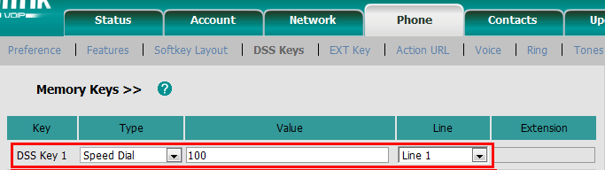
Speed Dial
Access to webpage →Phone →DSS Keys

Slide 7
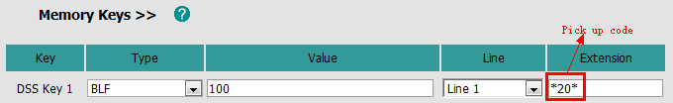
Busy Lamp Field(BLF)
101 monitor 100
102 call 100
Basic
DSS key
Notes:
BLF allows one or more specific users to be monitored for status changes. For example, you can configure BLF on a supervisor’s phone for monitoring the status of a user’s phone, to check whether he is busy or idle.
But with this method, when you press DSS key to pick up the call, you only can see the number 100, but can’t see who make the call.
So our V70 firmware improve this feature.

Slide 8
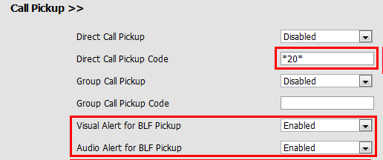
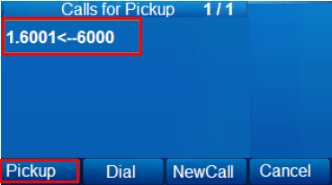
Busy Lamp Field(BLF)
Advanced(V70)
1. DSS key
2. Phone→ Features→ Call Pickup
Notes:
When there’s an incoming call on your monitor account, you will see in your LCD, that who make the call, and call who, then you can decide whether pickup it or not. This is just a simulated LCD to make you understand better.

Slide 9
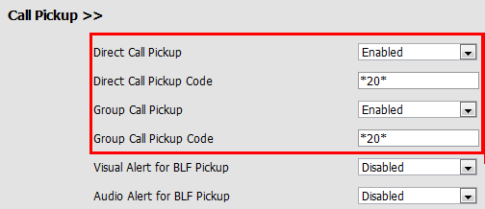

Pick Up
Direct/Group Pick Up: *20*
Incoming call→ Off hook→DPickup/Gpickup→Extension→ DPickup/Gpickup
Notes:
We also improve pick up feature.
Direct pickup is used for picking up an incoming call on a specific extension. A user can pick up the incoming call by pressing a pickup DSS key directly or off hook and press DPickup soft key, then input the extension of the ringing phone and then pressing DPickup soft key again.
Group pickup is used for picking up incoming calls within a pre-defined group. If the group receives multiple incoming calls, a user picks up the first incoming call.
This feature is for some people who is used to the traditional phone, they pick up after off hook.

Slide 10
Call Park/Retrieve
Call park allows a user to park a call at a special extension and then retrieve it on any other phone in the system.
Phone A-Call Park: *01
Phone B-Call Retrieve: *11 or dial *11 directly
Notes:
Call park allows a user to park a call at a special extension and then retrieve it on any other phone in the system.
This feature is different from hold feature, for example, you receive a call, and you need to check something in another office, then you can press call park DSS key, and go to another office, after you check, you press retrieve code and continue to talk with him. If you hold the call, after you check the information, you still need to back to unhold the call.

Slide 11
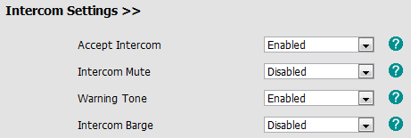
Intercom
Intercom: *9
Phone→ Features→ Intercom Settings
Notes:
Intercom allows establishing a two-way audio conversation directly.

Slide 12

Voice Mail
Webpage→ Account → Advanced

Slide 13
Call Completion
When a call fails, the call completion feature allows notifying the caller when the callee becomes available to receive a call→ Need server support
Not answer
Busy
Reject the call
Phone→ Features→ General Information
Wait for 100? Ok/Cancel
Dial 100? Ok/Cancel

Slide 14
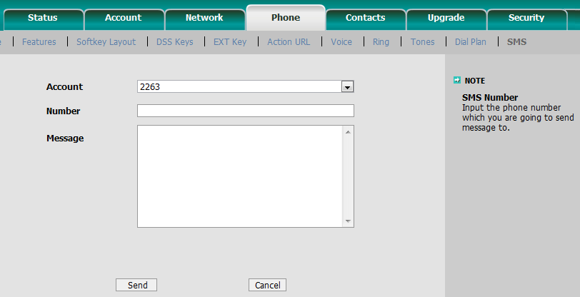
SMS
Access to webpage → Phone→ SMS
Notes:
Account: your VOIP account
Number: the number you want to send message to
Message: the message contents you want to send

Slide 15
Multicast Paging
Users can configure a multicast paging key on the IP phone, which is used to send/receive a Real-time Transport Protocol (RTP) stream to/from the pre-configured multicast address(es) without involving SIP signaling.
Each IP phone can listen to as many as 10 different multicast IP addresses.

Slide 16
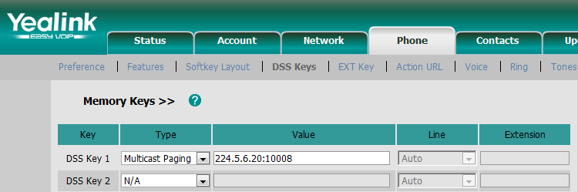
Multicast Paging-Send
DSS Key:
Access to webpage →Phone →DSS Keys →Memory Keys
Codec:
Access to webpage →Phone →Features →General Information
Notes:
The IP phone can send an RTP stream without involving SIP signaling by pressing a multicast paging key. The multicast paging key is assigned a multicast address (IP: Port), which can be defined to transmit the RTP stream to a group of designated phones. When the IP phone sends the RTP stream to a preconfigured multicast address,each IP phone that has been configured to listen to the multicast address can receive the RTP stream.When the originator stops sending the RTP stream, the IP phones stop receiving the RTP stream.

Slide 17
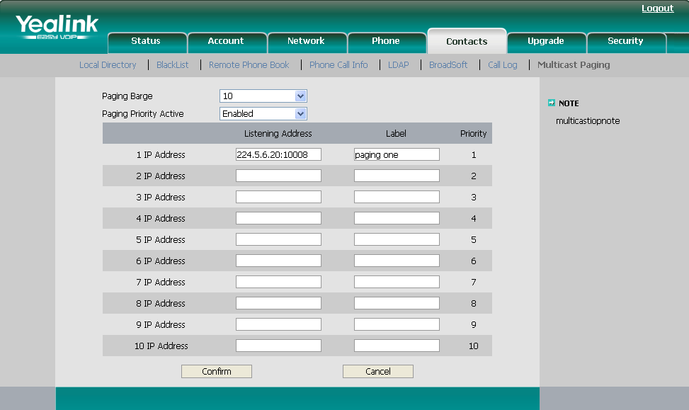
Multicast Paging-Receive
Access to webpage →Contacts →Multicast Paging
Notes:
The IP phone can handle the incoming multicast paging calls differently depending on the configurations
Paging Barge
The parameter defines the priority of the voice call in progress, which can decide how the IP phone handles the incoming multicast paging callswhen there is already a voice call on the IP phone.If the parameter is configured as disabled, all incomingmulticast paging calls will be automatically ignored.If the parameter is the priority value, the incoming multicast paging callswith higher priority are automatically answered and the ones with lower priority are ignored.
Paging Priority Active
The parameter decides how the IP phone handles the incoming multicast paging calls, when there is already a multicast paging call on the IP phone. If the parameter isconfigured as disabled, the IP phone will automatically ignore all incoming multicast paging calls.If the parameter is configured as enabled,the incoming multicast paging callswith higher priority are automatically answered and the ones with lower priority are ignored.
of Paging Barge and Paging Priority Active parameters.

Slide 18
Music on Hold
Music on hold (MoH) is the business practice of playing recorded music to fill the silence that would be heard by the party who has been placed on hold.
Account→ Advanced→ Music on Hold Server
Format:
<10.1.3.165>
10.1.3.165
<sip:moh@ucap.com>
sip:moh@ucap.com
<yealink.com>
yealink.com

Slide 19

Advanced Features

Slide 20
Advanced Features
Phonebook
APP/API
Security
Call Center

Slide 21
Phonebook
Local Phonebook
Remote Phonebook
LDAP
Broadsoft Phonebook

Slide 22
Local Phonebook

Slide 23
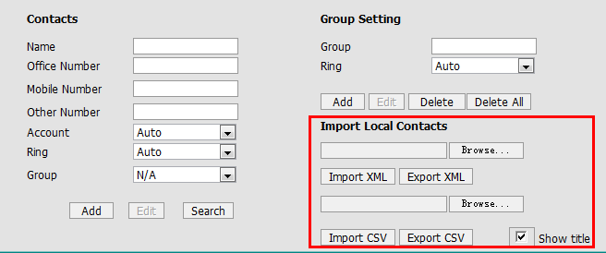

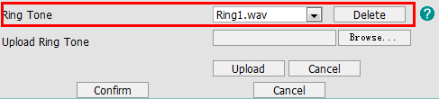
Local Phonebook
Webpage →Contacts →Local Directory
Account →Basic Phone →Preference
2
1
4
3

Slide 24
Remote(XML) Phonebook

Slide 25
Remote(XML) Phonebook
Remote phonebook is the IP phone book maintained centrally, which is stored on the remote server. The IP phone can establish a connection with the remote server and download the entries, and then display the entries on the phone user interface.
User manual download:
ftp://yealinkftp:yealinkftp@ftp.yealink.com/Training/AdvancedFeature/XML%20Phonebook/

Slide 26
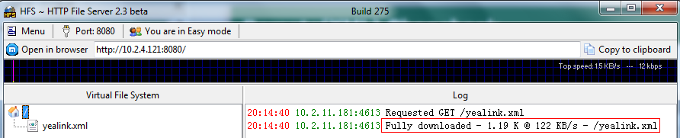
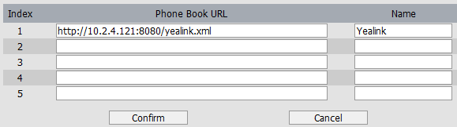
Remote(XML) Phonebook
<500kb

Slide 27

Remote(XML) Phonebook
Phone→ Features→ General Information
Can display the name of remote phonebook contacts
Only VP530 support search
Notes:
When there’s an incoming call, and caller name is stored in your xml phonebook, you want to see his name displayed on the LCD, you can enable this SRemote name option.
The SRemote Name Flash Time feature defines how often the IP phones refresh the local cache of the remote phonebook.

Slide 28
Remote(XML) Phonebook
Sales.xml- Direct Contacts
<YealinkIPPhoneDirectory> \\Change Company Name
<DirectoryEntry>
<Name>Jack</Name> \\Change Name
<Telephone>1110</Telephone> \\Extension number
<Telephone>18676762325</Telephone> \\Telephone number
</DirectoryEntry>
<DirectoryEntry>
……
</DirectoryEntry>
<SoftKeyItem> \\Shortcut Keys
<Name>0</Name> \\Keys Number
<URL> http://10.2.4.121:8080/sales.xml </URL> \\Server Address
</SoftKeyItem>
</YealinkIPPhoneDirectory>
Notes:
You can just modify the red words.
You can also set the shortcut key, for example, set “0” as the shortcut keys, if you press “0”, it will go to sales.xml file.

Slide 29
Remote(XML) Phonebook
Yealink.xml-Group Contacts
<YealinkIPPhoneMenu> \\Change Company Name
<Title>Yealink</Title> \\Company Name
<MenuItem>
<Name>Sales</Name> \\Group Name
<URL> http://10.2.4.121:8080/Sales.xml </URL> \\Server Address
</MenuItem>
<MenuItem>
<Name>Marketing</Name> \\Group Name
<URL> http://10.2.4.121:8080/Marketing.xml </URL> \\Server Address
</MenuItem>
……
<SoftKeyItem>
<Name>0</Name>
<URL> http://10.2.4.40:9/sales.xml </URL>
</SoftKeyItem>
</YealinkIPPhoneMenu>
Notes:
About XML phonebook, many customer want to use search feature, and for some large enterprise they need to support more contacts, at this time, XML phonebook can’t meet their requirement. So we can suggest LDAP for them.

Slide 30
LDAP

Slide 31
LDAP
Lightweight Directory Access Protocol
An application protocol for accessing and maintaining distributed directory information services over an Internet Protocol (IP) network.
● Support LDAP version 2 or 3
● Support Microsoft’s Active Directory
User manual download:
ftp://yealinkftp:yealinkftp@ftp.yealink.com/Training/AdvancedFeature/LDAP/

Slide 32
Network Topology
Client: Control data
Server: Store data and search data
Phones: Require data and display data
Server
Client
Phones
Notes:
There are three main actors in LDAP Phonebook: LDAP Client, LDAP Server and phones.
The client is used to remotely control the data of the server. It can add, delete or modify the contacts data.
The server stores all the contacts data and when the phone requests, it can search the right data and returns them to the phone.
The phone provides the search conditions/information the user enters for the server to search and it will display the data returned from the server.

Slide 33
Advantages
Searching fast
No limitation Contacts
Easy to manage(modify in the server)
DSS Key:
Notes:
Faster Searching:
The phone doesn’t need to download all the contact data to local and the server would return the right data to the phone directly one by one.
No limitation:
There is no limitation in LDAP Phonebook, but the size of XML Phonebook should be not more than 500K.
Easy to manage:
If you need to add, delete or modify data, you just need to edit in the server and there is no need to do any changes on the phone.

Slide 34
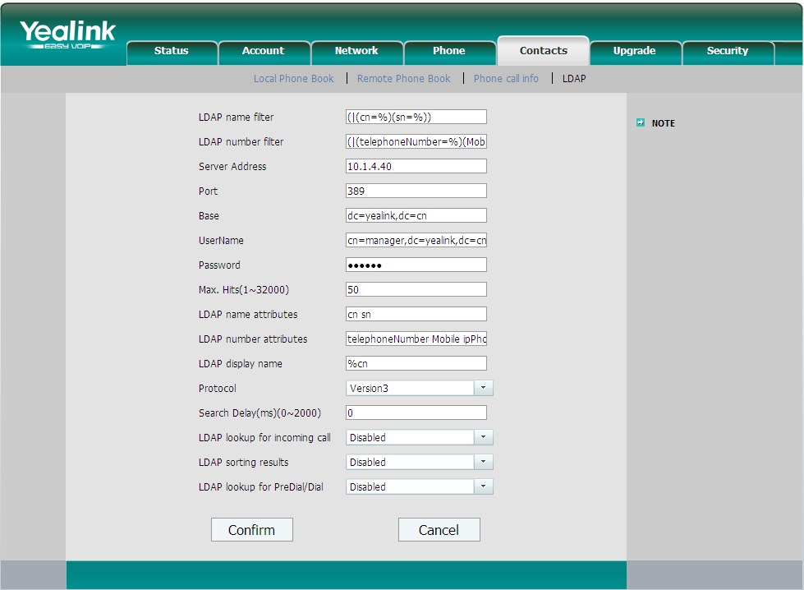
Phone Setting
Notes:
LDAP lookup for incoming call
If you enable this, when there’s incoming call, the phone LCD will display the caller ID.
LDAP Sorting Results
This setting is for sorting the search results, if make this option “Enabled”, it will arrange in the first alphabetical of the name order if server return the name display; if only return the number display, it will list in numerical order.
LDAP Lookup for PreDial/Dial
This setting can be used to enable call out line identification using LDAP. When the setting is turned “Enabled”, the phone performs an LDAP number search for PreDial or Dial status.

Slide 35
Phone Setting
Configuration Items | Description
LDAP name filter | LDAP name filter is the search criteria for name look ups.
LDAP number filter | LDAP name filter is the search criteria for number look ups.
Server Address | This setting refers to the DNS name or IP address of the LDAP server.
Port | This setting specifies the LDAP server port. The default value is 389.
Base | This setting specifies the LDAP search base (the distinguished name of the search base object) which corresponds to the location in the directory from which the LDAP search is requested to begin.
Username | This setting specifies the bind “Username” for LDAP servers.
Password | This setting specifies the bind “Password” for LDAP servers.
Max. Hits | This setting specifies how many results would return to the phone
LDAP name attributes | This setting can be used to specify the “name” attributes of each record which are to be returned in the LDAP search results.
LDAP number attributes | This setting can be used to specify the “number” attributes of each record which are to be returned in the LDAP search results by the LDAP server.
LDAP display name | This setting is for showing the entry information on the screen.

Slide 36
Phone Setting
Protocol | Protocol is the protocol version for the phone when send the bind request to the server. The default value is Version 3.
Search Delay(ms)(0~2000) | This setting is for configuring the delay display time after search.
LDAP lookup for incoming call | This setting can be used to enable calling line identification using LDAP. When the setting is turned “Enable”, the phone performs an LDAP number search for the incoming number and displays the name of the calling party accordingly.
LDAP Sorting Results | This setting is for sorting the search results, if make this option “Enabled”, it will arrange in the first alphabetical of the name order if return the name display; if only has the number return, it will list in numerical order.
LDAP Lookup for PreDial/Dial | This setting can be used to enable call out line identification using LDAP. When the setting is turned “Enabled”, the phone performs an LDAP number search for PreDial or Dial status.

Slide 37
BroadSoft Phonebook

Slide 38
BroadSoft Phonebook
Access the BroadSoft directory through your IP phone
Add contacts from the BroadSoft directory to your local directory
Dial a number from the BroadSoft directory
Access up to 6 BroadSoft directories
Support Enterprise Directory/ Group Directory/ Personal Directory
Notes:
You can access the BroadSoft directory through the IP phone. You can add contacts from the BroadSoft directory to your local directory. You can also dial a contact from the BroadSoft directory. The BoradWorks server provides four types of directory: Enterprise Directory, Group Directory, Personal Directory and Common Directory. The Common Directory is not supported by Yealink IP phones.
Yealink phong can support maximum 6 Broadsoft directories .
About the introduction for every kind of directory ,you can refer to the documents which we will sent you after training ,the manual also contains the phonebook configuration on BroadWorks .

Slide 39
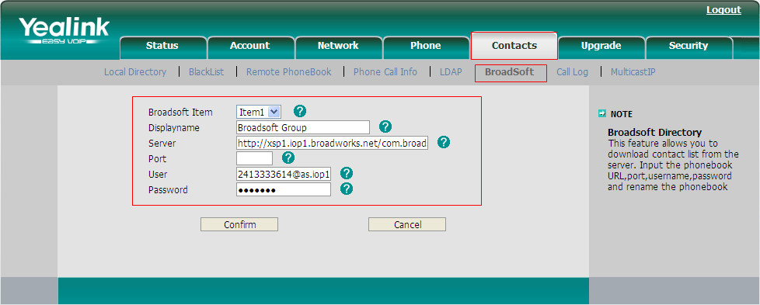
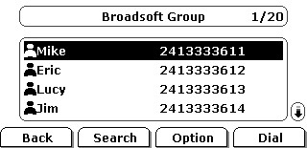
Configuring BroadSoft Phonebook
Browse to webpage →Contacts →BroadSoft
LCD: Press Directory →Broadsoft
Notes:
For configurating the Broadsoft phonebook ,you need to browser to Contacts->BroadSoft.
And Select the desired BroadSoft item from the pull-down list of BroadSoft Item.
Enter the parameters: display name, server address, port, username and password in the corresponding fields .

Slide 40
APP/API
XML Browser
Action URI
Action URL

Slide 41
XML Browser
User manual download:
ftp://yealinkftp:yealinkftp@ftp.yealink.com/Training/AdvancedFeature/ XML%20Browser/

Slide 42
What is XML Browser
Three ways
Initiated from Phone-DSS Keys
Initiated from Server-Push XML
Initiated by XML SIP Notify
Notes:
This attached picture shows that the work flow for XML browser .it is the phone-initiated application ,and use the HTTP or HTTPS transport protocol .Phone can request the data from server on it own .
You can press the predefined key on phone to trigger the phone initiated application of XML browser. After pressing the key, the IP phone issues an HTTP or HTTPs GET command to the server, and waits for the 200 OK answer with XML document in message body ,phone can decodes and displays the xml document on the LCD screen such as Microsoft Internet Explorer or Firefox would do as a web client.

Slide 43
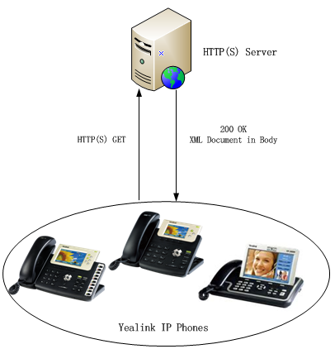
Initiated from Phone-DSS Keys
HTTP(S)
Phone-initiated application
Yealink IP phone acting as a client
Notes:
This attached picture shows that the work flow for XML browser .it is the phone-initiated application ,and use the HTTP or HTTPS transport protocol .Phone can request the data from server on it own .
You can press the predefined key on phone to trigger the phone initiated application of XML browser. After pressing the key, the IP phone issues an HTTP or HTTPs GET command to the server, and waits for the 200 OK answer with XML document in message body ,phone can decodes and displays the xml document on the LCD screen such as Microsoft Internet Explorer or Firefox would do as a web client.

Slide 44
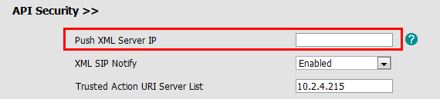
Initiated from Server-Push XML
HTTP(S)
Server-initiated application
Access to webpage→ Phone →Features →API Security
Notes:
Push XML also use the HTTP and HTTPs transport protocol ,but is the server-initiated application .
The end users do not need to do any additional operate. The server alters the XML application by posting an HTTP or HTTPs message to the phone. when phone receives request, it will determine whether to display corresponding content on the phone which sent by the specified server or not.

Slide 45
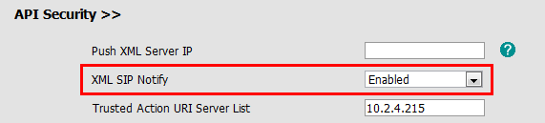
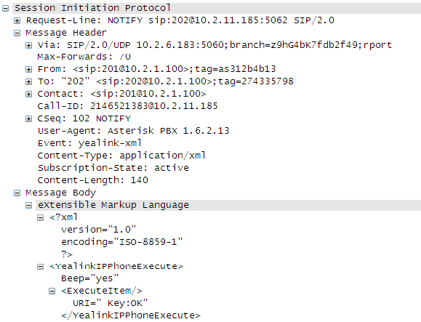
Initiated by XML SIP Notify
Access to webpage→ Phone →Features →API Security
When the phone receives the XML SIP NOTIFY message, the phone will display the information or execute the command in the NOTIFY message.
Notes:
Push XML also use the HTTP and HTTPs transport protocol ,but is the server-initiated application .
The end users do not need to do any additional operate. The server alters the XML application by posting an HTTP or HTTPs message to the phone. when phone receives request, it will determine whether to display corresponding content on the phone which sent by the specified server or not.

Slide 46
Application Scenarios
Practical Applications
Weather report
Stock information
Google search
News service
…
Execute Actions
Reboot the phone
Reset the phone
Changing LED status
…
Configure Phone

Slide 47
XML Object
2 types of XML objects
UI objects: Control the display
Non UI objects: Execute and configure
T3XG/VP530:
• TextMenu (UI)
• TextScreen (UI)
• InputScreen (UI)
• Directory (UI)
• FormattedTextScreen (UI)
• ImageScreen (UI)
• PhoneExecute (non UI)
• PhoneConfiguration (non UI)
• PhoneStatus (non UI)
T2X:
• TextMenu (UI)
• TextScreen (UI)
• InputScreen (UI)
• Directory (UI)
• PhoneExecute (non UI)
• PhoneConfiguration (non UI)
• PhoneStatus (non UI)

Slide 48
Action URL/URI
User manual download:
ftp://yealinkftp:yealinkftp@ftp.yealink.com/Training/AdvancedFeature/Action%20URL-URI/

Slide 49
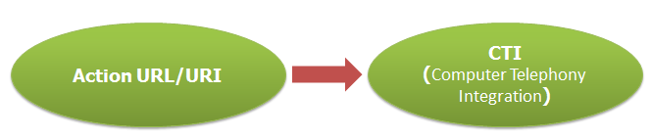
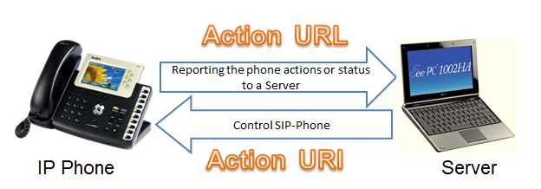
Introduction
Notes:
Action URL & Active URI is a kind of CTI(Computer Telephony Integration) application, allow interactions on a phone and a computer to be integrated.

Slide 50
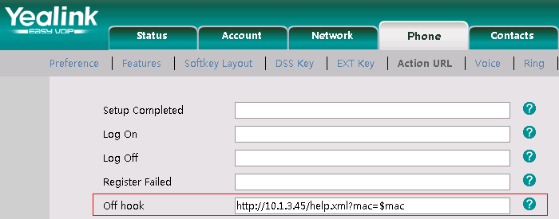
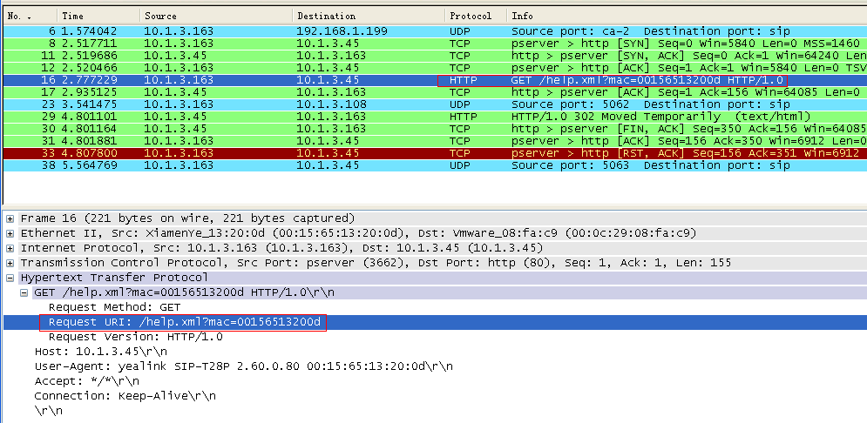
Action URL
Notes:
Action URL is an HTTP GET request allowing the IP phone to interact with web server applications. You can specify a URL that triggers a GET request when certain events occur.

Slide 51
Action URI
Action URI
Input URI in the web browser
1. Trigger pressing the OK button of your phone:
http://10.2.4.234/cgi-bin/ConfigManApp.com?key=OK
2. Make outgoing call:
http://10.2.4.224/cgi-bin/cgiServer.exx?number=765432&outgoing_uri=123123123@10.2.1.199
Destination
Account
Notes:
Opposite to Action URL, Action URI allows the IP phone to interact with web server application by receiving and handling HTTP GET requests. When receiving a URI, the IP phone will perform the specified action and respond with a 200 OK message.

Slide 52
Security
SRTP
TLS
OpenVPN

Slide 53
SRTP
User manual download:
ftp://yealinkftp:yealinkftp@ftp.yealink.com/Training/AdvancedFeature/SRTP-TLS/

Slide 54
SRTP
Secure Real-Time Transport Protocol (SRTP)
It provides means of encrypting the RTP streams during VoIP phone calls to avoid interception and eavesdropping.
The parties participating in the call should enable the SRTP feature simultaneously.
This negotiation process is compliant with RFC 4568.
Access to webpage →Account →Advanced
Per-account basis
lock icon appears on the LCD screen

Slide 55
TLS
User manual download:
ftp://yealinkftp:yealinkftp@ftp.yealink.com/Training/AdvancedFeature/SRTP-TLS/

Slide 56
TLS
Transport Layer Security
TLS is a commonly-used protocol for providing communications privacy and managing the security of message transmission.
Prevent eavesdropping and tampering
Encrypt SIP message
Lock icon appears on the phone LCD screen
Notes:
The TLS protocol is composed of two layers: the TLS Record Protocol and the TLS Handshake Protocol. The TLS Record Protocol completes the actual data transmission and ensures the integrity and privacy of the data. The TLS Handshake Protocol allows the server and client to authenticate each other and negotiate an encryption algorithm and cryptographic keys before data is exchanged.

Slide 57
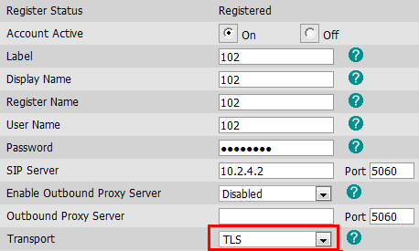
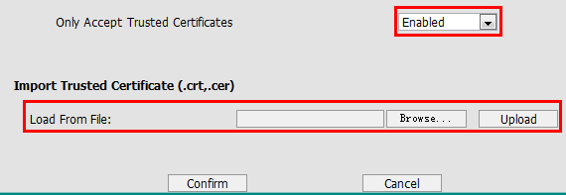
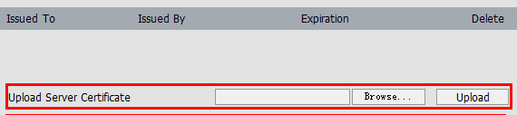
TLS Configuration
1. Account →Basic →Transport →TLS
2. Uploading certificates to the IP phone
Security →Trusted Certificates Security →Server Certificates
Notes:
Trusted Certificate: When the IP phone requests a TLS connection with a server, the IP phone should verify the certificate sent by the server to decide whether the server is trusted based on the trusted certificates list. You can upload up to 10 trusted certificates to the IP phone.
Server Certificate: When the other clients request a TLS connection with the IP phone, the IP phone sends the server certificate to the clients for authentication. You can only upload one server certificate to the IP phone. The old server certificate will be overwritten by the new one.

Slide 58
Open VPN
User manual download:
ftp://yealinkftp:yealinkftp@ftp.yealink.com/Training/AdvancedFeature/Open%20VPN/

Slide 59
What’s VPN
VPN (Virtual Private Network) is a secured private network connection built on top of public telecommunication infrastructure, such as the Internet. It provides remote offices or individual users with secure access to their organization's network.
Scalability
Reliability
Security
Convenience
Notes:
VPN (Virtual Private Network) is a secured private network connection built on top of public telecommunication infrastructure, such as the Internet.

Slide 60
Two Types of VPN
Remote-access VPN
(Connecting an individual device to a network)
Allow employees to access their company's intranet from home or outside the office
Site-to-site VPN
(Connecting two networks together)
Allow employees in geographically separated offices to share one cohesive virtual network.

Slide 61
Open VPN
Open VPN is a full featured SSL VPN software solution that creates secure connections in remote access facilities.
Linux/ Xbsd/ Mac OS X/ Windows 2000/XP
Notes:
It is designed to work with the TUN/TAP virtual networking interface.
TUN and TAP are virtual network kernel devices.
TAP simulates a link layer device and provides a virtual point-to-point connection.
TUN simulates a network layer device and provides a virtual network segment.

Slide 62
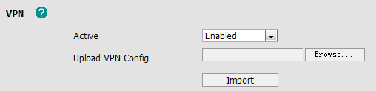
Phone Setting
Access to webpage →Network →Advanced
Client.tar:
Vpn.cnf/ Ca.crt/ Client.crt/ Client.key
V70 can upload the VPN certification via auto provisioning:
network.vpn_enable = 1
openvpn.url =
Click this button, and choose VPN file

Slide 63
Call Center
Hot Desking
ACD
Feature Key Synchronization

Slide 64
Hot Desking
User manual download:
ftp://yealinkftp:yealinkftp@ftp.yealink.com/Training/AdvancedFeature/Hot%20Desking/

Slide 65
Hot Desking
Hot Desking originates from the definition of being the temporary physical occupant of a work station or surface by a particular employee.
Delete all accounts
Register own account
DSS Key- Hot Desking
Notes:
Hot desking is regularly used in places where not all the employees are in the office at the same time, or not in the office for long periods at a time, which means actual personal offices would often be vacant, consuming valuable space and resources.
The hot desking feature allows a user to delete all accounts on the IP phone, register his account on line 1. In order to use this feature, you need to assign a hot desking DSS key.

Slide 66
Automatic Call Distribution(ACD)

Slide 67
What is Automatic Call Distribution
Automatic Call Distribution (ACD) feature is often used in offices for customer service, such as call center.
The ACD system handles incoming calls by automatically queuing and directing calls to available agents. The ACD feature on the IP phone allows the ACD system to distribute calls from large volumes of incoming calls to the registered users.
Notes:
A user needs to press an ACD key to log in the ACD system. The ACD system monitors the ACD status on the user’s phone and then decides whether to assign an incoming call to it. The user can change the ACD status on the IP phone. The ACD key LED on the IP phone indicates the ACD status.

Slide 68
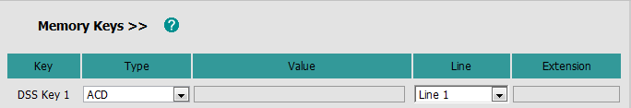
Configuration of ACD
Access to webpage →Phone →DSS Keys →Memory Keys
Notes:
A user needs to press an ACD key to log in the ACD system. The ACD system monitors the ACD status on the user’s phone and then decides whether to assign an incoming call to it. The user can change the ACD status on the IP phone. The ACD key LED on the IP phone indicates the ACD status.

Slide 69
Feature Key Synchronization
Notes:
Now is turn to Feature key synchronization(ˌsiŋkrənaiˈzeiʃən]) .We will only have a simple introduce for this feature in today’s training .For the specific configuration on BroadWorks for this features ,please refer to the manuals which we will send you after training .

Slide 70
Feature Key Synchronization
Feature Key Synchronization provides the capability to synchronize the following BroadWorks feature status with the IP phone
Do Not Disturb(DND)
Call Forwarding Always (CFA)
Call Forwarding Busy (CFB)
Call Forwarding No Answer (CFNA)
ACD state
Remote control the phone features
Notes:
This feature provides the capability to synchronize the following five BroadWorks feature status with the IP phone.
Do Not Disturb/Call Forwarding Always/Call Forwarding Busy/Call Forwarding No Answer /ACD state .
If a user changes the status of one of these features via the BroadWorks web portal or feature access code ,the BroadWorks server will notify the IP phone of the status change. Conversely, if the user changes the feature status on the IP phone, the IP phone will notify the BroadWorks server of the status change.
This function is convenient for user to remote control phone function in server side .

Slide 71
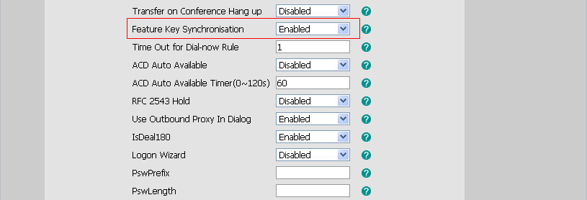
Configuring the Feature Key Synchronization
Browse to Phone →Features
Enabled Feature Key Synchronization
Notes:
For active this feature ,you need to enter into phone setting page and Browser to Phone→Features ,and enabled the Feature Key Synchronization .
For example, when you enable the Feature Key Synchronisation, and active the DND feature by pressing the DND soft key on the IP phone, the IP phone will synchronize the DND state to the BroadSoft user registered on the IP phone. And if DND state is change in BroadWorks , server will notify phone to change the state ,too .

Slide 72


