Slide 1

Yealink Phone Features
The Global TOP5 Sip Phone Supplier

Slide 2

Agenda
Business Cases
Compare to Competitors
RPS
Basic Features
Advanced Features
Auto Provisioning

Slide 3

Business Cases

Slide 4












Worldwide Partners
SMB
…
Enterprise
…
Carrier
…
IP Contact Center
…
Notes:
3CX is a PBX based on Windows, it’s popular in SMB field.
Elastix is based on Asterisk-open source.
Broadsoft-BLF list, SCA, ACD…
Now we can compatible with Genesys platform well, we support many features of this platform, for example, Genesys ACD, Business Continuity(redundancy server), and now we are making IOT certification with Genesys.

Slide 5












Worldwide Customers
Carrier
Others
…

Slide 6
Broad Interoperability
Carrier Solution |  | IP-PBX for SMB |  | Hard Phone and Soft phone
BroadSoft |  | 2N |  | Aastra
Cisco |  | 3CX |  | AudioCodec
Ericsson |  | Asterisk |  | Avaya
Huawei |  | Brekeke |  | Cisco
Alcatel-Lucent |  | Critical Edge Box |  | Counterpath
Nokia-Siemens |  | Datus |  | Dlink
Nortel |  | Digium SwitchVox |  | Doro
ZTE |  | Elastix |  | Firefly
Metaswitch |  | Epygi |  | Grandstream
VoipSwitch |  | Freeconet |  | LG
 |  | IP Brick |  | Linksys
Enterprise Solution |  | IPCortex |  | Nortel
Altigen |  | PBXnSIP |  | Planet
Avaya |  | PolySpeak |  | Polycom
Dasan |  | Sangoma |  | Radvision
eOn |  | Siptel |  | Samsung
Fujitsu |  | Starface |  | Siemens
ITS |  | TalkSwitch |  | SJ phone
NEC-Phillips |  | Teleware |  | Snom
Nortel SCS |  | Trixbox |  | Thomson
Panasonic Communications |  | Xorcom |  | Vocal
Tadiran |  | Yeastar |  | VoIPBuster
Teltronics |  | Zultys MX250 |  | Voip Switch
Notes:
Yealink phone also have a broad interoperability. In this list, you can see Yealink phone can works in almost all the popular IP-PBXs

Slide 7











Cases
UN Governments
HSBC Bank
UOB Bank
Ping An Group
T-Mobile
China Mobile
State Grid
Pizza Hut
……
Qatar Airline
South Africa Subway
Dubai 5-star Hotel
Notes:
Yealink phones are deployed in these government organizations, for example…
So our phones involves in all walks of life.

Slide 8
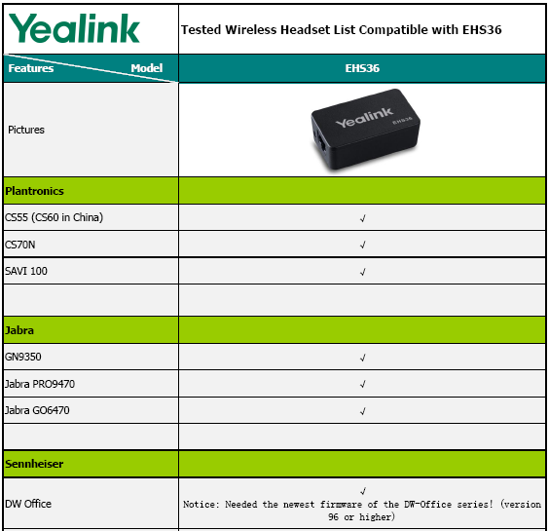
Headset Interoperability
Wire Headset:
T2X/ T3X---RJ-9(YHS32)
VP530---2.5mm
Wireless Headset Adapter：
T28/T26/T38---EHS36

Slide 9
Compare To Competitors

Slide 10
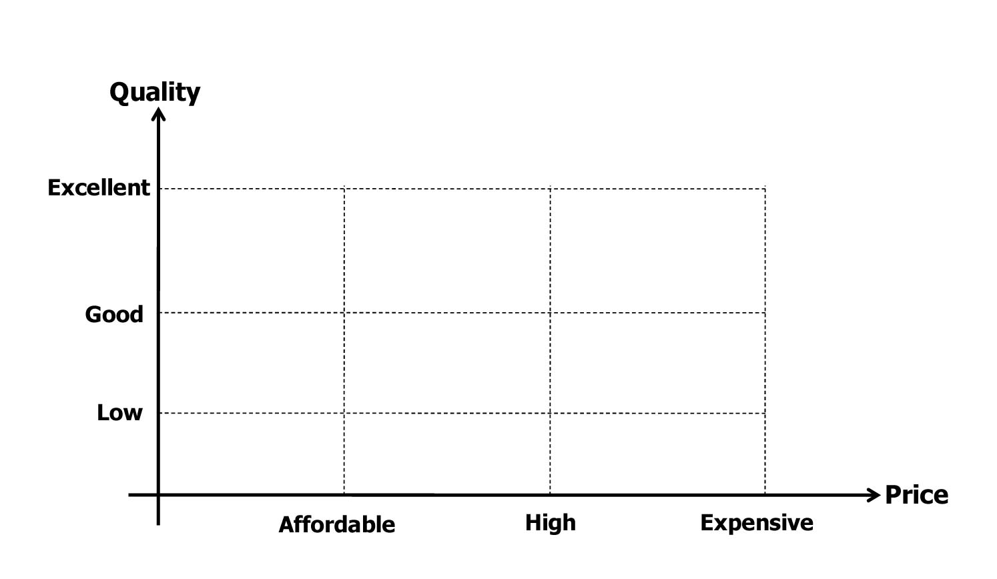







Yealink Position
Notes:
You can see Yealink position in this picture, Yealink provide a high quality production and with an affordable price

Slide 11
Compare to Competitors
Save xx% cost
Rapid technical support
Easy to use
Broad interoperability
Notes:
Yealink phone have the same quality and same features as SNOM phone. the main advantage of Yealink phone is the price, technical support, easy to use and deploy .

Slide 12

RPS
(Redirection and Provisioning Service)
Notes:
RPS is a free service developed for all Yealink customers worldwide. Through RPS, service providers can greatly simplify mass deployments of Yealink phones, save time and money in configuring and shipping phones, reduce errors caused by complicated manual configuration.

Slide 13
Challenges in SP Market
PO/AutoP URL /Address…
Service Provider
Distributor
Unpack + Configure + Pack
Purchase Order
Ship Phones
Customer
Service Provider
Complex PO information sending
Security hazard
Distributor
Troublesome unpacking process
Complicated manual phone configuration

Slide 14




Yealink Perfect Solution
Redirection & Provisioning Service
Hosted cloud servers

Slide 15
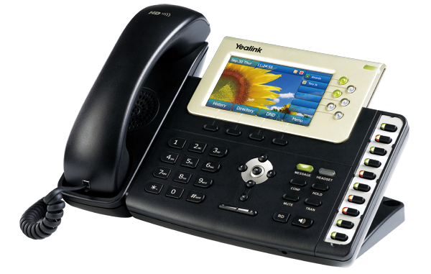
How RPS works
Service Provider
Simple PO information
Distributor
  Directly ship phones
Unpack+Configure+Pack
Registration of
the phone
Zero-touch config
Customer
Notify config server URL
RPS servers
Contacting RPS upon boot-up
Phone A

Slide 16
Benefits of using Yealink RPS
Simplified deployment — Customer Plug and Play installation
Savings of time and money — Direct shipping to customers
Reduced configuration errors — No manual configuration

Slide 17

Basic Features

Slide 18
Basic Features
Call Transfer
BLF
Pick Up
Call Park/Retrieve
Intercom
Call Completion
SMS
Multicast Paging
…

Slide 19
Call Transfer
Scenarios: A→B→C
Blind Transfer
B press Transfer+ C + Transfer/Hang up
Semi-attended Transfer
B press Transfer+ C + OK/SEND, when C is ringing, B hang up
Phone →Features →Transfer Settings
Attended Transfer
B press Transfer+ C + OK/SEND, after C answered, B talk with C, then B press Transfer/Hang up

Slide 20
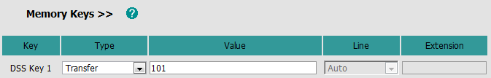

Transfer via DSS Key
Access to Phone → DSS Keys → Memory Keys
Access to Phone Features → Transfer Settings

Slide 21
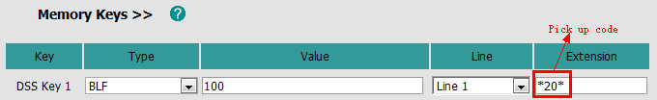
Busy Lamp Field(BLF)
101 monitor 100
102 call 100
Basic
DSS key
Notes:
BLF allows one or more specific users to be monitored for status changes. For example, you can configure BLF on a supervisor’s phone for monitoring the status of a user’s phone, to check whether he is busy or idle.
But with this method, when you press DSS key to pick up the call, you only can see the number 100, but can’t see who make the call.
So our V70 firmware improve this feature.

Slide 22
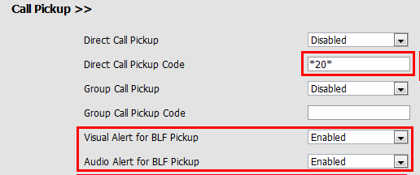
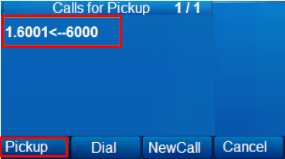
Busy Lamp Field(BLF)
Advanced(V70)
1. DSS key
2. Phone→ Features→ Call Pickup
Notes:
When there’s an incoming call on your monitor account, you will see in your LCD, that who make the call, and call who, then you can decide whether pickup it or not. This is just a simulated LCD to make you understand better.

Slide 23
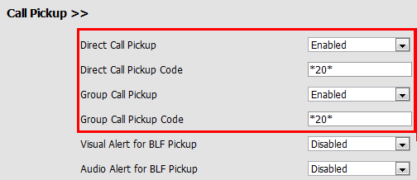

Pick Up
Direct/Group Pick Up: *20*
Incoming call→ Off hook→DPickup/Gpickup→Extension→ DPickup/Gpickup
Notes:
We also improve pick up feature.
Direct pickup is used for picking up an incoming call on a specific extension. A user can pick up the incoming call by pressing a pickup DSS key directly or off hook and press DPickup soft key, then input the extension of the ringing phone and then pressing DPickup soft key again.
Group pickup is used for picking up incoming calls within a pre-defined group. If the group receives multiple incoming calls, a user picks up the first incoming call.
This feature is for some people who is used to the traditional phone, they pick up after off hook.

Slide 24
Call Park/Retrieve
Call park allows a user to park a call at a special extension and then retrieve it on any other phone in the system.
Phone A-Call Park: *01
Phone B-Call Retrieve: *11 or dial *11 directly
Notes:
Call park allows a user to park a call at a special extension and then retrieve it on any other phone in the system.
This feature is different from hold feature, for example, you receive a call, and you need to check something in another office, then you can press call park DSS key, and go to another office, after you check, you press retrieve code and continue to talk with him. If you hold the call, after you check the information, you still need to back to unhold the call.

Slide 25
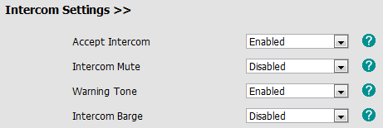
Intercom
Intercom: *9
Phone→ Features→ Intercom Settings
Notes:
Intercom allows establishing a two-way audio conversation directly.

Slide 26
Call Completion
When a call fails, the call completion feature allows notifying the caller when the callee becomes available to receive a call→ Need server support
Not answer
Busy
Reject the call
Phone→ Features→ General Information
Wait for 100? Ok/Cancel
Dialing 100? Ok/Cancel

Slide 27
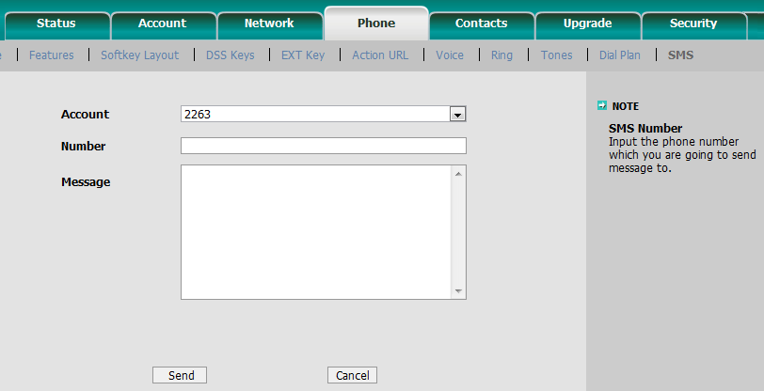
SMS
Access to webpage → Phone→ SMS
Notes:
Account: your VOIP account
Number: the number you want to send message to
Message: the message contents you want to send

Slide 28
Multicast Paging
Users can configure a multicast paging key on the IP phone, which is used to send/receive a Real-time Transport Protocol (RTP) stream to/from the pre-configured multicast address(es) without involving SIP signaling.
Each IP phone can listen to as many as 10 different multicast IP addresses.
Notes:
IP phones support to send and receive RTP streams.You can configure a multicast paging key on the IP phone,whichis used to send a Real-time Transport Protocol (RTP) stream to the pre-configuredmulticast address(es)without involving SIP signaling.You can also configure the IP phone to receive an RTP stream from pre-configured multicast listening address(es) without involving SIP signaling.Each IP phone can be configured to listen to as many as 10 different multicast IP addresses.

Slide 29
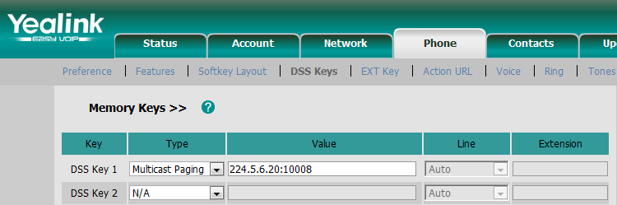
Multicast Paging-Send
DSS Key:
Access to webpage →Phone →DSS Keys →Memory Keys
Codec:
Access to webpage →Phone →Features →General Information
Notes:
The IP phone can send an RTP stream without involving SIP signaling by pressing a multicast paging key. The multicast paging key is assigned a multicast address (IP: Port), which can be defined to transmit the RTP stream to a group of designated phones. When the IP phone sends the RTP stream to a preconfigured multicast address,each IP phone that has been configured to listen to the multicast address can receive the RTP stream.When the originator stops sending the RTP stream, the IP phones stop receiving the RTP stream.

Slide 30
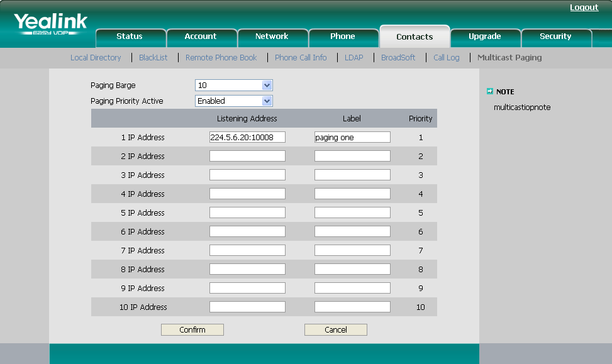
Multicast Paging-Receive
Access to webpage →Contacts →Multicast Paging
Notes:
The IP phone can handle the incoming multicast paging calls differently depending on the configurations
Paging Barge
The parameter defines the priority of the voice call in progress, which can decide how the IP phone handles the incoming multicast paging callswhen there is already a voice call on the IP phone.If the parameter is configured as disabled, all incomingmulticast paging calls will be automatically ignored.If the parameter is the priority value, the incoming multicast paging callswith higher priority are automatically answered and the ones with lower priority are ignored.
Paging Priority Active
The parameter decides how the IP phone handles the incoming multicast paging calls, when there is already a multicast paging call on the IP phone. If the parameter isconfigured as disabled, the IP phone will automatically ignore all incoming multicast paging calls.If the parameter is configured as enabled,the incoming multicast paging callswith higher priority are automatically answered and the ones with lower priority are ignored.
of Paging Barge and Paging Priority Active parameters.

Slide 31

Advanced Features

Slide 32
Advanced Features
Remote Phonebook
LDAP
XML Browser/Push XML
Action URI/URL
Hot Desking
Open VPN
…

Slide 33
Remote(XML) Phonebook

Slide 34
Remote(XML) Phonebook
Remote phonebook is the IP phone book maintained centrally, which is stored on the remote server. The IP phone can establish a connection with the remote server and download the entries, and then display the entries on the phone user interface.
User manual download:
ftp://yealinkftp:yealinkftp@ftp.yealink.com/Training/AdvancedFeature/XML%20Phonebook/

Slide 35
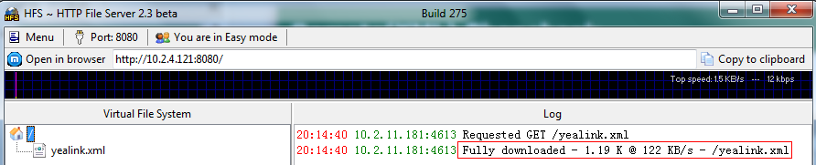
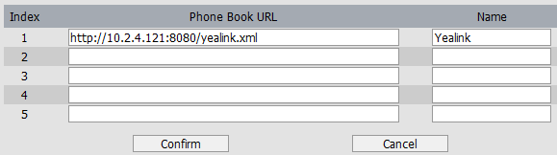
Remote(XML) Phonebook
<500kb

Slide 36

Remote(XML) Phonebook
Phone→ Features→ General Information
Can display the name of remote phonebook contacts
Only VP530 support search
Notes:
When there’s an incoming call, and caller name is stored in your xml phonebook, you want to see his name displayed on the LCD, you can enable this SRemote name option.
The SRemote Name Flash Time feature defines how often the IP phones refresh the local cache of the remote phonebook.

Slide 37
Remote(XML) Phonebook
Sales.xml- Direct Contacts
<YealinkIPPhoneDirectory> \\Change Company Name
<DirectoryEntry>
<Name>Jack</Name> \\Change Name
<Telephone>1110</Telephone> \\Extension number
<Telephone>18676762325</Telephone> \\Telephone number
</DirectoryEntry>
<DirectoryEntry>
……
</DirectoryEntry>
<SoftKeyItem> \\Shortcut Keys
<Name>0</Name> \\Keys Number
<URL> http://10.2.4.121:8080/sales.xml </URL> \\Server Address
</SoftKeyItem>
</YealinkIPPhoneDirectory>
Notes:
You can just modify the red words.
You can also set the shortcut key, for example, set “0” as the shortcut keys, if you press “0”, it will go to sales.xml file.

Slide 38
Remote(XML) Phonebook
Yealink.xml-Group Contacts
<YealinkIPPhoneMenu> \\Change Company Name
<Title>Yealink</Title> \\Company Name
<MenuItem>
<Name>Sales</Name> \\Group Name
<URL> http://10.2.4.121:8080/Sales.xml </URL> \\Server Address
</MenuItem>
<MenuItem>
<Name>Marketing</Name> \\Group Name
<URL> http://10.2.4.121:8080/Marketing.xml </URL> \\Server Address
</MenuItem>
……
<SoftKeyItem>
<Name>0</Name>
<URL> http://10.2.4.40:9/sales.xml </URL>
</SoftKeyItem>
</YealinkIPPhoneMenu>
Notes:
About XML phonebook, many customer want to use search feature, and for some large enterprise they need to support more contacts, at this time, XML phonebook can’t meet their requirement. So we can suggest LDAP for them.

Slide 39
LDAP

Slide 40
LDAP
Lightweight Directory Access Protocol
An application protocol for accessing and maintaining distributed directory information services over an Internet Protocol (IP) network.
● Support LDAP version 2 or 3
● Support Microsoft’s Active Directory
User manual download:
ftp://yealinkftp:yealinkftp@ftp.yealink.com/Training/AdvancedFeature/LDAP/

Slide 41
Network Topology
Client: Control data
Server: Store data and search data
Phones: Require data and display data
Server
Client
Phones
Notes:
There are three main actors in LDAP Phonebook: LDAP Client, LDAP Server and phones.
The client is used to remotely control the data of the server. It can add, delete or modify the contacts data.
The server stores all the contacts data and when the phone requests, it can search the right data and returns them to the phone.
The phone provides the search conditions/information the user enters for the server to search and it will display the data returned from the server.

Slide 42
Advantages
Searching fast
No limitation Contacts
Easy to manage(modify in the server)
DSS Key:
Notes:
Faster Searching:
The phone doesn’t need to download all the contact data to local and the server would return the right data to the phone directly one by one.
No limitation:
There is no limitation in LDAP Phonebook, but the size of XML Phonebook should be not more than 500K.
Easy to manage:
If you need to add, delete or modify data, you just need to edit in the server and there is no need to do any changes on the phone.

Slide 43
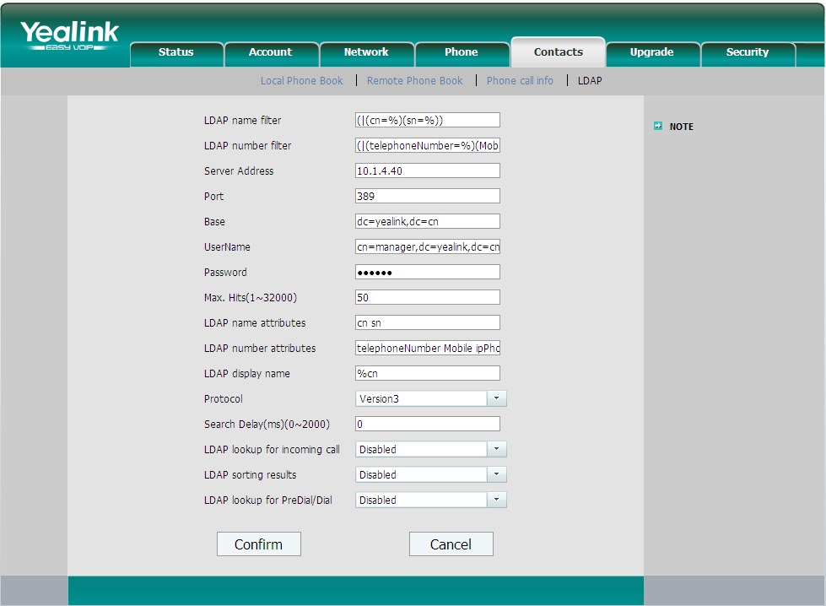
Phone Setting
Notes:
LDAP Sorting Results
This setting is for sorting the search results, if make this option “Enabled”, it will arrange in the first alphabetical of the name order if return the name display; if only has the number return, it will list in numerical order.
LDAP Lookup for PreDial/Dial
This setting can be used to enable call out line identification using LDAP. When the setting is turned “Enabled”, the phone performs an LDAP number search for PreDial or Dial status.

Slide 44
Phone Setting
Configuration Items | Description
LDAP name filter | LDAP name filter is the search criteria for name look ups.
LDAP number filter | LDAP name filter is the search criteria for number look ups.
Server Address | This setting refers to the DNS name or IP address of the LDAP server.
Port | This setting specifies the LDAP server port. The default value is 389.
Base | This setting specifies the LDAP search base (the distinguished name of the search base object) which corresponds to the location in the directory from which the LDAP search is requested to begin.
Username | This setting specifies the bind “Username” for LDAP servers.
Password | This setting specifies the bind “Password” for LDAP servers.
Max. Hits | This setting specifies how many results would return to the phone
LDAP name attributes | This setting can be used to specify the “name” attributes of each record which are to be returned in the LDAP search results.
LDAP number attributes | This setting can be used to specify the “number” attributes of each record which are to be returned in the LDAP search results by the LDAP server.
LDAP display name | This setting is for showing the entry information on the screen.

Slide 45
Phone Setting
Protocol | Protocol is the protocol version for the phone when send the bind request to the server. The default value is Version 3.
Search Delay(ms)(0~2000) | This setting is for configuring the delay display time after search.
LDAP lookup for incoming call | This setting can be used to enable calling line identification using LDAP. When the setting is turned “Enable”, the phone performs an LDAP number search for the incoming number and displays the name of the calling party accordingly.
LDAP Sorting Results | This setting is for sorting the search results, if make this option “Enabled”, it will arrange in the first alphabetical of the name order if return the name display; if only has the number return, it will list in numerical order.
LDAP Lookup for PreDial/Dial | This setting can be used to enable call out line identification using LDAP. When the setting is turned “Enabled”, the phone performs an LDAP number search for PreDial or Dial status.

Slide 46
XML Browser
User manual download:
ftp://yealinkftp:yealinkftp@ftp.yealink.com/Training/AdvancedFeature/ XML%20Browser/

Slide 47
What is XML Browser
Three ways
Initiated from Phone-DSS Keys
Initiated from Server-Push XML
Initiated by XML SIP Notify
Notes:
This attached picture shows that the work flow for XML browser .it is the phone-initiated application ,and use the HTTP or HTTPS transport protocol .Phone can request the data from server on it own .
You can press the predefined key on phone to trigger the phone initiated application of XML browser. After pressing the key, the IP phone issues an HTTP or HTTPs GET command to the server, and waits for the 200 OK answer with XML document in message body ,phone can decodes and displays the xml document on the LCD screen such as Microsoft Internet Explorer or Firefox would do as a web client.

Slide 48
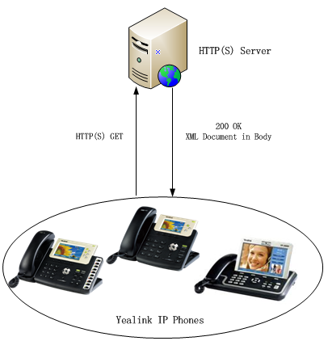
Initiated from Phone-DSS Keys
HTTP(S)
Phone-initiated application
Yealink IP phone acting as a client
Notes:
This attached picture shows that the work flow for XML browser .it is the phone-initiated application ,and use the HTTP or HTTPS transport protocol .Phone can request the data from server on it own .
You can press the predefined key on phone to trigger the phone initiated application of XML browser. After pressing the key, the IP phone issues an HTTP or HTTPs GET command to the server, and waits for the 200 OK answer with XML document in message body ,phone can decodes and displays the xml document on the LCD screen such as Microsoft Internet Explorer or Firefox would do as a web client.

Slide 49
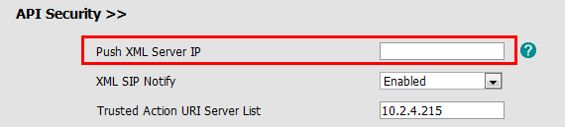
Initiated from Server-Push XML
HTTP(S)
Server-initiated application
Access to webpage→ Phone →Features →API Security
Notes:
Push XML also use the HTTP and HTTPs transport protocol ,but is the server-initiated application .
The end users do not need to do any additional operate. The server alters the XML application by posting an HTTP or HTTPs message to the phone. when phone receives request, it will determine whether to display corresponding content on the phone which sent by the specified server or not.

Slide 50
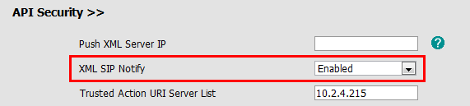
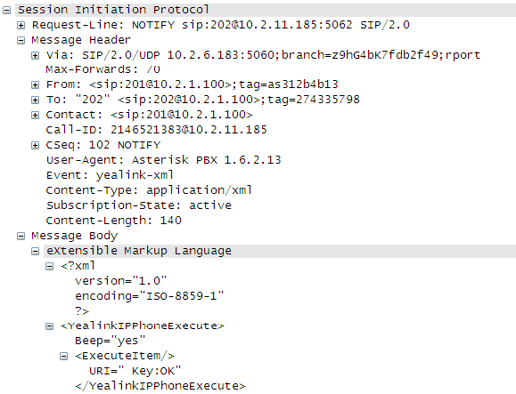
Initiated by XML SIP Notify
Access to webpage→ Phone →Features →API Security
When the phone receives the XML SIP NOTIFY message, the phone will display the information or execute the command in the NOTIFY message.
Notes:
Push XML also use the HTTP and HTTPs transport protocol ,but is the server-initiated application .
The end users do not need to do any additional operate. The server alters the XML application by posting an HTTP or HTTPs message to the phone. when phone receives request, it will determine whether to display corresponding content on the phone which sent by the specified server or not.

Slide 51
Application Scenarios
Practical Applications
Weather report
Stock information
Google search
News service
…
Execute Actions
Reboot the phone
Reset the phone
Changing LED status
…
Configure Phone

Slide 52
XML Object
2 types of XML objects
UI objects: Control the display
Non UI objects: Execute and configure
T3XG/VP530:
• TextMenu (UI)
• TextScreen (UI)
• InputScreen (UI)
• Directory (UI)
• FormattedTextScreen (UI)
• ImageScreen (UI)
• PhoneExecute (non UI)
• PhoneConfiguration (non UI)
• PhoneStatus (non UI)
T2X:
• TextMenu (UI)
• TextScreen (UI)
• InputScreen (UI)
• Directory (UI)
• PhoneExecute (non UI)
• PhoneConfiguration (non UI)
• PhoneStatus (non UI)

Slide 53
Action URL/URI
User manual download:
ftp://yealinkftp:yealinkftp@ftp.yealink.com/Training/AdvancedFeature/Action%20URL-URI/

Slide 54
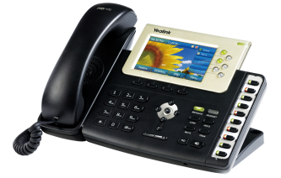

Introduction
Action URL/URI
CTI (Computer Telephony Integration)
Action URL
Reporting the phone actions or status to a Server
Control SIP-Phone
Action URI
IP Phone
Server
Notes:
Action URL & Active URI is a kind of CTI(Computer Telephony Integration) application, allow interactions on a phone and a computer to be integrated.

Slide 55
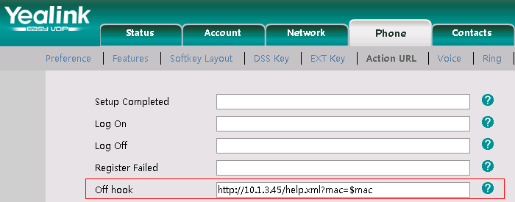
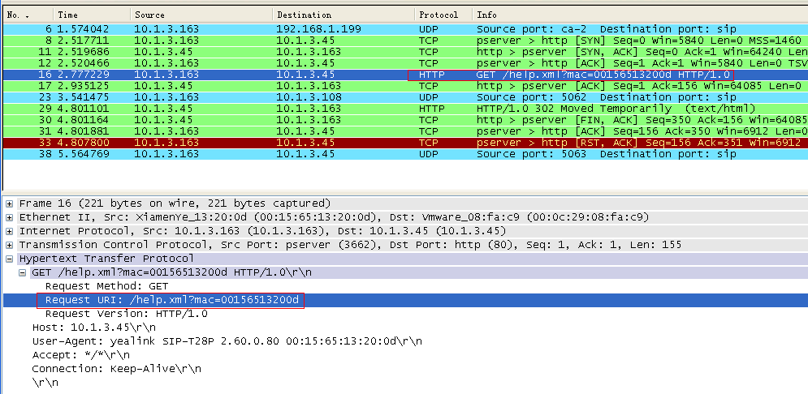
Action URL
Notes:
Action URL is an HTTP GET request allowing the IP phone to interact with web server applications. You can specify a URL that triggers a GET request when certain events occur.

Slide 56
Action URI
Action URI
Input URI in the web browser
1. Trigger pressing the OK button of your phone:
http://10.2.4.234/cgi-bin/ConfigManApp.com?key=OK
2. Make outgoing call:
http://10.2.4.224/cgi-bin/cgiServer.exx?number=765432&outgoing_uri=123123123@10.2.1.199
Destination
Account
Notes:
Opposite to Action URL, Action URI allows the IP phone to interact with web server application by receiving and handling HTTP GET requests. When receiving a URI, the IP phone will perform the specified action and respond with a 200 OK message.

Slide 57
Hot Desking
User manual download:
ftp://yealinkftp:yealinkftp@ftp.yealink.com/Training/AdvancedFeature/Hot%20Desking/

Slide 58
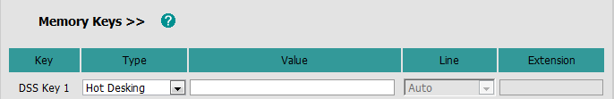
Hot Desking
Hot Desking originates from the definition of being the temporary physical occupant of a work station or surface by a particular employee.
Delete all accounts
Register own account
DSS Key- Hot Desking
Notes:
Hot desking is regularly used in places where not all the employees are in the office at the same time, or not in the office for long periods at a time, which means actual personal offices would often be vacant, consuming valuable space and resources.
The hot desking feature allows a user to delete all accounts on the IP phone, register his account on line 1. In order to use this feature, you need to assign a hot desking DSS key.

Slide 59
Open VPN
User manual download:
ftp://yealinkftp:yealinkftp@ftp.yealink.com/Training/AdvancedFeature/Open%20VPN/

Slide 60
What’s VPN
VPN (Virtual Private Network) is a secured private network connection built on top of public telecommunication infrastructure, such as the Internet. It provides remote offices or individual users with secure access to their organization's network.
Scalability
Reliability
Security
Convenience
Notes:
VPN (Virtual Private Network) is a secured private network connection built on top of public telecommunication infrastructure, such as the Internet.

Slide 61
Two Types of VPN
Remote-access VPN
(Connecting an individual device to a network)
Allow employees to access their company's intranet from home or outside the office
Site-to-site VPN
(Connecting two networks together)
Allow employees in geographically separated offices to share one cohesive virtual network.

Slide 62
Open VPN
Open VPN is a full featured SSL VPN software solution that creates secure connections in remote access facilities.
Linux/ Xbsd/ Mac OS X/ Windows 2000/XP
Notes:
It is designed to work with the TUN/TAP virtual networking interface.
TUN and TAP are virtual network kernel devices.
TAP simulates a link layer device and provides a virtual point-to-point connection.
TUN simulates a network layer device and provides a virtual network segment.

Slide 63
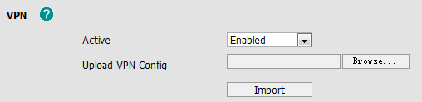
Phone Setting
Access to webpage →Network →Advanced
Client.tar:
Vpn.cnf/ Ca.crt/ Client.crt/ Client.key
V70 can upload the VPN certification via auto provisioning:
network.vpn_enable = 1
openvpn.url =
Click this button, and choose VPN file

Slide 64

Auto Provisioning

Slide 65
What
Mass deployment
Plug and Play
Common.cfg
Mac.cfg-Account
Notes:
When you put common.cfg and mac.cfg file to the auto provision server at the same time, the phone will first download common.cfg, and then mac.cfg.
So if there’s same parameter in common and mac cfg file, the phone will get the value from mac cfg file.

Slide 66
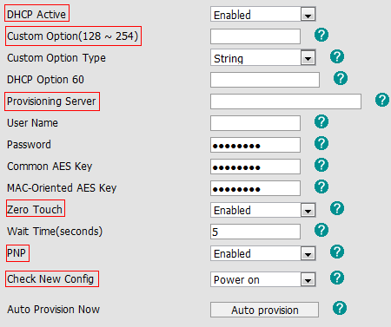
How
Zero-Sp-Touch
PnP Server
DHCP Custom Option
DHCP Option 66
DHCP Option 43
Phone Flash
(HTTP/HTTPS/TFTP/FTP)
Notes:
This is the flow when the phone power on.
First it will detect Zero-Sp-Touch, if you enabled Zero Touch option, after the phone boot up, the phone will ask you to set your network environment, and fill the auto provision server URL, so you don’t need to access to your webpage to configure these.
If ZST is disabled, the phone will detect PnP server, if you enabled PNP option. the phone will send SIP SUBSCRIBE messages to a multicast address when it boots up. Any SIP server understanding that message will reply with a SIP NOTIFY message containing the Auto Provisioning Server URL where the phones can request their configuration.
DHCP Custom Option, A valid Custom Option is from 128 to 254. The Custom Option Type must be in accordance with the one defined in the DHCP server

Slide 67
The Name of CFG File
Phone Model | Common Configuration File
SIP-T28(P) | y000000000000.cfg
SIP-T26(P) | y000000000004.cfg
SIP-T22(P) | y000000000005.cfg
SIP-T20(P) | y000000000007.cfg
SIP-T12(P) | y000000000008cfg
SIP-T18(P) | y000000000009.cfg
SIP-T38G | y000000000038.cfg
SIP-T32G | y000000000032.cfg
VP530 | y000000000023.cfg
Auto Provisioning User Guide
-V61 or lower version:
http://www.yealink.com/Upload/document/YealinkT2XPT3XGVP530phonesAutoProvisioningUserGuide/YealinkSIPT2XPphonesAutoProvisionUserGuideRev_610-21130127888.zip

Slide 68
Example
1. How to upgrade firmware(V61)
ftp://yealinkftp:yealinkftp@ftp.yealink.com/Training/Autop/Upgrade Firmware via Auto Provision.pdf
2. Set VOIP account(V70)
#!version:1.0.0.1
#Enable or disable the account1, 0-Disabled (default), 1-Enabled;
account.1.enable = 1
#Configure the label displayed on the LCD screen for account1.
account.1.label = Cathy
#Configure the display name of account1.
account.1.display_name = Cathy
#Configure the username and password for register authentication.
account.1.auth_name = 8521
account.1.password = 8521
#Configure the register user name.
account.1.user_name = 8521
#Configure the SIP server address.
account.1.sip_server_host = 10.2.1.197

Slide 69
M7
V70 Upgrading Manual
Template
CCT tool
Download:
http://www.yealink.com/Upload/document/YealinkT2XPT3XGVP530phonesAutoProvisioningUserGuide/YealinkT2XPT3XGVP530phonesAutoProvisioningUserGuideRev_700-02264277235.zip

Slide 70
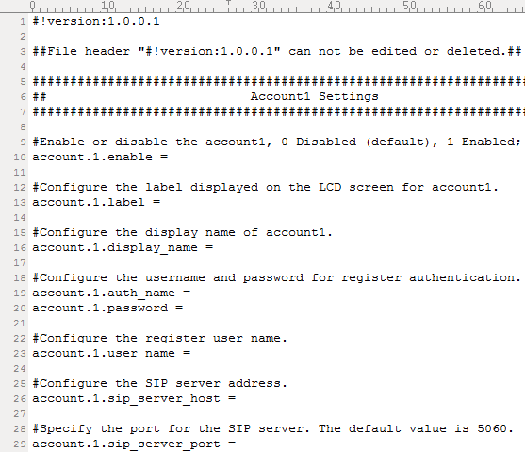
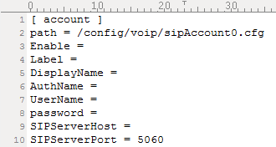
M7 Template
M7 -Unified V70 template of T2x/T3x/VP530
M1/ M2--- T2x/ T3x old template
M7
M1

Slide 71
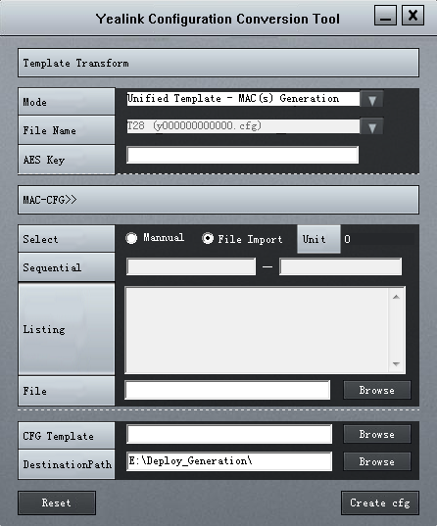
CCT Tool
Yealink Configuration Conversion Tool——”CCT”
①Convert M1/M2 to M7
②Generate Mac.cfg files
in batch automatically

Slide 72

Q&A
Thank you!

