Slide 1

Yealink Phone Features

Slide 2

Agenda
Basic Features
Advanced Features
New Products

Slide 3

Basic Features

Slide 4
Basic Features
Call Transfer
BLF
Pick Up
Call Park/Retrieve
Intercom
Call Completion
Music on Hold
…

Slide 5

Call Transfer
Scenarios: A→B→C
Blind Transfer
B press Transfer+ C + Transfer/Hang up
Semi-attended Transfer
B press Transfer+ C + OK/SEND, when C is ringing, B hang up
Attended Transfer
B press Transfer+ C + OK/SEND, after C answered, B talk with C, then B press Transfer/Hang up

Slide 6
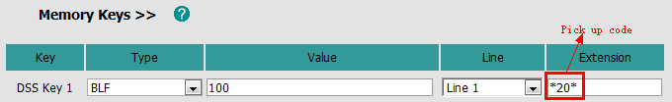
Busy Lamp Field(BLF)
101 monitor 100
102 call 100
Basic
DSS key
Notes:
BLF allows one or more specific users to be monitored for status changes. For example, you can configure BLF on a supervisor’s phone for monitoring the status of a user’s phone, to check whether he is busy or idle.
But with this method, when you press DSS key to pick up the call, you only can see the number 100, but can’t see who make the call.
So our V70 firmware improve this feature.

Slide 7
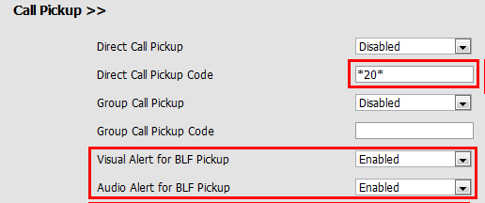
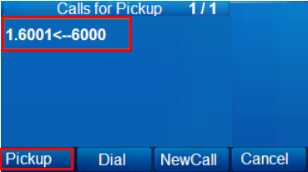
Busy Lamp Field(BLF)
Advanced(V70)
1. DSS key
2. Phone→ Features→ Call Pickup
Notes:
When there’s an incoming call on your monitor account, you will see in your LCD, that who make the call, and call who, then you can decide whether pickup it or not. This is just a simulated LCD to make you understand better.

Slide 8
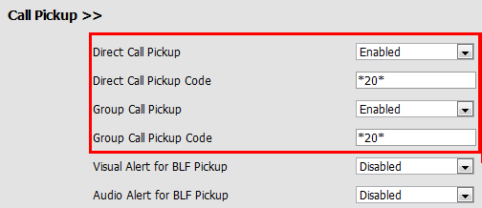

Pick Up
Direct/Group Pick Up: *20*
Incoming call→ Hook off→DPickup/Gpickup→Extension→ DPickup/Gpickup
Notes:
We also improve pick up feature.
Direct pickup is used for picking up an incoming call on a specific extension. A user can pick up the incoming call by pressing a pickup DSS key directly or hook off and press DPickup soft key, then input the extension of the ringing phone and then pressing DPickup soft key again.
Group pickup is used for picking up incoming calls within a pre-defined group. If the group receives multiple incoming calls, a user picks up the first incoming call.
This feature is for some people who is used to the traditional phone, they pick up after hook off.

Slide 9
Call Park/Retrieve
Call park allows a user to park a call at a special extension and then retrieve it on any other phone in the system.
Phone A-Call Park: *01
Phone B-Call Retrieve: *11 or dial *11 directly
Notes:
Call park allows a user to park a call at a special extension and then retrieve it on any other phone in the system.
This feature is different from hold feature, for example, you receive a call, and you need to check something in another office, then you can press call park DSS key, and go to another office, after you check, you press retrieve code and continue to talk with him. If you hold the call, after you check the information, you still need to back to unhold the call.

Slide 10
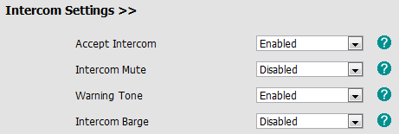
Intercom
Intercom: *9
Phone→ Features→ Intercom Settings
Notes:
Intercom allows establishing a two-way audio conversation directly.

Slide 11
Call Completion
When a call fails, the call completion feature allows notifying the caller when the callee becomes available to receive a call→ Need server support
Not answer
Busy
Reject the call
Phone→ Features→ General Information
Wait for 100? Ok/Cancel
Dial 100? Ok/Cancel

Slide 12
Music on Hold
Music on hold (MoH) is the business practice of playing recorded music to fill the silence that would be heard by the party who has been placed on hold.
Account→ Advanced→ Music on Hold Server
Format:
<10.1.3.165>
10.1.3.165
<sip:moh@ucap.com>
sip:moh@ucap.com
<yealink.com>
yealink.com

Slide 13

Advanced Features

Slide 14
Advanced Features
Remote Phonebook
LDAP
XML Browser/Push XML
Action URI/URL
Hot Desking
Dial Plan
Open VPN
User Access Level
TR069
…

Slide 15
Remote(XML) Phonebook

Slide 16
Remote(XML) Phonebook
Remote phonebook is the IP phone book maintained centrally, which is stored on the remote server. The IP phone can establish a connection with the remote server and download the entries, and then display the entries on the phone user interface.
User manual download:
ftp://yealinkftp:yealinkftp@ftp.yealink.com/Training/AdvancedFeature/XML%20Phonebook/

Slide 17
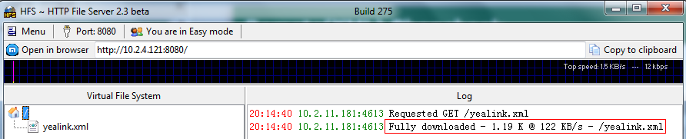
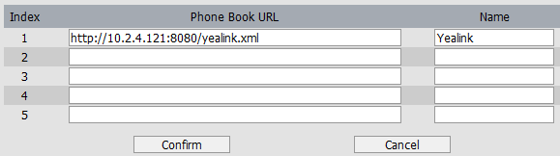
Remote(XML) Phonebook
<500kb

Slide 18

Remote(XML) Phonebook
Phone→ Features→ General Information
Can display the name of remote phonebook contacts
Only VP530 support search
Notes:
When there’s an incoming call, and caller name is stored in your xml phonebook, you want to see his name displayed on the LCD, you can enable this SRemote name option.
The SRemote Name Flash Time feature defines how often the IP phones refresh the local cache of the remote phonebook.

Slide 19
Remote(XML) Phonebook
Sales.xml- Direct Contacts
<YealinkIPPhoneDirectory> \\Change Company Name
<DirectoryEntry>
<Name>Jack</Name> \\Change Name
<Telephone>1110</Telephone> \\Extension number
<Telephone>18676762325</Telephone> \\Telephone number
</DirectoryEntry>
<DirectoryEntry>
……
</DirectoryEntry>
<SoftKeyItem> \\Shortcut Keys
<Name>0</Name> \\Keys Number
<URL> http://10.2.4.121:8080/sales.xml </URL> \\Server Address
</SoftKeyItem>
</YealinkIPPhoneDirectory>
Notes:
You can just modify the red words.
You can also set the shortcut key, for example, set “0” as the shortcut keys, if you press “0”, it will go to sales.xml file.

Slide 20
Remote(XML) Phonebook
Yealink.xml-Group Contacts
<YealinkIPPhoneMenu> \\Change Company Name
<Title>Yealink</Title> \\Company Name
<MenuItem>
<Name>Sales</Name> \\Group Name
<URL> http://10.2.4.121:8080/Sales.xml </URL> \\Server Address
</MenuItem>
<MenuItem>
<Name>Marketing</Name> \\Group Name
<URL> http://10.2.4.121:8080/Marketing.xml </URL> \\Server Address
</MenuItem>
……
<SoftKeyItem>
<Name>0</Name>
<URL> http://10.2.4.40:9/sales.xml </URL>
</SoftKeyItem>
</YealinkIPPhoneMenu>
Notes:
About XML phonebook, many customer want to use search feature, and for some large enterprise they need to support more contacts, at this time, XML phonebook can’t meet their requirement. So we can suggest LDAP for them.

Slide 21
LDAP

Slide 22
LDAP
Lightweight Directory Access Protocol
An application protocol for accessing and maintaining distributed directory information services over an Internet Protocol (IP) network.
● Support LDAP version 2 or 3
● Support Microsoft’s Active Directory
User manual download:
ftp://yealinkftp:yealinkftp@ftp.yealink.com/Training/AdvancedFeature/LDAP/

Slide 23
Network Topology
Client: Control data
Server: Store data and search data
Phones: Require data and display data
Server
Client
Phones
Notes:
There are three main actors in LDAP Phonebook: LDAP Client, LDAP Server and phones.
The client is used to remotely control the data of the server. It can add, delete or modify the contacts data.
The server stores all the contacts data and when the phone requests, it can search the right data and returns them to the phone.
The phone provides the search conditions/information the user enters for the server to search and it will display the data returned from the server.

Slide 24
Advantages
Searching fast
No limitation Contacts
Easy to manage(modify in the server)
DSS Key:
Notes:
Faster Searching:
The phone doesn’t need to download all the contact datas to local and the phone would return the right datas to the phone directly one by one.
No limitation:
There is no limitation in LDAP Phonebook, but the size of XML Phonebook should be not more than 500K.
Easy to manage:
If you need to add、delete or modify datas, you just need to edit in the server and there is no need to do any changes on the phone.

Slide 25
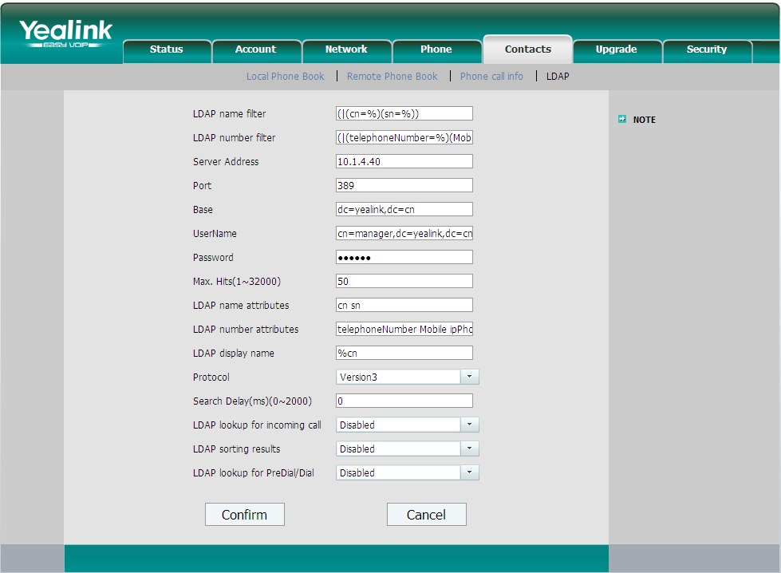
Phone Setting
Notes:
LDAP Sorting Results
This setting is for sorting the search results, if make this option “Enabled”, it will arrange in the first alphabetical of the name order if return the name display; if only has the number return, it will list in numerical order.
LDAP Lookup for PreDial/Dial
This setting can be used to enable call out line identification using LDAP. When the setting is turned “Enabled”, the phone performs an LDAP number search for PreDial or Dial status.

Slide 26
Phone Setting
Configuration Items | Description
LDAP name filter | LDAP name filter is the search criteria for name look ups.
LDAP number filter | LDAP name filter is the search criteria for number look ups.
Server Address | This setting refers to the DNS name or IP address of the LDAP server.
Port | This setting specifies the LDAP server port. The default value is 389.
Base | This setting specifies the LDAP search base (the distinguished name of the search base object) which corresponds to the location in the directory from which the LDAP search is requested to begin.
Username | This setting specifies the bind “Username” for LDAP servers.
Password | This setting specifies the bind “Password” for LDAP servers.
Max. Hits | This setting specifies how many results would return to the phone
LDAP name attributes | This setting can be used to specify the “name” attributes of each record which are to be returned in the LDAP search results.
LDAP number attributes | This setting can be used to specify the “number” attributes of each record which are to be returned in the LDAP search results by the LDAP server.
LDAP display name | This setting is for showing the entry information on the screen.

Slide 27
Phone Setting
Protocol | Protocol is the protocol version for the phone when send the bind request to the server. The default value is Version 3.
Search Delay(ms)(0~2000) | This setting is for configuring the delay display time after search.
LDAP lookup for incoming call | This setting can be used to enable calling line identification using LDAP. When the setting is turned “Enable”, the phone performs an LDAP number search for the incoming number and displays the name of the calling party accordingly.
LDAP Sorting Results | This setting is for sorting the search results, if make this option “Enabled”, it will arrange in the first alphabetical of the name order if return the name display; if only has the number return, it will list in numerical order.
LDAP Lookup for PreDial/Dial | This setting can be used to enable call out line identification using LDAP. When the setting is turned “Enabled”, the phone performs an LDAP number search for PreDial or Dial status.

Slide 28
XML Browser/Push XML
User manual download:
ftp://yealinkftp:yealinkftp@ftp.yealink.com/Training/AdvancedFeature/ XML%20Browser/

Slide 29
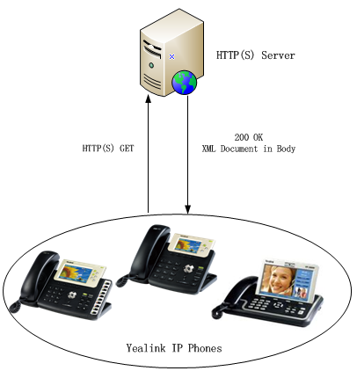
What is XML Browser
HTTP(S)
Phone-initiated application
Yealink IP phone acting as a client
Notes:
This attached picture shows that the work flow for XML browser .it is the phone-initiated application ,and use the HTTP or HTTPS transport protocol .Phone can request the data from server on it own .
You can press the predefined key on phone to trigger the phone initiated application of XML browser. After pressing the key, the IP phone issues an HTTP or HTTPs GET command to the server,and waits for the 200 OK answer with XML document in message body ,phone can decodes and displays the xml document on the LCD screen such as Microsoft Internet Explorer or Firefox would do as a web client.

Slide 30
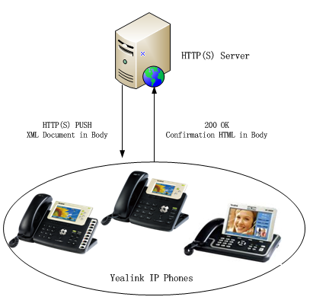
What is Push XML
HTTP(S)
Server-initiated application
Yealink IP phone acting as a server (HTTP(S) post)
Notes:
Push XML also use the HTTP and HTTPs transport protocol ,but is the server-initiated application .
The end users do not need to do any additional operate. The server alters the XML application by posting an HTTP or HTTPs message to the phone. when phone receives request, it will determine whether to display corresponding content on the phone which sent by the specified server or not.

Slide 31
Application Scenarios
Practical Applications
Weather report
Stock information
Google search
News service
…
Execute Actions
Reboot the phone
Reset the phone
Changing LED status
…
Configure Phone

Slide 32
XML Object
2 types of XML objects
UI objects: Control the display
Non UI objects: Execute and configure
T3XG/VP530:
• TextMenu (UI)
• TextScreen (UI)
• InputScreen (UI)
• Directory (UI)
• FormattedTextScreen (UI)
• ImageScreen (UI)
• PhoneExecute (non UI)
• PhoneConfiguration (non UI)
• PhoneStatus (non UI)
T2X:
• TextMenu (UI)
• TextScreen (UI)
• InputScreen (UI)
• Directory (UI)
• PhoneExecute (non UI)
• PhoneConfiguration (non UI)
• PhoneStatus (non UI)

Slide 33
Action URL/URI
User manual download:
ftp://yealinkftp:yealinkftp@ftp.yealink.com/Training/AdvancedFeature/Action%20URL-URI/

Slide 34
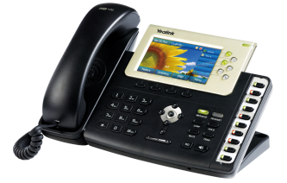

Introduction
Action URL/URI
CTI (Computer Telephony Integration)
Action URL
Reporting the phone actions or status to a Server
Control SIP-Phone
Action URI
IP Phone
Server
Notes:
Action URL & Active URI is a kind of CTI(Computer Telephony Integration) application, allow interactions on a phone and a computer to be integrated.

Slide 35
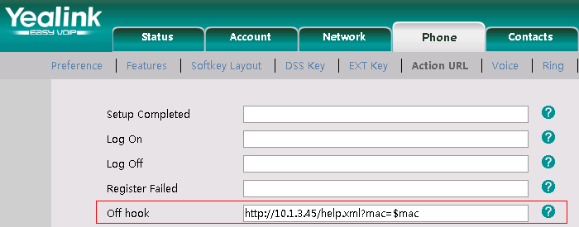
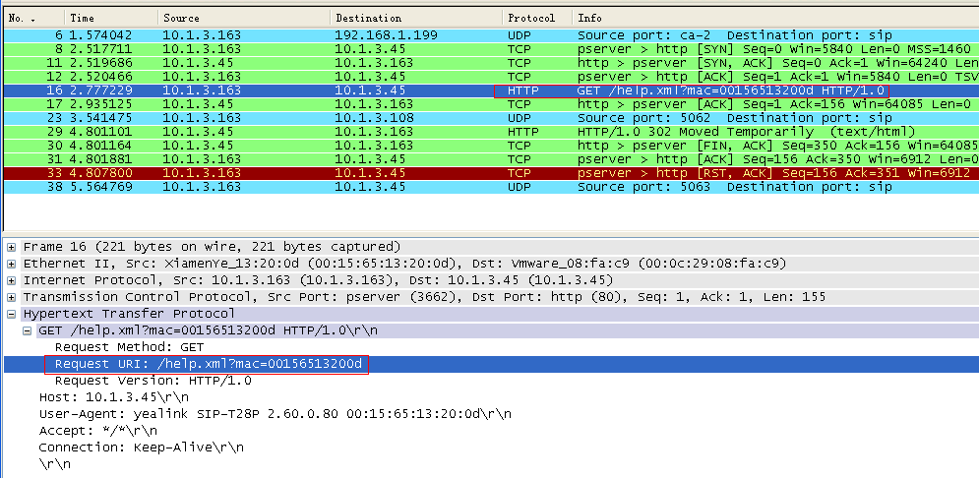
Action URL
Notes:
Action URL is an HTTP GET request allowing the IP phone to interact with web server applications. You can specify a URL that triggers a GET request when certain events occur.

Slide 36
Action URI
Action URI
Input URI in the web browser
1. Trigger pressing the OK button of your phone:
http://10.2.4.234/cgi-bin/ConfigManApp.com?key=OK
2. Make outgoing call:
http://10.2.4.224/cgi-bin/cgiServer.exx?number=765432&outgoing_uri=123123123@10.2.1.199
Destination
Account
Notes:
Opposite to Action URL, Action URI allows the IP phone to interact with web server application by receiving and handling HTTP GET requests. When receiving a URI, the IP phone will perform the specified action and respond with a 200 OK message.

Slide 37
Hot Desking
User manual download:
ftp://yealinkftp:yealinkftp@ftp.yealink.com/Training/AdvancedFeature/Hot%20Desking/

Slide 38
Hot Desking
Hot Desking originates from the definition of being the temporary physical occupant of a work station or surface by a particular employee.
Delete all accounts
Register own account
DSS Key- Hot Desking
Notes:
Hot desking is regularly used in places where not all the employees are in the office at the same time, or not in the office for long periods at a time, which means actual personal offices would often be vacant, consuming valuable space and resources.
The hot desking feature allows a user to delete all accounts on the IP phone, register his account on line 1. In order to use this feature, you need to assign a hot desking DSS key.

Slide 39
Dial Plan
User manual download:
ftp://yealinkftp:yealinkftp@ftp.yealink.com/Training/AdvancedFeature/Dial%20Plan/

Slide 40
Dial Plan
Replace Rule
Dial-now
Area Code
Block Out
Notes:
Dial plan is a plan for dialing numbers aimed at making dialing intelligent, convenient and fast. Yealink provide four solution to make dial plan useful

Slide 41


Replace Rule
Replace complex number with simple number
Exact Match
Press 5, phone will dial out 5702000
Partial Match
Press 05702000, phone will dial out 00865702000
PS: Up to 20 replace rules
Notes:
For some old people, it is very difficult for them to remember some complex numbers. Replace Rule is a plan that allows you to replace complex number with simple number. so Replace Rule can solve this issue. bracket

Slide 42

Dial-now
Send a call without pressing SEND/OK button after you input the number
e.g. Number start with 01 - 09 and 11 digits
Time setting:
Phone →Features →General Information
Notes:
Dial-now is a solution to make you send a call without press send/OK button after you input the number.

Slide 43
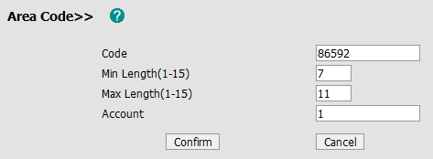
Area Code
Adding correct area code automatically
Press 5702000, dial out 865925702000
“5702000” length: 7

Slide 44

Block Out
Not allow to dial some forbidden numbers
When you dial out the 8518, the phone will indicate “Forbidden number” and forbid the outgoing call.

Slide 45
Open VPN
User manual download:
ftp://yealinkftp:yealinkftp@ftp.yealink.com/Training/AdvancedFeature/Open%20VPN/

Slide 46
What’s VPN
VPN (Virtual Private Network) is a secured private network connection built on top of public telecommunication infrastructure, such as the Internet. It provides remote offices or individual users with secure access to their organization's network.
Scalability
Reliability
Security
Convenience
Notes:
VPN (Virtual Private Network) is a secured private network connection built on top of public telecommunication infrastructure, such as the Internet.

Slide 47
Two Types of VPN
Remote-access VPN
(Connecting an individual device to a network)
Allow employees to access their company's intranet from home or outside the office
Site-to-site VPN
(Connecting two networks together)
Allow employees in geographically separated offices to share one cohesive virtual network.

Slide 48
Open VPN
Open VPN is a full featured SSL VPN software solution that creates secure connections in remote access facilities.
Linux/ Xbsd/ Mac OS X/ Windows 2000/XP
Notes:
It is designed to work with the TUN/TAP virtual networking interface.
TUN and TAP are virtual network kernel devices.
TAP simulates a link layer device and provides a virtual point-to-point connection.
TUN simulates a network layer device and provides a virtual network segment.

Slide 49
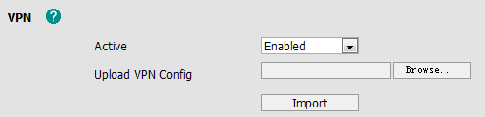
Phone Setting
Access to webpage →Network →Advanced
Client.tar:
Vpn.cnf/ Ca.crt/ Client.crt/ Client.key
V70 can upload the VPN certification via auto provisioning:
network.vpn_enable = 1
openvpn.url =
Click this button, and choose VPN file

Slide 50
User Access Level
User manual download:
ftp://yealinkftp:yealinkftp@ftp.yealink.com/Training/AdvancedFeature/User%20Access%20Level/

Slide 51
User Access Level
Users can personalize the configurations for different access levels according to their requirement.
Admin-Hosted PBX
Var-Reseller
User-End user
Notes:
With Admin access level, Hosted PBX can manage all configurations for var and user, enable or disable some features.
Var is for the value-added reseller who has higher access level than user, var can change some certain configuration and can maintain the device of users.
User is usually for the end users, in order to prevent the phone from going wrong with some incorrect configurations, the end users are limited with only some features, if the end users want to use some value-added features, they have to contact the hosted PBX for help.

Slide 52
Application Scenarios
Hosted PBX sets [Call forward] function only for admin, if users would like to have this function, they should ask admin to open this function by paying some charge, and it’s a value-added function.
(always-forward = 0)
Some Hosted PBX provide the IP phone to their customers for free but require customers to have a minimum consumption monthly, to avoid the customer from using other Hosted PBX’s account, they can hide the SIP on User level.
(sip_server = 2)

Slide 53
User Access Level
Enable VAR level:
-----------------------------------------------------------------------
[ Advanced ]
path = /config/Advanced/Advanced.cfg
var_enabled = 1 ;; 1 means Enable var, 0 means Disable var
-----------------------------------------------------------------------
ItemName = 0 The item is visible in all access level.
ItemName = 1 The item is visible in admin and var level.
ItemName = 2 The item is only visible in admin level.
e.g.
Features = 0
DSSKey = 2
WebItemsLevel.cfg

Slide 54
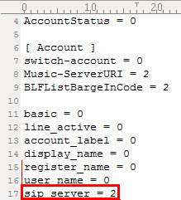
Upload WebItemsLevel.cfg
[ WebItemsLevel ]
path = /tmp/download.cfg
server_address = http://10.2.4.114:8080/T2X/WebItemsLevel.cfg
(V61)
WebItemsLevel.cfg:

Slide 55
TR069
User manual download:
ftp://yealinkftp:yealinkftp@ftp.yealink.com/Training/AdvancedFeature/TR069/

Slide 56
TR069
TR069 is a protocol for communication between a CPE and Auto-Configuration Server (ACS) that encompasses secure auto-configuration as well as other CPE management functions
within a common framework.
IOT list-ACS:
Avsystem
Worksys
Alcatel
Finepoint
Friendly
ZTE
HuaWei
Notes:
Customer Premises Equipment

Slide 57
TR069
Auto-Configuration and Dynamic Service Provisioning
Software/Firmware Image Management
Status and Performance Monitoring
Diagnostics

Slide 58
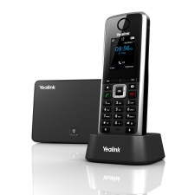
New Product

Slide 59
Key Features of SIP DECT
HD voice
Cat-iq2.0 Protocol , G.722 codec
1.8” 128x160 TFT color LCD
Full duplex speaker/handset
PoE Supported
50m indoor, 300m outdoor

Slide 60
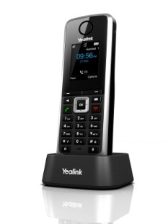
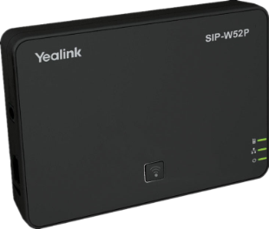
Key Features of SIP DECT
4 lines simultaneous calls, up to 5 handsets
speaking
speaking
speaking
busy
speaking
Cost saving
Perfect high efficiency for busy offices
Notes:
People can walk back to the warehouse to check on inventory or shipping status while keeping the customer on the line

Slide 61

Q&A
Thank you!

