Slide 1

Yealink Solution with BroadWorks
The Global TOP5 Sip Phone Supplier
Notes:
Hello everybody ,this is **** from Yealink technical support team .It’s my pleasure to host today’s training .Here is our topic for reference. let’s start the training now.

Slide 2

Agenda
Who is BroadSoft
Success Cases
How to Configure the Features of BroadWorks
Provisioning in BroadWorks
BroadTouch

Slide 3

Who is BroadSoft
American Based Company, Established at 1998
The largest VOIP/UC solution provider for carrier
Occupy 70% Carrier market share
Notes:
BroadSoft is an American Based Company and it’s established at 1998 .They focus on VOIP Carrier Market which is the biggest Carrier IMS solution provider now.The Carrier Market share is about 70%.
Yealink is constructing a good relationship with Broadsoft now.

Slide 4
What is BroadWorks
BroadWorks
BroadCloud
BroadTouch
BroadWorks is an integrated system of voice applications and servers for service providers.
Notes:
Broadsoft has 3 products as follows :BroadWorks/BroadCloud/BroadTouch. Today we only focus on Broadworks .
BroadWorks is an integrated system of voice applications and servers for service providers . The system delivers a broad set of differentiated, value-added communication services -ranging from media services such as voice mail, conference to personal calling functions ,such as selective call forwarding, and dial-by-name.
BroadCloud is BroadSoft's cloud-based, hosted infrastructure that serves as the foundation for BroadSoft's growing cloud-based communications capabilities.
BroadTouch offers a simple and easy-to-use user interface (UI) that brings together the power of BroadWorks®, our award-winning application platform and BroadCloud, our hosted, cloud-based service delivery platform. As a result, telecommunications service providers can deploy tightly integrated Unified Communications (UC) services already provided by these platforms, with a homogeneous user experience across a broad range of communication devices and platforms. Such services include high-definition (HD) voice, video calling and conferencing, instant messaging, presence and web collaboration.

Slide 5
Success Cases

Slide 6

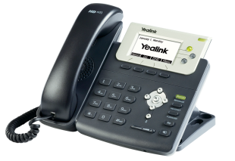
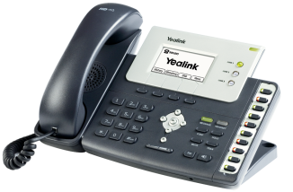
Telefonica
One of the largest telecommunication carriers in the World and the second largest telecommunication carriers in Europe.
Target to Enterprise and Firms
Monthly fee with free phone use
Yealink T26P, T22P
Notes:
Telefonica is one of the largest telecommunication carriers in the World and the second largest telecommunication carriers in Europe.
They Cooperated with BroadSoft by providing stable solutions for abundant European customers since 2009, satisfying the needs of communication and collaboration on a large scale.
Target to Enterprise and Firms with operation mode of Monthly fee with free phone use
They Choose Yealink T26P, T22P

Slide 7


PCCW
7
The largest telecommunication carrier in HK.
Target to SMB
Monthly fee with free phone use
Yealink T28P, T26P
Notes:
And this case is PCCW ,PCCW is the largest telecommunication carrier in HK.
Yealink has established a friendly relationship and co-operation with provider customers by various solutions for the development needs of the corporates.
They Target to SMB with operation mode of Monthly fee with free phone use
Their model is Yealink T28P, T26P

Slide 8



And More…
8
Notes:
Now We have more successful cases with BroadSoft Carrier all over the world .
Such as KPN :The largest telecommunication carrier in the Netherlands, rewarded as one of the top 10 telecommunication companies for investment.
SingTel :the largest telecommunication carrier in Singapore ,Telkom SA ,the largest telecommunication carrier in South Africa .

Slide 9
How to Configure the Features of BroadWorks
Notes:
Now we will introduce the specific configuration step on BroadWorks and yealink phone for every features. BLF list ,SCA,ACD, Feature Key Synchronization, Phonebook and Call log .

Slide 10
BroadWorks Features
Busy Lamp Field List (BLF List)
Shared Call Appearance (SCA)
Automatic Call Distribution (ACD)
Network Conference
Feature Key Synchronization
Phonebook and Call Log
Notes:
We could almost support most of Features on Broadsoft, contain Busy Lamp Field List, Automatic Call Distribution, Feature Key Synchronization, Shared Call Appearance ,Phonebook and Call Log . ACD didn’t be supported on VP530 .
According to the preliminary plan ,Version 71 of VP530 will support it ,and it will be released at the end of this year .

Slide 11
Special Firmware for BroadWorks-Q1 of 2013
Hoteling
Hoteling feature allows users to login their personal accounts on different phones anywhere, then the phone will be configured to their familiar mode, with all their custom configuration
Anywhere
Emergency Escalation to Supervisor
Queue Status Notification
Value-added features via XSI
Remote Office configuration
Redundancy server
……
Notes:
We could almost support most of Features on Broadsoft, contain Busy Lamp Field List, Automatic Call Distribution, Feature Key Synchronization, Shared Call Appearance ,Phonebook and Call Log . ACD didn’t be supported on VP530 .
According to the preliminary plan ,Version 71 of VP530 will support it ,and it will be released at the end of this year .

Slide 12
Busy Lamp Field
Notes:
First one is BLF LIST —BLF LIST stands for Busy Lamp Field List.
It’s the BLF feature on Broadworks.

Slide 13
Busy Lamp Field
The Busy Lamp Field (BLF) List feature on the IP phone allows a list of specific extensions to be monitored for status changes.
You can use BLF List feature to monitor a list of users defined on BroadWorks.
Notes:
The Busy Lamp Field (BLF) List feature on the IP phone allows a list of specific extensions to be monitored for status changes.
You can use BLF List feature to monitor a list of users defined on BroadWorks. For example, you can create a BLF List URI to monitor a list of users on the BroadWorks server. The monitored users include a list of user1, user2 and user3. The BLF List keys on the IP phone can present the status of user1, user2 and user3. The LEDs key illuminate either flashing or solid depending on the status of those users.
This feature enables the monitoring phone to subscribe to a list of users, and receive notifications of the state of the monitored users. Different indicators on the monitoring phone show different status of the monitored users. When the monitored user places a call, a busy indicator on the monitoring phone shows that the user’s phone is in use and busy.

Slide 14
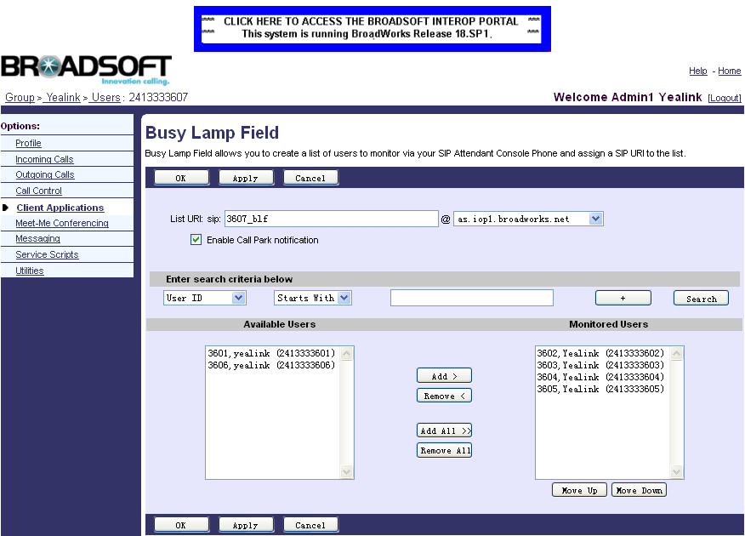
Configuring BLF list on the BroadWorks
Browse to Profile→Users→Search to display all the existing users.
Select users (e.g. 2413333607)
Click on Client Applications→Busy Lamp Field
List URI @ domain name
Select Monitored Users
Notes:
For using BLF list feature ,you need to predefine the BLF list group firstly on BroadWorks . After login as group administrator, you can click Profile->Users->Search to display all the existing users . Select one of the users (e.g. 2413333607) to configure the BLF List feature. Then click on Client Applications->Busy Lamp Field, which as picture show . Enter the BLF List URI (e.g. 3607_blf) in the List URI field. Select the domain name (e.g. as.iop1.broadworks.net) from the pull-down list followed by @ sign. If you want to use the Call notification function ,you can Click the Enable Call Park notification checkbox. Click Search to display all available users. Select the desired users from the Available Users list, and click the Add> button to add them to the Monitored Users list. you can repeat the above steps to add more users to the Monitored Users list.

Slide 15

Configuring BLF List on the Yealink IP Phone
Browse to Account →Advanced
Fill the BLF List URI, BLF List Pickup Code, BLF List Barge In Code
Notes:
After defining the BLF list group, you need to configure the necessary configuration in phone. For the following steps:
1.Enter into web setting page of phone ,and click on Account page.
2. Select the account from the pull-down list of Account, which has been configured the BLF List feature on the BroadWorks server.
3.Click on Advanced page. Enter the BLF List URI in the BLF List URI field, Enter the pickup code in the BLF List Code field. (This option is Optional. It is used for pick up the incoming call on monitor phone), Enter the barge-in code in the BLF List Barge In Code field. (This option is Optional too. it used for join in the active call on monitor phone to set up an conference)

Slide 16
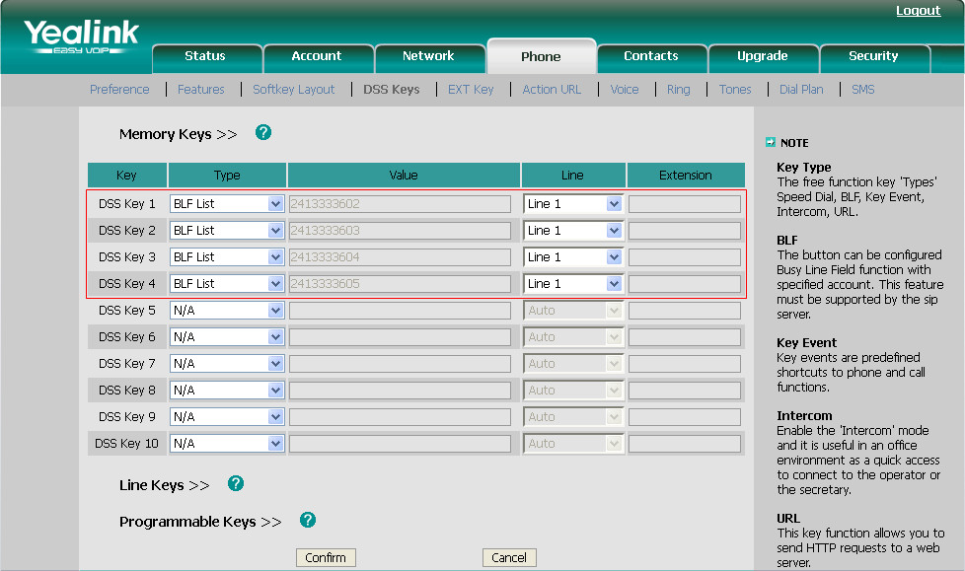
DSS Key
Browse to Phone →DSS Keys →Memory Keys(Line Keys)
Select BLF List Type
In V70 firmware IP phone will automatically assign the phone number of the BLF List users to the BLF List keys in order, according to BroadWorks server.
Notes:
Also you need to configure BLF list option on DSS key or line key . For the following steps:
1. Click on Phone->DSS Keys->Memory Keys>> (Line Keys>>).
2. Select the desired DSS key
3. Choose BLF List from the pull-down list of Type .
4. Select the desired line from the pull-down list of Line.
5. Click Confirm to save the change.
You can repeat steps 2 to 5 to configure more BLF List keys. After setting the above configurations, according to the response message from the BroadWorks server, the IP phone will automatically assign the phone number of the BLF List users to the BLF List keys. Then the BLF setting is finished .

Slide 17
Shared Call Appearance(SCA)
Notes:
Now let me instroduce the feature of the shared call apperance .

Slide 18
Share Call Appearance
The Shared Call Appearance (SCA) feature allows the administrator to assign an extension to multiple phones. Any of the phones can be used to make or receive calls.
Notes:
The Shared Call Appearance (SCA) feature allows the administrator to assign an extension to multiple phones. Any of the phones can be used to make or receive calls.
A call that is active on one phone will be presented visually to phones that share the call appearance, It means if one member in SCA group change the call state ,other members in the same group can see the instant state change .
A SCA group contains one primary account and multi-alternative accounts(they have same features but some difference in configuration on phone ) .

Slide 19
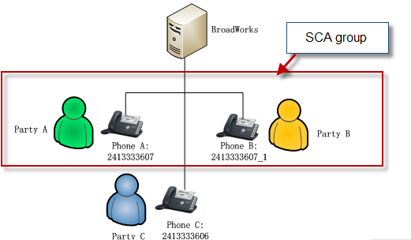
Application Scenarios
Boss and Secretary :
The secretary can share the boss's extension on her phone. When there is an incoming call to the extension of the boss, both the phones of the boss and the secretary will ring simultaneously. Either the boss or the secretary can answer the call. This call state can be shared and also some special operation can be done according the status indication, such as Public hold, Private hold, Barge in.
Boss
Primary account
Secretary
Alternative account
Customer
Notes:
This feature is very useful in the similar scenario like boss and secretary ,If the secretary and boss are in the same SCA group . When there is an incoming call from Party C to the extension of the boss, party A, both the phones of the boss and the secretary will ring simultaneously. Either the boss or the secretary can answer the call. For example ,secretary answer the call .This call state can be shared on boss .and boss can make some special operations according the state ,such as public hold ,private hold, barge in .You can refer to the document which we will send you later for details .Now we are aim at introducing the configuration on BroadWorks and phone .

Slide 20
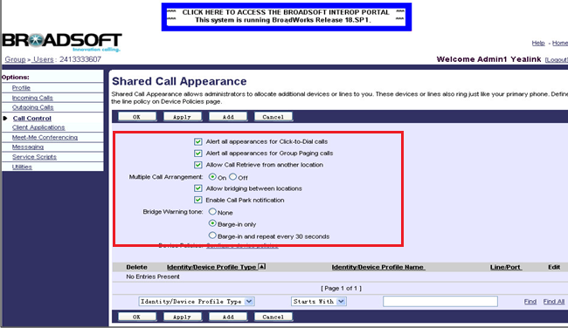
Configuring the BroadWorks Server
Browse to Profile →Users →Search , select a user
Browse to Call Control→ Shared Call Appearance
Set the SCA parameters as below
Click Add to add alternative accounts to this user
Notes:
You can follow the steps to configure the BroadWorks Server. Firstly, log in as the group admin. Go to Profile->Users, and press Search to display all the existing users . You can Select the user 2413333607.Then Click on Call Control->Shared Call Appearance. Set the SCA parameters as follow , these parameters are for configuring the specific authorities of this SCA account .then you can Click on Add to add alternative accounts to this user.

Slide 21
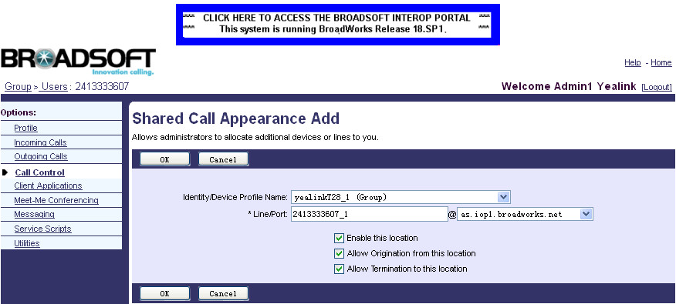
Configuring the BroadWorks Server
Select the Device Profile Name (e.g. yealinkT28_1)
Fill the alternative extension (e.g. 2413333607_1) in the *Line/Port field
Select domain name of BroadWorks
Notes:
After you click on Add button ,you can enter into the setting page of alternative account, you can Select the desired device profile name (e.g. yealinkT28_1) from the pull-down list of Identity/Device Profile Name. Then Enter the alternative extension (e.g. 2413333607_1) in the *Line/Port field. And press OK to finish one alternative account adding .You can follow the adding steps to add multi-alternative accounts to this user .
Now the server configuration has been finished .

Slide 22
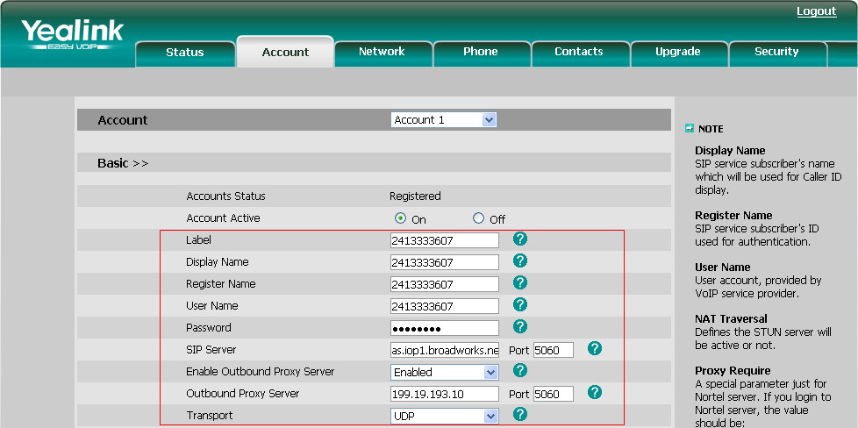
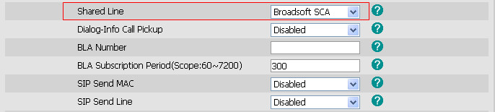
Configuring Primary Account
Primary account-Boss
Browse to Account →Basic , register the primary account 2413333607
Click Advanced → Shared Line, select Broadsoft SCA
Notes:
And in phone side ,in order to configure Phone A with primary account ,you can enter the corresponding account information in account Basic page .And set the value of Shared line as Broadsoft SCA in Advanced page .

Slide 23
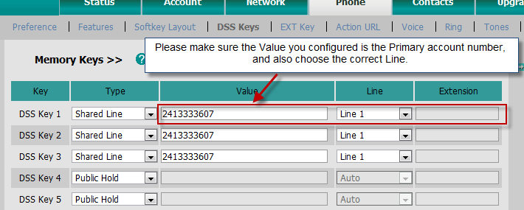
Configuring Primary Account
Browse to Phone →DSS Keys
Select Shared Line Type, fill account in Value, and select Line
Select Public Hold/Private Hold either in Memory Key or Line Key
If you use V70 or higher firmware, you don’t need to configure DSS Key on T2x, but needed on T3X/VP530, we will make them unitary in the next version（Q1 of 2013）.
Notes:
Then go to Phone DSS key page , and configure Share Line/Public Hold/Private Hold either in Memory Key or Line Key. Please note that the value of the key is the Primary account number and also choose the correct line .Then primary account setting in phone side has been finished .

Slide 24
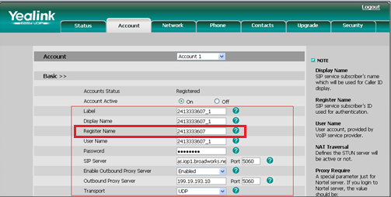
Configuring Alternative Account
Alternative account-Secretary
Browse to Account →Basic , register the alternative account 2413333607_1
Fill the primary account 2413333607 into the Register Name field, but not 2413333607_1
Click Advanced → Shared Line, select Broadsoft SCA
Notes:
As to configure Phone V with alternative account ,it is familiar with primary account configuration . One thing to note here is that you should fill the same primary account 2413333607 in the Register Name field .

Slide 25
Configuring Alternative Account
Browse to Phone →DSS Keys
Select Shared Line Type, fill primary account in Value, and select Line
Select Public Hold/Private Hold either in Memory Key or Line Key
If you use V70 or higher firmware, you don’t need to configure DSS Key on T2x, but needed on T3X/VP530, we will make them unitary in the next version（Q1 of 2013）.
Notes:
Then go to Phone DSS key page , and configure Share Line/Public Hold/Private Hold either in Memory Key or Line Key. Please note that the value of the key is the Primary account number and also choose the correct line .Then primary account setting in phone side has been finished .

Slide 26
Automatic Call Distribution(ACD)

Slide 27
What is Automatic Call Distribution
Automatic Call Distribution (ACD) feature is often used in offices for customer service, such as call center.
The ACD system handles incoming calls by automatically queuing and directing calls to available agents. The ACD feature on the IP phone allows the ACD system to distribute calls from large volumes of incoming calls to the registered users.
Notes:
Automatic Call Distribution (ACD) feature is often used in offices for customer service, such as call center.
The ACD system handles incoming calls by automatically queuing and directs calls to available agents. The ACD feature on the IP phone allows the ACD system to distributing calls from large volumes of incoming calls to the registered users.

Slide 28
Enable BroadSoft ACD Feature
It can only be enabled by auto provisioning:
#Enable the ACD feature on the phone
---------------------------------------------------------------------
#!version:1.0.0.1
#Select the platform for ACD; 2 means BroadSoft.
account.1.sip_server_type = 2
#Enable the AS-feature synchronization.
bw.feature_key_sync = 1
#ACD
account.1.acd.enable = 1
account.1.acd.available = 1
account.1.acd.initial_state = 1
account.1.acd.unavailable_reason = 0
acd.enable = 1
Notes:
Automatic Call Distribution (ACD) feature is often used in offices for customer service, such as call center.
The ACD system handles incoming calls by automatically queuing and directs calls to available agents. The ACD feature on the IP phone allows the ACD system to distributing calls from large volumes of incoming calls to the registered users.

Slide 29
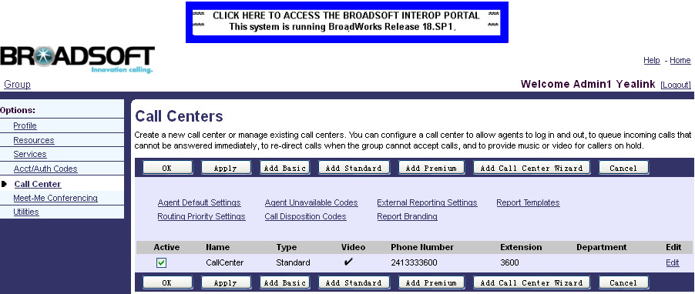
Creating a call center on the BroadWorks
Browse to Call Center →Call Centers →Add Standard
Go back to Call Center →Call Centers , check the Active checkbox
Click Edit
Notes:
For using ACD feature ,you need to create a call center on the BroadWorks server and Assign agents to the specific call center .
.For creating a call center ,you need to Log in as the group admin firstly ,then Click Call Center->Call Centers to enter call centers adding page ,click Add Standard to add a Standard call center.
After creating the call center, go back to Call Center->Call Centers and click the Active checkbox to active this call center, as show in picture.

Slide 30
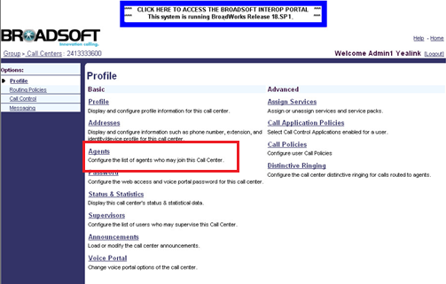
Assigning agents to the call center
Click Agents
Notes:
After creating one new call center ,you need to assign agents to this call center .The incoming call to this call center can be assigned to the agents in this call center.
Click on Call Center→Call Centers , browse the call center created and click Edit. Click on Agents to enter into the agents assign page .

Slide 31
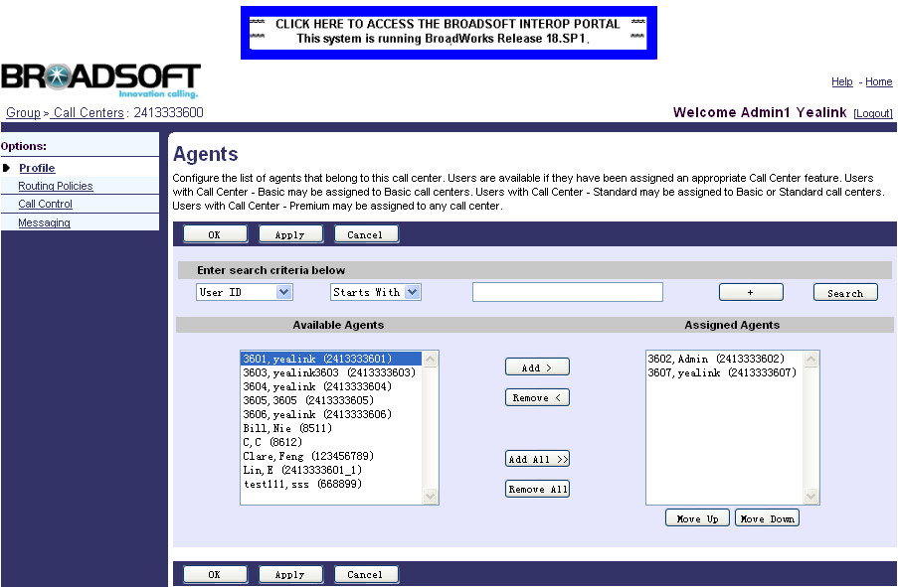
Assigning agents to the call center
Click Search to display all available agents.
Add Assigned Agents from Available Agents
Notes:
To display all available agents. You need to click search .All available agents will display in the below Available Agents box .You can add multi-agents to this call center . Click Apply to save the change.

Slide 32
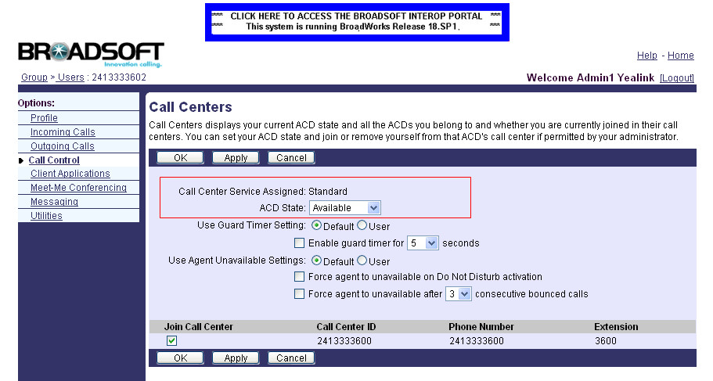
Changing ACD State on the BroadWorks
Browse to Users →Search
Select one of the call center agents
Browse to Call Control →Call Centers
Select the desired in ACD State
Select Join Call Center
Notes:
After assigning the agents ,you can check the specific agent status by entering the user’s call center configuration page.
Entering into Users→Call control →call centers, you can see the corresponding options related to an agent .
Two kinds of important ACD states are Available and Unavailable .
The ACD system can handles incoming calls by automatically queuing and directing calls to available agents.
Now the Broadworks ACD configuration is finished .

Slide 33
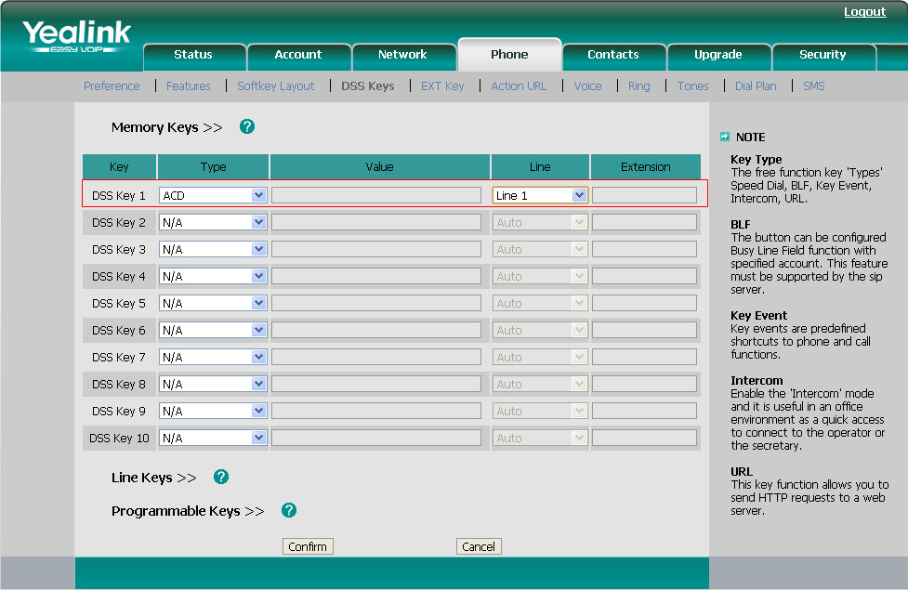
Configuring ACD on Yealink phone
Browse to webpage →Phone →DSS Keys
Select ACD and Line
Notes:
Now go to phone side .To use the ACD feature, you should configure an ACD key on phone in advance. Browser to Phone→DSS Keys
And Select ACD from the pull-down list of Type.
Select the desired line from the pull-down list of Line. Then click on confirm .
Please Make sure the selected line has registered one of the call center agents.
We recommended configure no more than a single ACD key per IP phone.

Slide 34
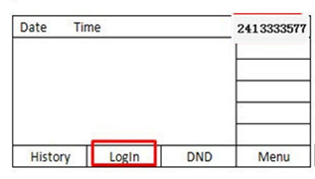
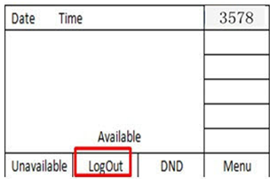
Using ACD on Yealink phone
Press Login Key
After log in , press the Available / Unavailable soft key to change the ACD status

Slide 35
Network Conference
Notes:
First one is BLF LIST —BLF LIST stands for Busy Lamp Field List.
It’s the BLF feature on Broadworks.

Slide 36

Network Conference
Network Conference provides users with flexibility of call with multiple participants (more than three).
Once a network conference is commenced, the media server holds the conference, therefore, even if the initiator drops the call or puts the call on hold, the conference will continue with the remaining participants.
The IP phones implement network conference using the REFER method specified in RFC 4579.
This feature depends on support from a SIP server.
Access to webpage →Account →Advanced
Notes:
You can press this ACD key to login the ACS system .After pressing ACD key ,phone screen will prompts you to enter the USER ID and Password . User ID means the user identity used to log in the ACD system.
Password means the password used to log in the ACD system .
And after login ,you can switch ACD status by pressing the Avail / Unavail soft key .

Slide 37
Feature Key Synchronization
Notes:
Now is turn to Feature key synchronization(ˌsiŋkrənaiˈzeiʃən]) .We will only have a simple introduce for this feature in today’s training .For the specific configuration on BroadWorks for this features ,please refer to the manuals which we will send you after training .

Slide 38
Feature Key Synchronization
Feature Key Synchronization provides the capability to synchronize the following BroadWorks feature status with the IP phone
Do Not Disturb(DND)
Call Forwarding Always (CFA)
Call Forwarding Busy (CFB)
Call Forwarding No Answer (CFNA)
ACD state
Remote control the phone features
Notes:
This feature provides the capability to synchronize the following five BroadWorks feature status with the IP phone.
Do Not Disturb/Call Forwarding Always/Call Forwarding Busy/Call Forwarding No Answer /ACD state .
If a user changes the status of one of these features via the BroadWorks web portal or feature access code ,the BroadWorks server will notify the IP phone of the status change. Conversely, if the user changes the feature status on the IP phone, the IP phone will notify the BroadWorks server of the status change.
This function is convenient for user to remote control phone function in server side .

Slide 39
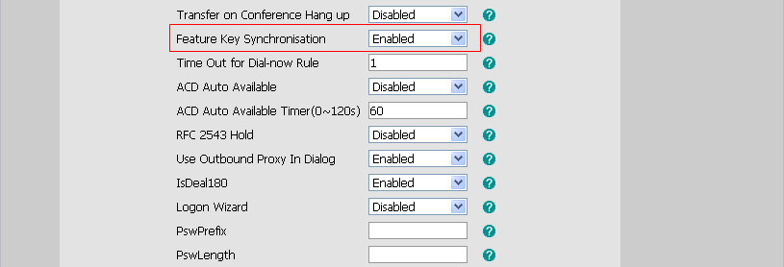
Configuring the Feature Key Synchronization
Browse to Phone →Features
Enabled Feature Key Synchronization
Notes:
For active this feature ,you need to enter into phone setting page and Browser to Phone→Fetures ,and enabled the Feature Key Synchronization .
For example, when you enable the Feature Key Synchronisation, and active the DND feature by pressing the DND soft key on the IP phone, the IP phone will synchronize the DND state to the BroadSoft user registered on the IP phone. And if DND state is change in BroadWorks , server will notify phone to change the state ,too .

Slide 40
BroadSoft Phonebook and Call Log
Notes:
Now is the Phonebook and Call log feature in BrodWorks . I will only make a brief introduction about the configuration of his two feature in phone side for server configuration ,you can refer to the documents which we will sent you after training .

Slide 41
BroadSoft Phonebook
Access the BroadSoft directory through your IP phone
Add contacts from the BroadSoft directory to your local directory
Dial a number from the BroadSoft directory
Access up to 6 BroadSoft directories
Support Enterprise Directory/ Group Directory/ Personal Directory
Notes:
You can access the BroadSoft directory through the IP phone. You can add contacts from the BroadSoft directory to your local directory. You can also dial a contact from the BroadSoft directory. The BoradWorks server provides four types of directory: Enterprise Directory, Group Directory, Personal Directory and Common Directory. The Common Directory is not supported by Yealink IP phones.
Yealink phong can support maximum 6 Broadsoft directories .
About the introduction for every kind of directory ,you can refer to the documents which we will sent you after training ,the manual also contains the phonebook configuration on BroadWorks .

Slide 42
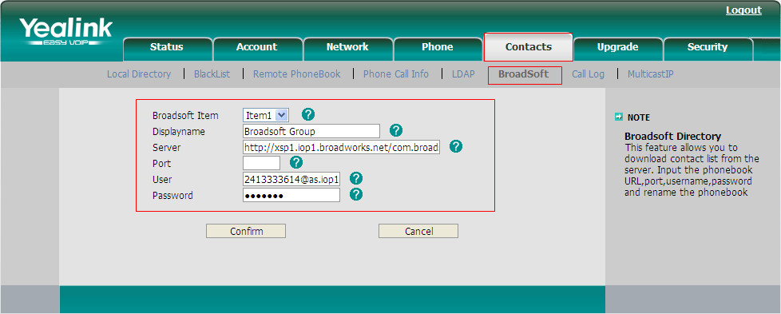
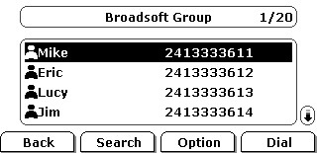
Configuring Broadsoft Phonebook
Browse to webpage →Contacts →BroadSoft
LCD: Press Directory →Broadsoft
Notes:
For configurating the Broadsoft phonebook ,you need to browser to Contacts->BroadSoft.
And Select the desired BroadSoft item from the pull-down list of BroadSoft Item.
Enter the parameters: display name, server address, port, username and password in the corresponding fields .

Slide 43
BroadSoft Call Log
Access the BroadSoft call log through your IP phone
The call log contains call information such as
Remote party/identification/time/date
Dial/Add/Delete a contact from the call log list
Missed/Received/Placed/All calls
Support up to 3 call log items.
Notes:
For Call log , You can access the call log of the desired BroadSoft user through your IP phone. The call log contains call information such as remote party identification, time and date.
In phone side ,You can check the call log, dial a call, add a contact or delete an entry from the call log list. The BroadSoft call log allows users to view and dial the stored numbers in the following lists: Missed, Received, and Placed.
You can configure your IP phone to access up to 3 call log items.

Slide 44
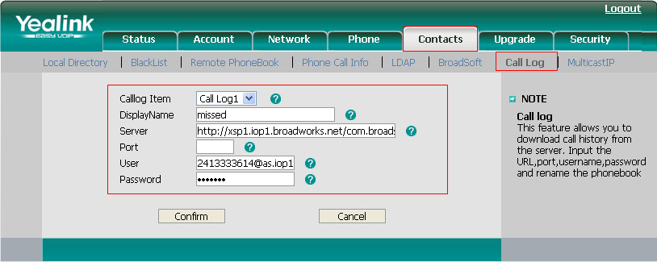
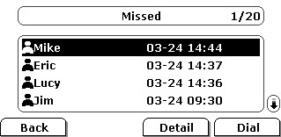
Configuring Broadsoft Call Log
Browse to webpage →Contacts →Call Log
LCD: Press Menu →History Type →Network CallLog
Notes:
For configurating the Broadsoft phonebook ,you need to browser to Contacts->BroadSoft.
And Select the desired BroadSoft item from the pull-down list of BroadSoft Item.
Enter the parameters: display name, server address, port, username and password in the corresponding fields .

Slide 45
Call Log URL
The corresponding URL used to access BroadSoft call log list
Call Log List | URL
Missed Lists | http://xsp1.iop1.broadworks.net/com.broadsoft.xsi-actions/v1.0/user/username@as.iop1.broadworks.net/directories/calllogs/missed
Received Lists | http://xsp1.iop1.broadworks.net/com.broadsoft.xsi-actions/v1.0/user/username@as.iop1.broadworks.net/directories/calllogs/received
Placed Lists | http://xsp1.iop1.broadworks.net/com.broadsoft.xsi-actions/v1.0/user/username@as.iop1.broadworks.net/directories/calllogs/placed
All Lists | http://xsp1.iop1.broadworks.net/com.broadsoft.xsi-actions/v1.0/user/username@as.iop1.broadworks.net/directories/calllogs/
Notes:
You can use the corresponding URL used to access the desired BroadSoft call log list of the specific user in the following table . Username means the account username you are using.

Slide 46
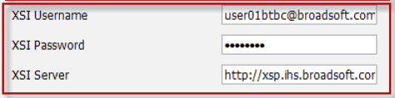
New Firmware in Q1 of 2013
Just need to fill XSI Username, Password, Server address
Notes:
You can use the corresponding URL used to access the desired BroadSoft call log list of the specific user in the following table . Username means the account username you are using.

Slide 47
Provisioning in BroadWorks
(DMS)
Notes:
The Next Topic we will talk about Auto Provisioning Process in Broadworks .

Slide 48
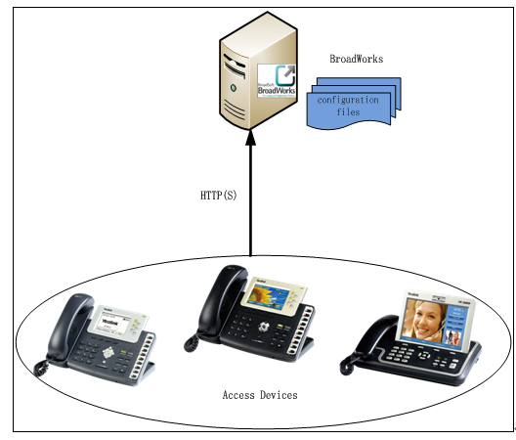
What is BroadWorks Device Management
The BroadWorks Device Management is a comprehensive solution for simplifying the integration, deployment, and maintenance of access devices in your network .
The administrator can manage and control all aspects of device configuration centrally in the network.
Notes:
The BroadWorks Device Management is a comprehensive solution for simplifying the integration, deployment, and maintenance of access devices in your network .Administrator on Broadworks can manage and control all Device configuration centrally
in the network. Just like you could manage or control all Yealink T2 seris/T3/VP series phone on Broadworks .By connecting devices to BroadWorks,it can download the configuration files, firmware, and other file resources required to deliver services.

Slide 49
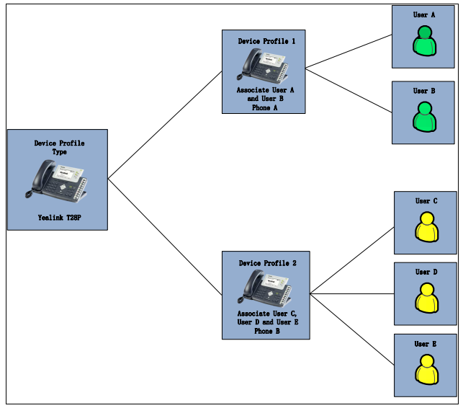
Key concepts
BroadWorks uses the following three key concepts for delivering services
and managing devices:
The Device Profile Type
The Device Profile
The User
Notes:
Before using Device Management, it is very important to check some key words:
The Device Profile Type/The Device Profile/The user
Device Profile Type is like a template for a model, like model Yealink T28.
When a new type of device is added to the network, a new device profile type should be created on BroadWorks to manage that type of device.
Device Profile is like a specific device , like Yealink T28P with specific MAC address .
When a new device is added to the network, a new device profile should be created on BroadWorks to manage that device. The device profile should be created from a given device profile type. This gives the device profile a predefined settings that are consistent with other devices of the same type in the network.
And Device Profile is like a specific T28P phone, like T28P with MAC
The User is like an account which we had in other PBX platform. The administrator can assign a device profile to one user or multiple users.
In the picture ,T28P is a device profile type ,this two phones are specific device profiles with multi-users .

Slide 50
Group Administrator
Web portals : Group Administrator
Limited feature configuration authority which is already predefined by System
Administrator .
Add
Modify
Delete
Notes:
In order to simplify the feature configuration steps on BroadWorks . We will introduce all configuration steps on BroadWorks which login as Group Administrator as follows.
Group Administrator portal is one of the portals which is used to login BroadWorks platform .It has limited feature configuration authority which already be predefined by System Administrator .
Here you can add, modify individual information within a calling group.

Slide 51
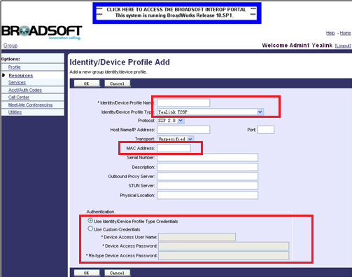
Adding BroadWorks Device Profile
Browse to Resources →Identity/Device Profiles
Fill in a Profile name
Select Profile Type
Assign Profile to a Device MAC
Select Use Custom Credentials
,Provide http login user name & password
Notes:
If you want to add a specific T28 phone on Broadworks
You have to create one Device Profile first.
Login the web portal as the group administration . Browser to Resources->Identity/Device Profiles. Click on Add. You can see this webpage . Select the desired device profile type (e.g. Yealink T28P) from the pull-down list of Identity/Device Profile Type .And Assign Profile to a Device MAC. You can use the default identity device profile type credentials .If you want to set the Authentication of Autop by yourselves , Select Use Custom Credentials ,Provide http login user name & password

Slide 52
Device Template Configuration Files
Two types of the template configuration files：
y0000000000xx.cfg
System template configuration files
Mac.cfg
Device-specific template configuration files
You can add upload device template configuration files at the profile level and at the group level (Take an example)
Notes:
As we know, phone need two different template configuration files for Autop .It is the same with BroadWorks .There are two types of files which is MAC.cfg.
You can upload device template configuration files at the profile level and at the group level . If you upload at profile level , the template configuration files can only be effectual for the specific device profile (e.g. yealinkT28).If you upload at group level , the template configuration files will be effectual for the device profile type (e.g. Yealink T28P). It means all the device profile associated with this device profile type can download the configuration files.

Slide 53
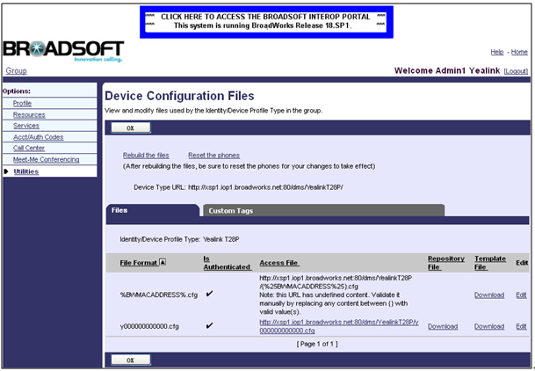
Uploading Template Files
Browse to Utilities→Device Configuration
Select the desired device profile type to edit (e.g. Yealink T28P)
Notes:
After login as group administration .you can Click on Utilities->Device Configuration. All existing device profile types will appear on he page.
Select the desired device profile type to edit (e.g. Yealink T28P). Click on Files tab. The page lists all existing template configuration files like the picture shows. Select the desired template configuration file to edit (e.g. y000000000000.cfg).

Slide 54
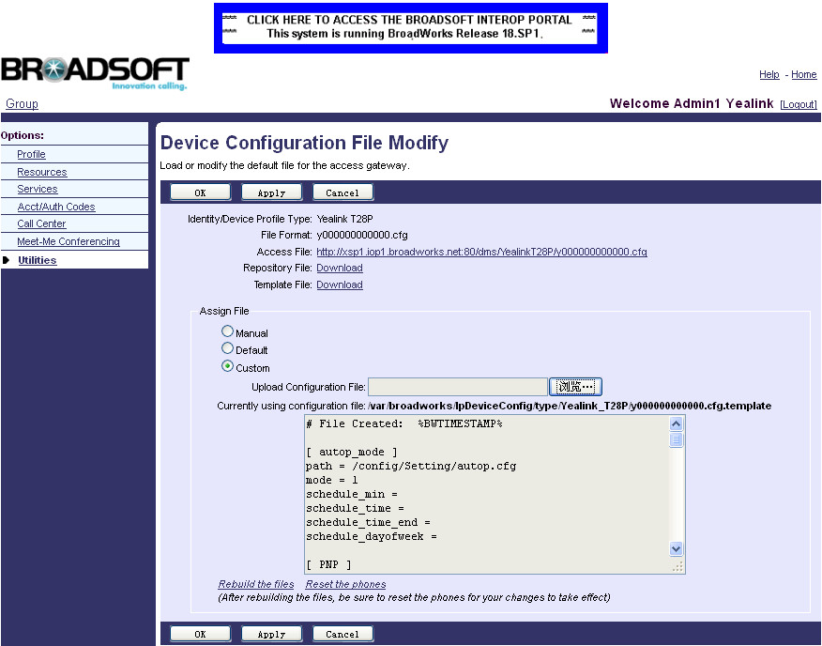
Uploading Template Files
Select the Custom in the Assign File block
the template configuration files will be effectual for the device profile type (e.g. Yealink T28P). It means all the device profile associated with this device profile type can download the configuration files.
Notes:
You will enter the Device File Modify page .Here you could choose to change the configuration file Manually.
Or Use the default one .Also can upload your own one by choosing “Custom” options .
After the above settings, the template configuration files will be effectual for the device profile type (e.g. Yealink T28P). It means that all the device profile associated with this device profile type can download the configuration files.

Slide 55
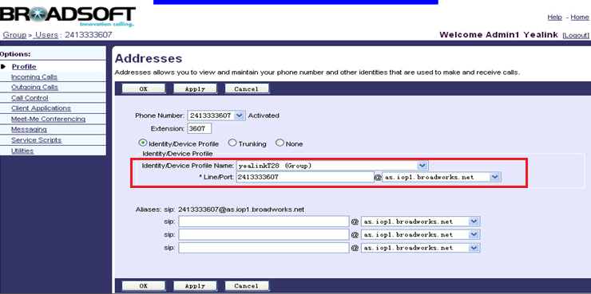
Assigning the Device Profile to the User
Browse to Profile →Users →Search
Select one of the users to be assigned to device profile.
Click Addresses
Select the Identity/Device profile
Notes:
Browser to Profile->Users->Search to display all existing users .Select one of the users to be assigned to device profile.
Click on Addresses. You can see the page as picture shows .you can Select the Identity/Device profile. In the Identity/Device profile block, select the desired device profile(e.g. yealinkT28) from the pull-down, enter the register’s user name in the Line/Port field, and select the domain name (e.g. as.iop1.broadworks.net) from the pull-down list of @.

Slide 56
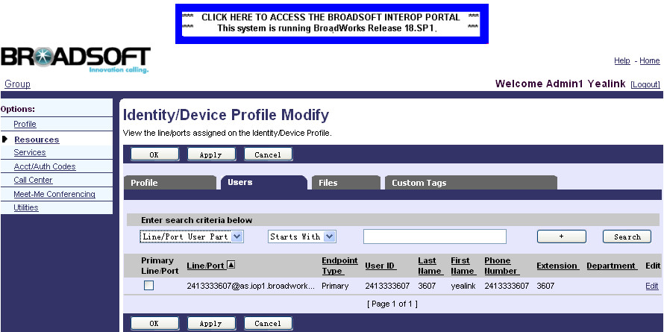
Checking Device Profile User
Browser to Resources->Identity/Device Profiles
Select the desired device profile (e.g. yealinkT28) to edit
Click Users ,you can check the assigned user like below
Notes:
You can check the users assigned to the device profile by entering into this path . e.g. yealinkT28 ,you can see the user we just assigned .

Slide 57
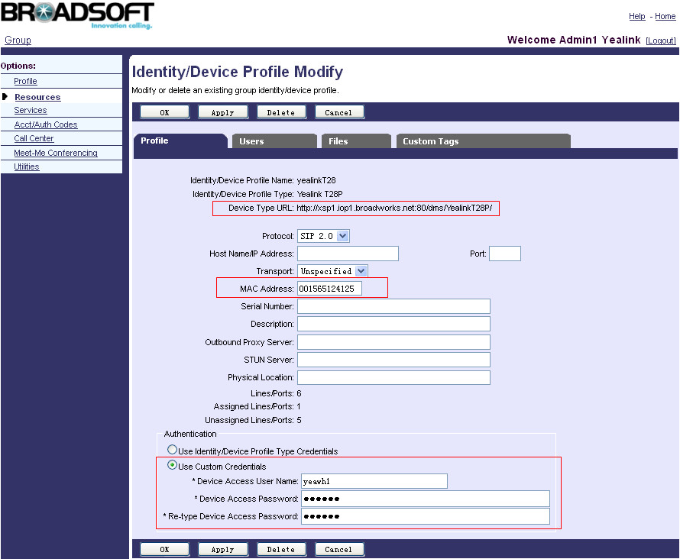
Downloading and Verifying Configurations
Browse to Resources->Identity/Device Profiles
Select the desired device profile (e.g. yealinkT28) to edit
Click Profile tab to check URL and MAC Address
Fill username and password in the corresponding fields
Notes:
After all the settings you have made on Broadworks. It need to apply it on your Device ,but you should know the Autop URL firstly .you could Broswer to this path , Select the desired Device (Yealink T28)
And then you will log into indentity/Device Profile Modify page again .Here you will find the configuration file downloading URL
Before Copying this URL to your own T28,.Make sure that the MAC address/user name/Password is all correct .

Slide 58
Downloading and Verifying Configurations
Browse to Upgrade →Advanced
Notes:
Write the URL which you copy from Broadworks just now to your T28 phone now, Under Upgrade→Advance page .
Remember to Copy the user name/Password and Set Check New Config to be “Power On” As figure shows.
Then you could press “Auto Provisioning” or reboot the phone to make your T28 download the Configuration file from Broadworks.
(Also you could use ZERO-SP-TOUCH to do the Provisioning Process, for details ,you can refer to autop manual)

Slide 59
Documents
User Guide for Phone Features Integrated with Broadworks-V1.3.pdf
Using Integrated Features on BroadWorks-V1.3.pdf
Yealink IP Phones Deployment Guide for BroadWorks Environments-V1.3.pdf
Download Link:
ftp://yealinkftp:yealinkftp@ftp.yealink.com/Training/BW/V70/

Slide 60
BroadTouch
Notes:
The Next Topic we will talk about Auto Provisioning Process in Broadworks .

Slide 61
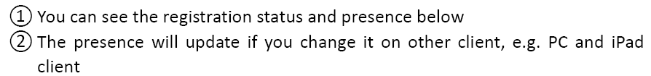
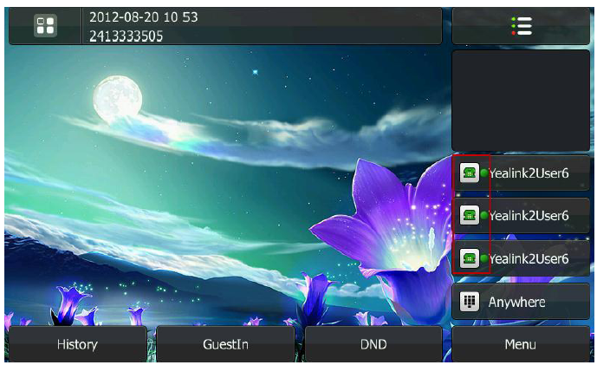
UC-If you are interested in this, please contact us

Slide 62
Thanks
Q&A
Notes:
Do you have any questions ,you can type on the screen or speak by mic directly .

